Slide 1
5.4 生活中的有機聚合物
Notes:
In this class we will learn some common organic polymers in our everyday life.

Slide 2
本節內容
1. 有機聚合物的種類：天然與合成
(Organic polymers)
2. 食品中的有機聚合物：醣類與蛋白質
3. 衣料纖維：天然與人造
Notes:
In this class we will learn some common organic polymers in our everyday life.

Slide 3
聚合物(Polymer)是甚麼
1.由許多小單元重複鏈結而成的巨大分子，稱為聚合物(polymer)；這些小單元稱為單體(monomer)
2. Polymer由數千到數十萬個原子(atoms)組成，分子量(molecule weight)可達上萬甚至上千萬。(一般的化合物分子量約<1000)
Notes:
Ask the students to read after me. 2. Organic polymers are usually composed by small units, which we call monomers. Monomers are combined together in specific ways. The same way is repeated over and over so that it becomes a huge molecule, that is polymer.

Slide 4
Organic Polymer
天然聚合物
Organic Polymer
Natural Polymer
(sort by source)
合成聚合物
Synthetic Polymer
Notes:
There are millions of polymers in the world. In order to help us understand, we need to classfy them. The most ez way is to sort them by source. If it comes from nature, it’s a natural polymer. If it’s manmade, it’s a synthetic polymer. For example, starch, which exists in grains and rhizome, is a natural polymer. The same as cellulose and protein.

Slide 5
Natural Polymer
Starch 澱粉
Natural Polymer
Cellulose 纖維素
Protein 蛋白質
Rubber 橡膠
Notes:
There are millions of polymers in the world. In order to help us understand, we need to classfy them. The most ez way is to sort them by source. If it comes from nature, it’s a natural polymer. If it’s manmade, it’s a synthetic polymer. For example, starch, which exists in grains and rhizome, is a natural polymer. The same as cellulose and protein.

Slide 6
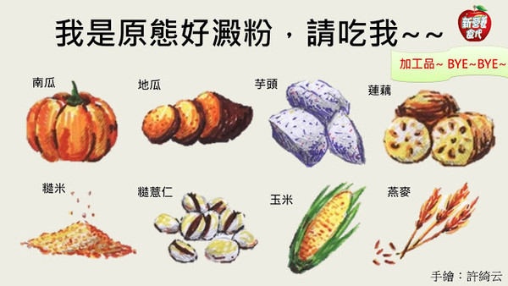
Natural Polymer：Starch
carbohydrates 醣類，碳水化合物
monomer：glucose葡萄糖
energy storage 儲存能量
rice，noodles，bread…
carbohydrates 醣類，碳水化合物，their H：O=2：1， the same with water(H₂O)➔general expressed as C_{m}(H₂O)_{n}

Slide 7
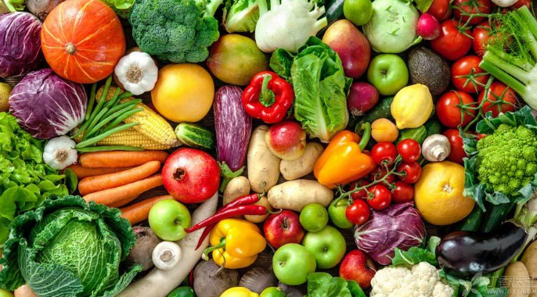
Natural Polymer：Cellulose
Carbohydrate醣類
monomer：glucose葡萄糖
main component in plant cell walls 植物細胞壁主要成分
cannot be digested by human beings 人類無法消化
Glucose is a mono-saccharide，which means it's carbon atoms are less than 7. ➔C₆H₁₂O₆

Slide 8
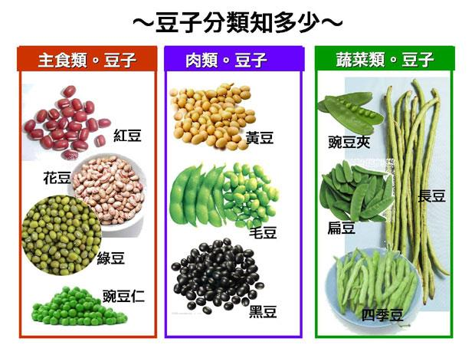
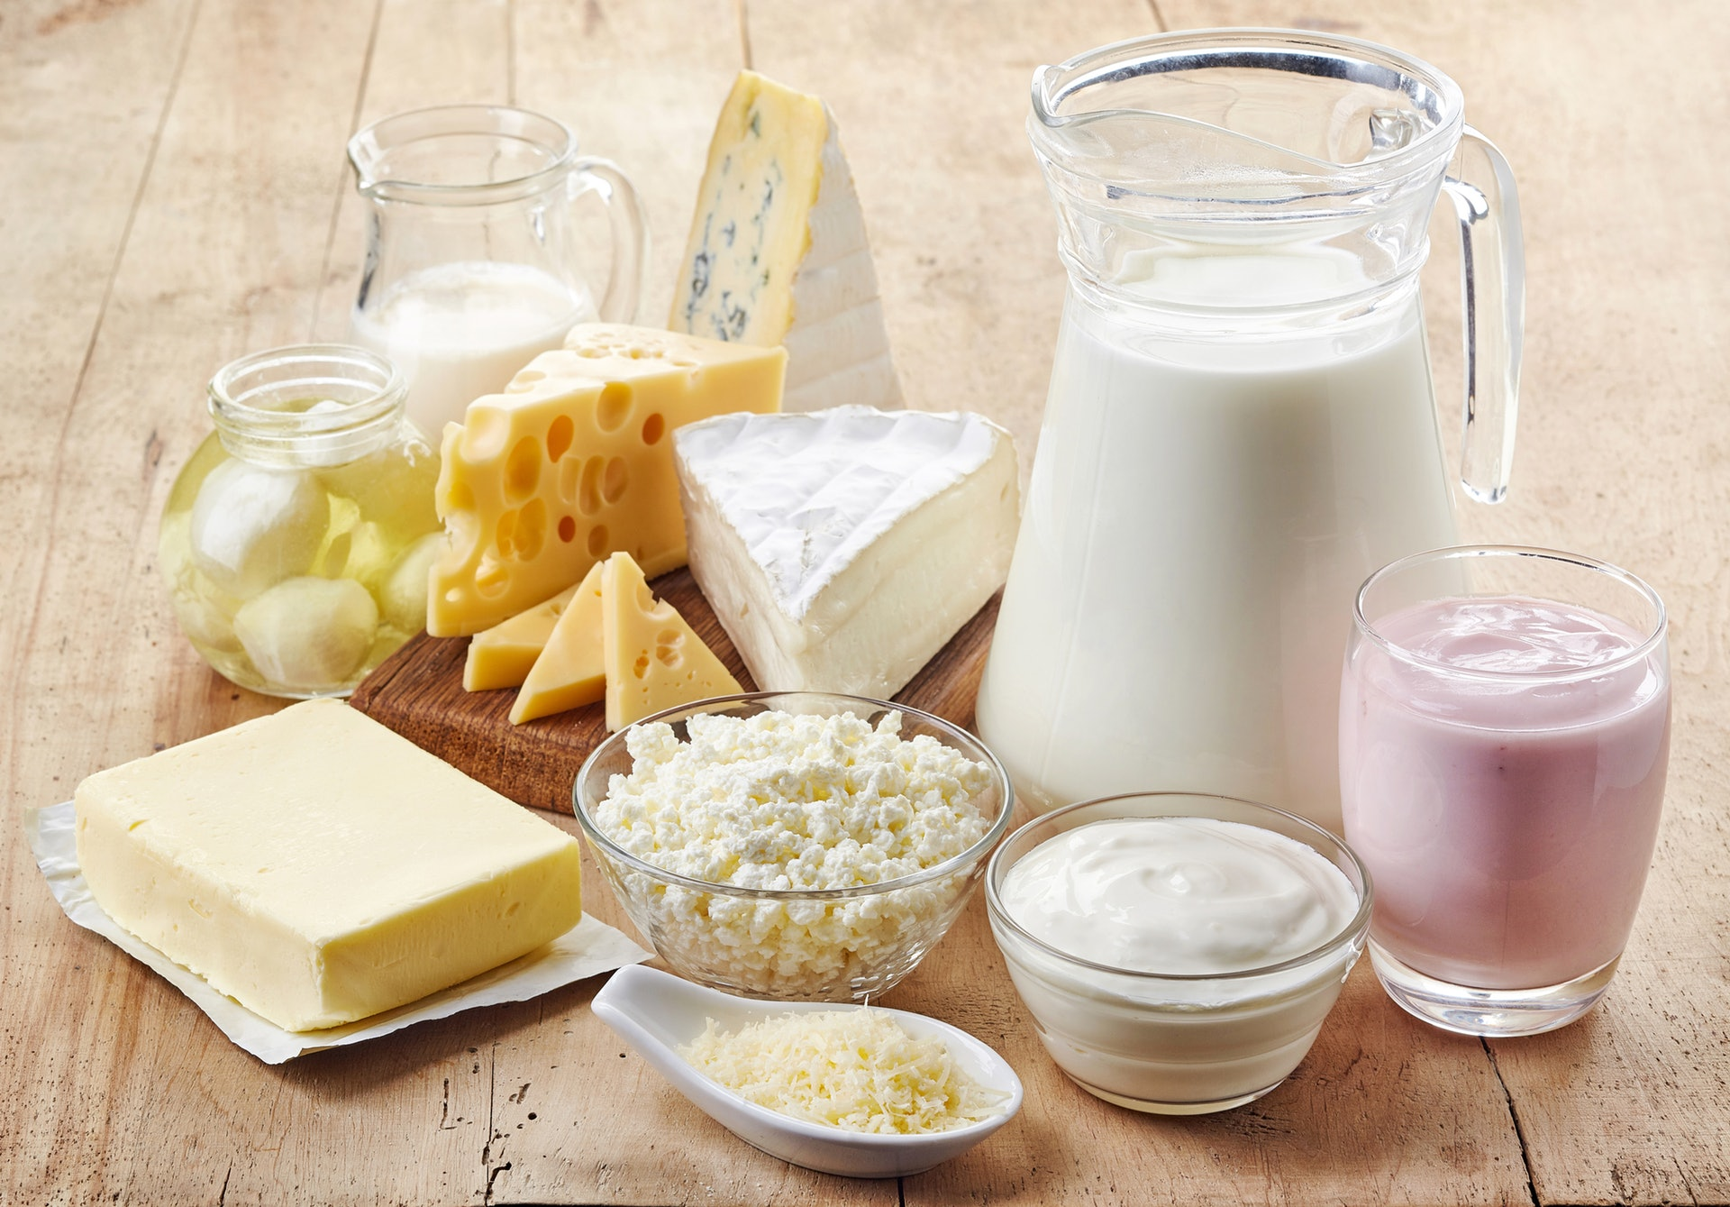
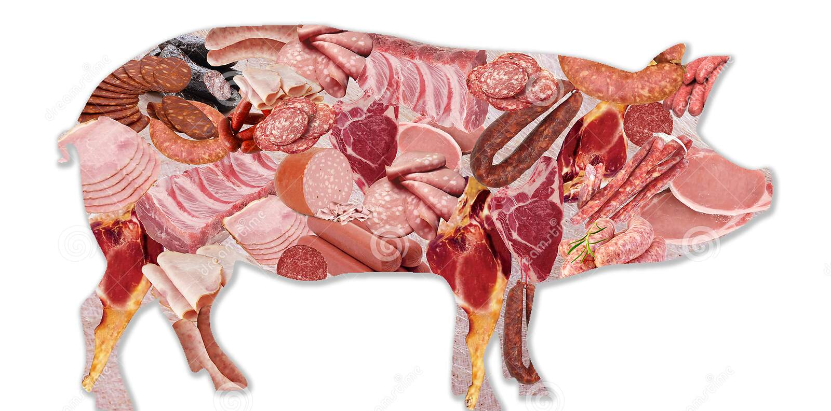
Natural Polymer：Protein
Plant based protein：exists in beans, brown rice, peas, soys, etc.
Animal based protien：exists in meat, fish, milk, cheese, etc.
Monomer：amino acid 胺基酸
Most animal based protein are complete proteins, meaning they contain all 9 of the essential amino acids.

Slide 9
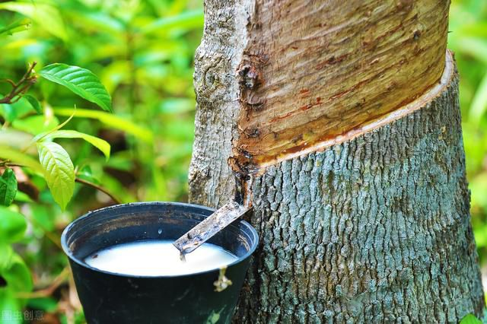
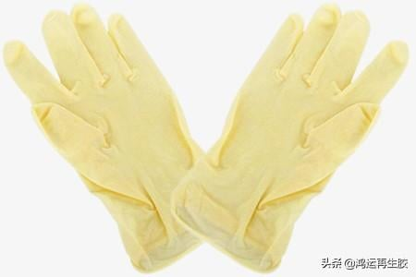
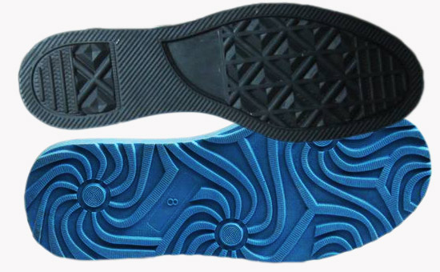
Natural Polymer：Rubber
monomer：*isoprene 異戊二烯

Slide 10
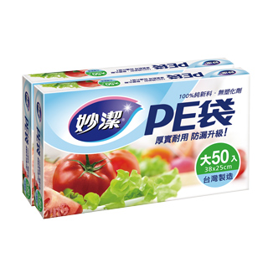
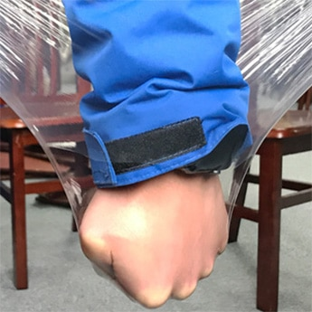
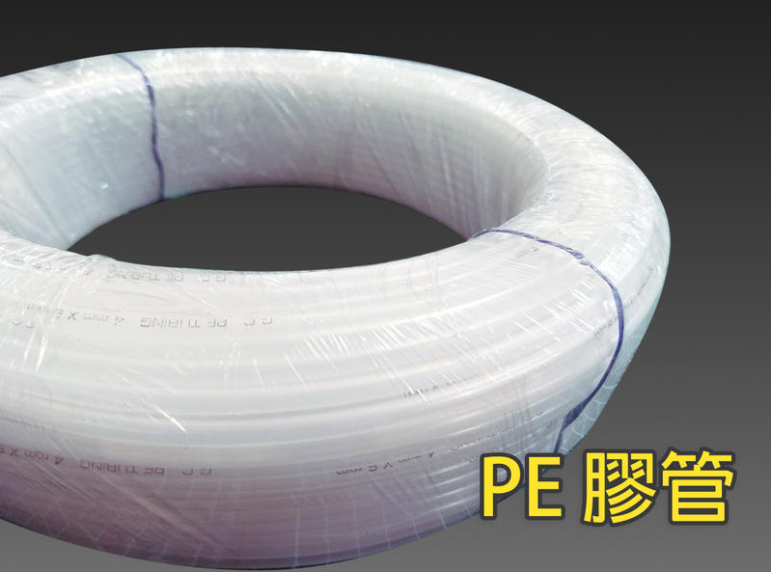
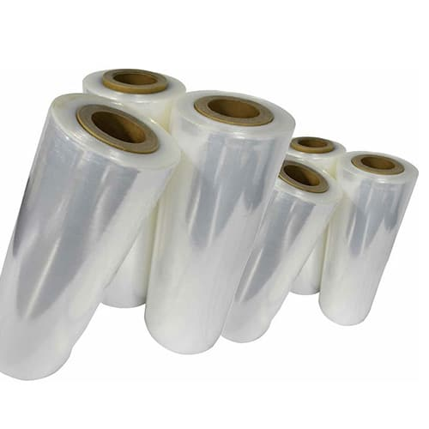
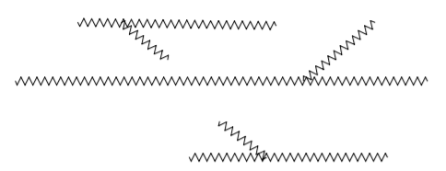
Synthetic—chain polymer
單體連接成鍊狀，分子可做較自由運動，通常受熱後就軟化或熔化，冷卻後就變硬成形，又稱為熱塑性聚合物(thermoplastic polymer)
PE—Polyethylene聚乙烯

Slide 11
Synthetic—chain polymer
Thermoplastic polymer
Polyethylene
PE
聚乙烯
Polypropylene
Polyvinyl Chloride
PP
聚丙烯
PVC
聚氯乙烯
PS
聚苯乙烯
Polystyrene

Slide 12
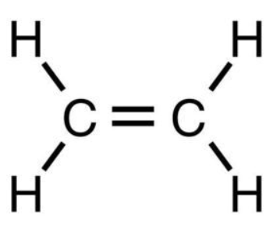
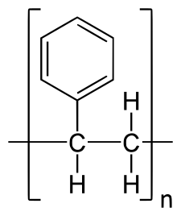
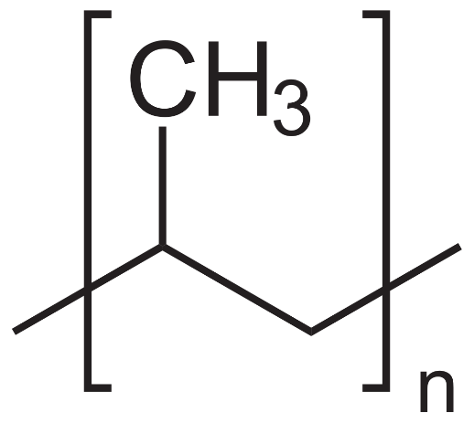
合成聚合物--鍊狀聚合物單體(補充)
聚乙烯(PE)：由乙烯C₂H₄(ethylene)聚合polymerite而成
聚氯乙烯(PVC)：由氯乙烯CH₂CHCl(polyvinyl chloride)聚合
聚苯乙烯(PS)：由苯乙烯(styrene)聚合而成
聚丙烯(PP)：由丙烯(propylene)聚合而成
H
H
Cl
Benzene ring苯環
C C
H
H
n

Slide 13
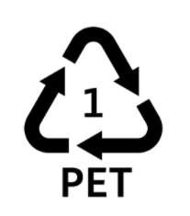
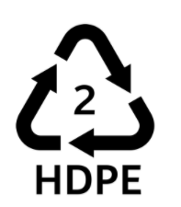
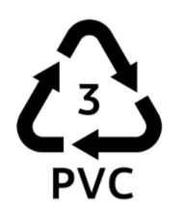
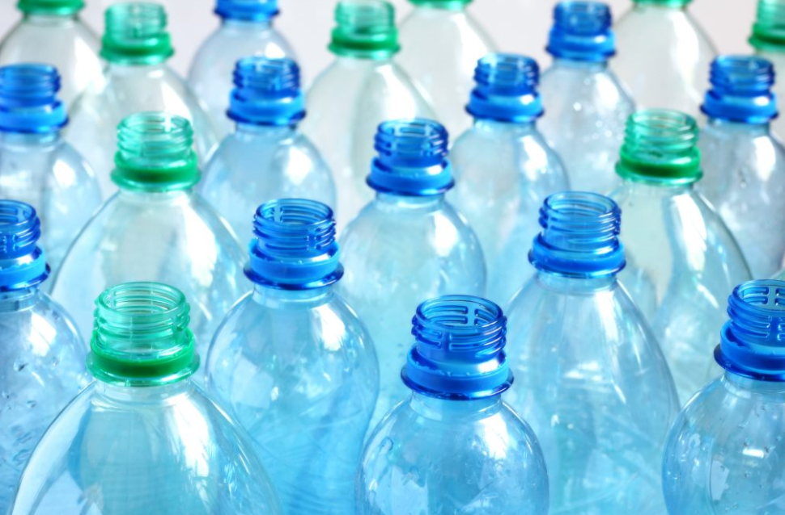
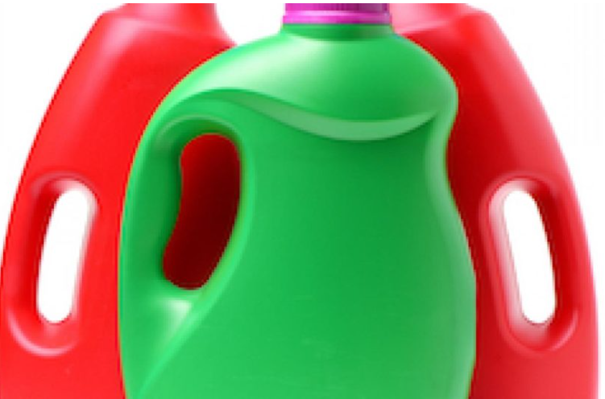
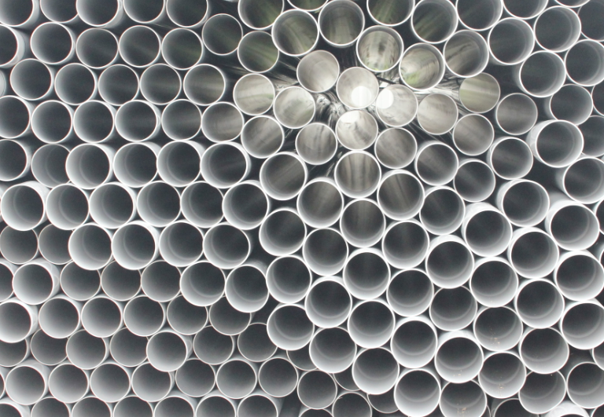
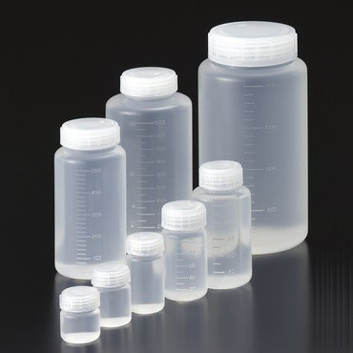
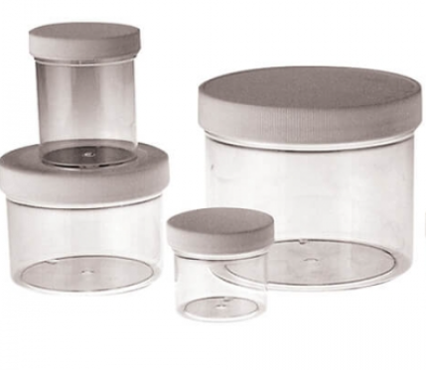
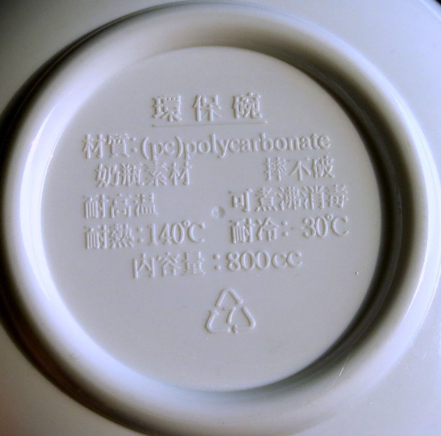
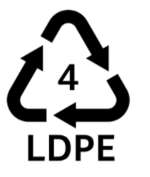
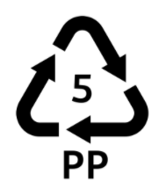
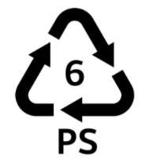
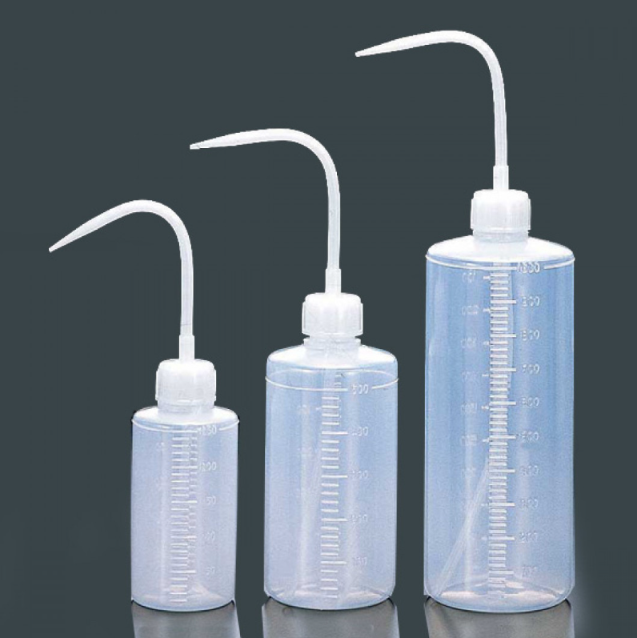
Recycling Signs For Plastics
Find all 7 plastics in your home！

Slide 14
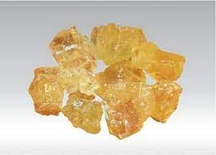
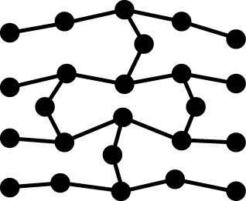
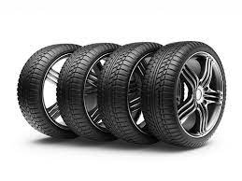
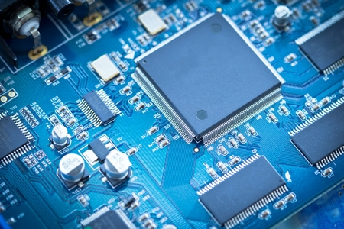
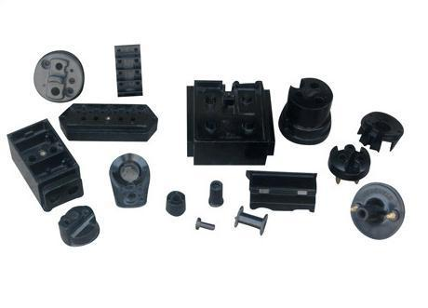
Synthetic—network polymer
單體連接成網狀立體結構，成形後，即使受熱也不會改變形狀，又稱為熱固性聚合物 thermosetting polymers
酚醛樹脂phenolic resin
電木bakelite
輪胎 tire synthetic rubber
電路板circuit board
Notes:
電路板 circuit board 電木bakelite 酚醛樹脂phenolic resin 環氧樹脂 epoxy resin

Slide 15
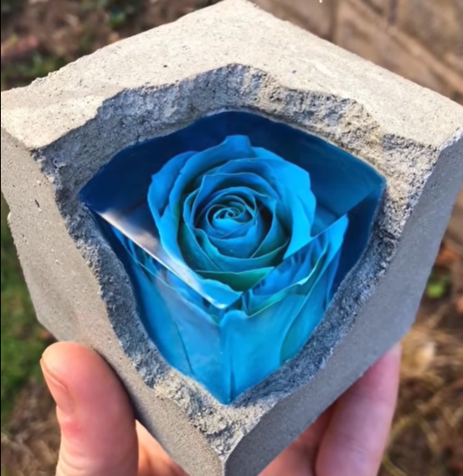
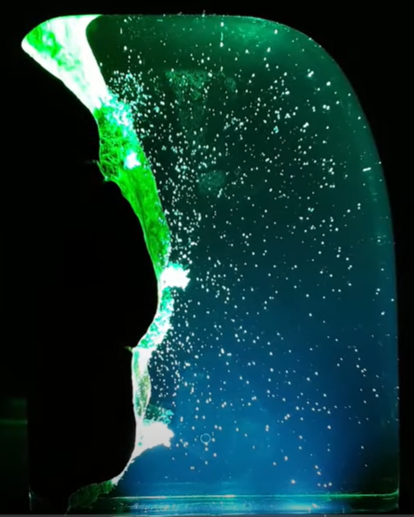
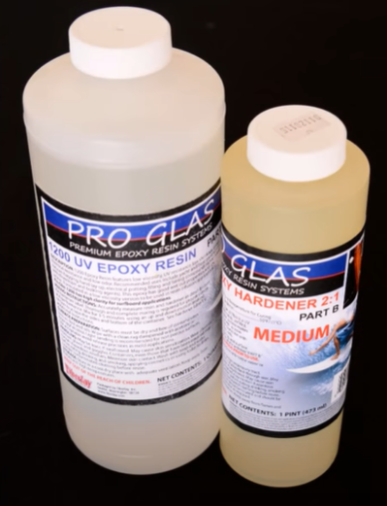
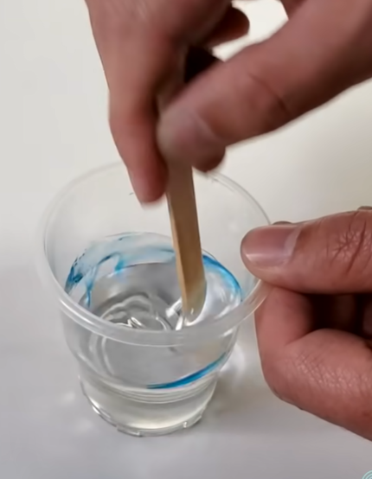
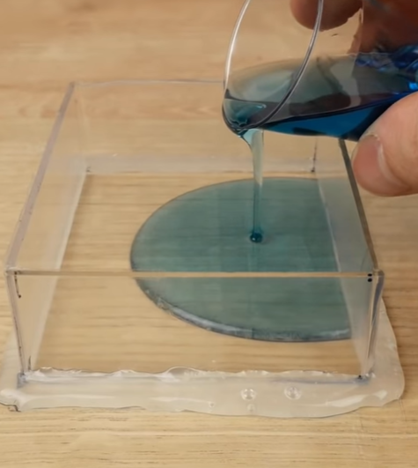
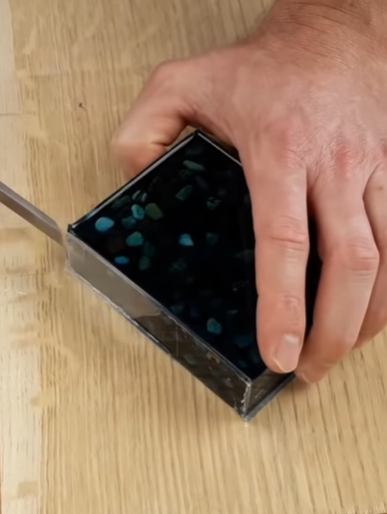
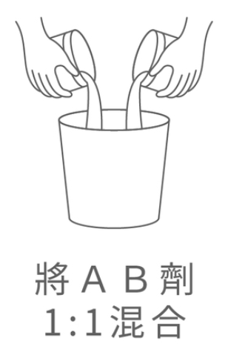
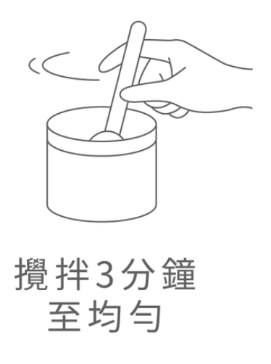
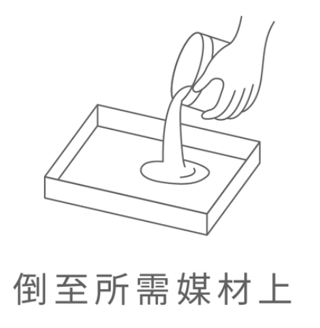
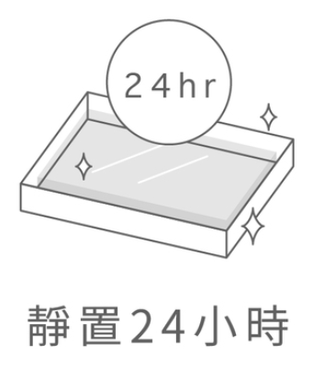
Epoxy resin handcrafts
環氧樹脂手工藝品製作

Slide 16
衣料纖維的分類
植物纖維
vegetable fiber
天然
纖維
衣料纖維
動物纖維
animal fiber
再生纖維
regenerated fiber
人造
纖維
合成纖維
artificial fiber
synthetic fiber

Slide 17
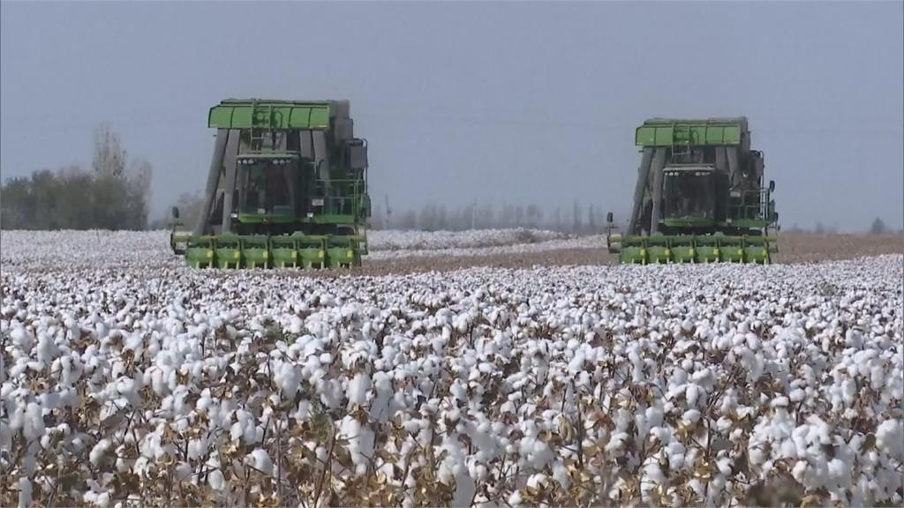
天然纖維—棉cotton

Slide 18
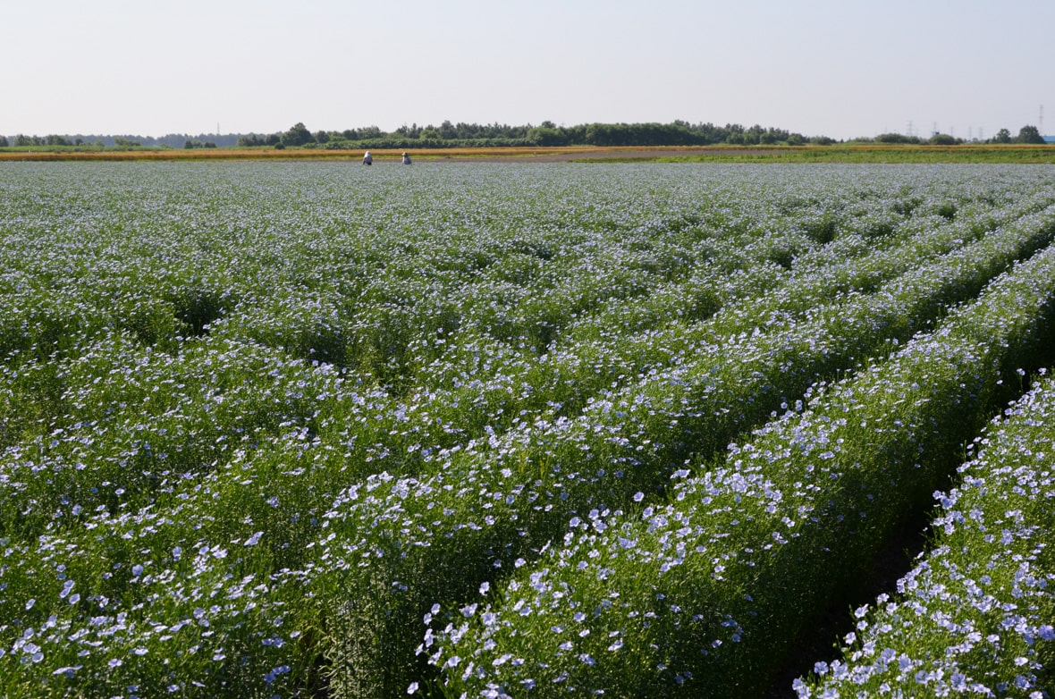
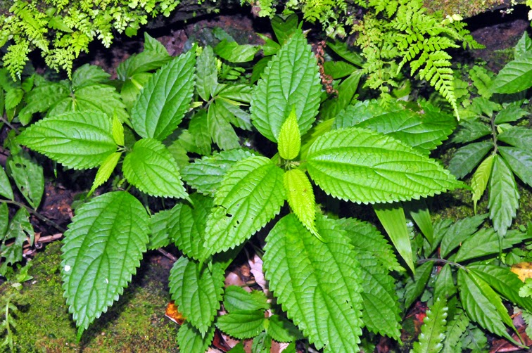
Natural fiber—flax
Xinjiang cotton
亞麻Flax → 亞麻布linen
Better Cotton Initiative BCI

Slide 19
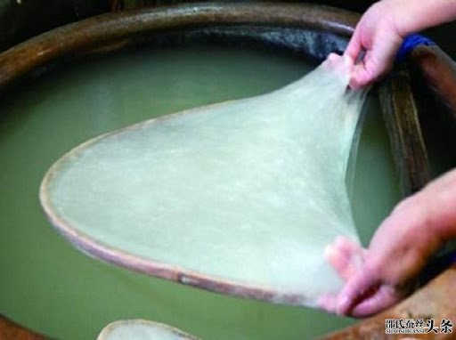
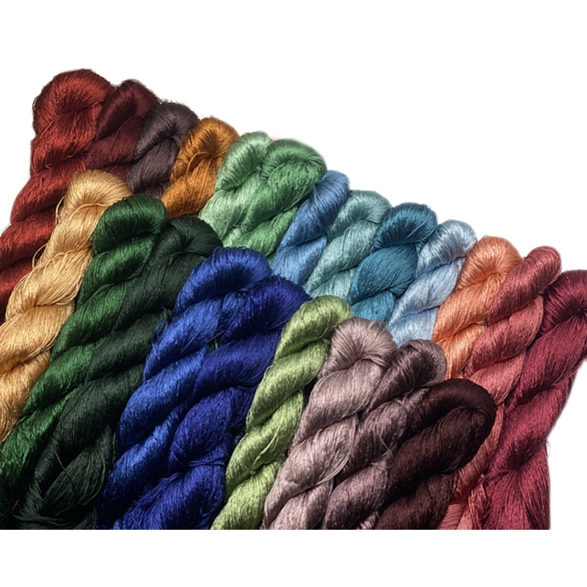
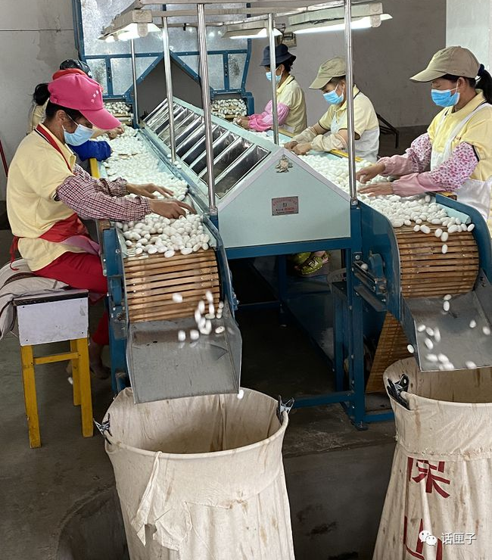
天然纖維—蠶絲silk
Xinjiang cotton

Slide 20
天然纖維—羊毛
Xinjiang cotton

Slide 21
Regenerated fiber
再生纖維素纖維：以纖維素為原料高純淨化
製漿，重新抽成絲狀，故
化學組成不變
嫘縈Rayon/人造絲
優點：吸水性佳，容易漂白染色
缺點：不耐拉扯

Slide 22
Synthetic fiber
合成纖維：主要由石油提煉出單體，再聚合而成
聚酯纖維(Polyester)：由酯類聚合而成，表面光滑，快乾，不易皺，不易縮水。
2. 尼龍纖維(聚醯胺Nylon)：強韌、平滑且重量輕、耐磨
耐撕且具有伸縮性，為熱塑性聚合物，且不耐酸。
3. 壓克力纖維(聚丙烯腈Acrylic)：具有良好的保暖效果，
常用作羊毛代替品。

