Slide 1
Shapes

Slide 2
A triangle has three sides.
Triangle
三角形

Slide 3
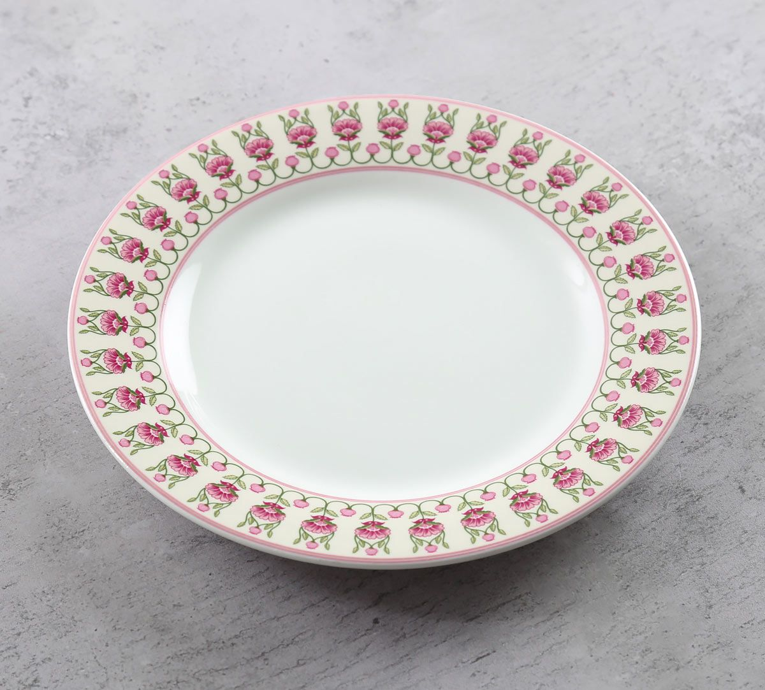
A circle is round.
Circle
圓形

Slide 4
What shape is it?
Circle

Slide 5
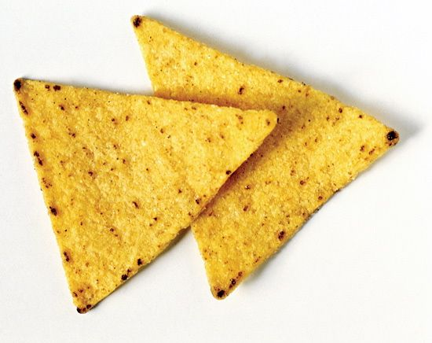
What shape is it?
What shape is it?
Triangle

Slide 6
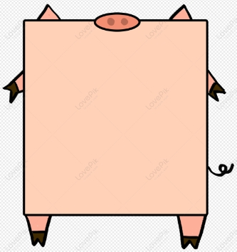
A square has four corners.
square
正方形

Slide 7
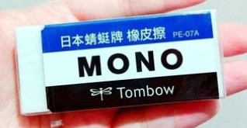
A rectangle has two long sides and two short sides.
rectangle
長方形

Slide 8
What shape is it?
square

Slide 9
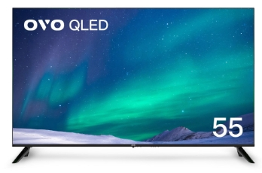
What shape is it?
rectangle

Slide 10
Triangle
Circle
square
rectangle

Slide 11
找出一樣的圖形。

Slide 13
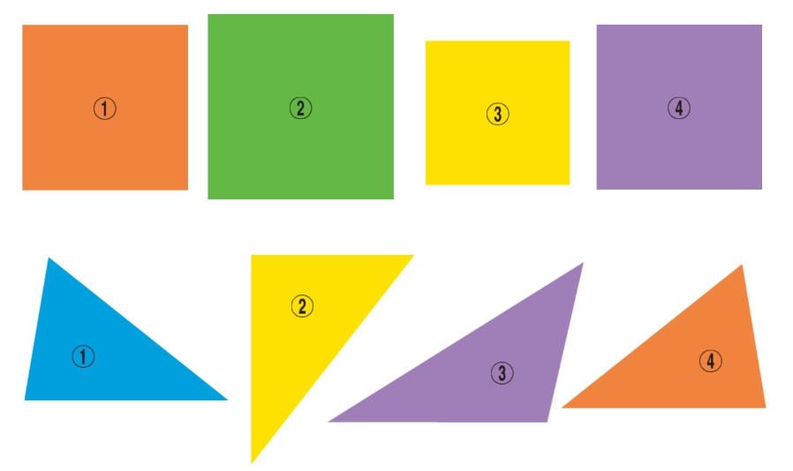
找出一樣的圖形。

Slide 15
附件怎樣變整齊?

Slide 16
大風吹
颱風吹

Slide 17
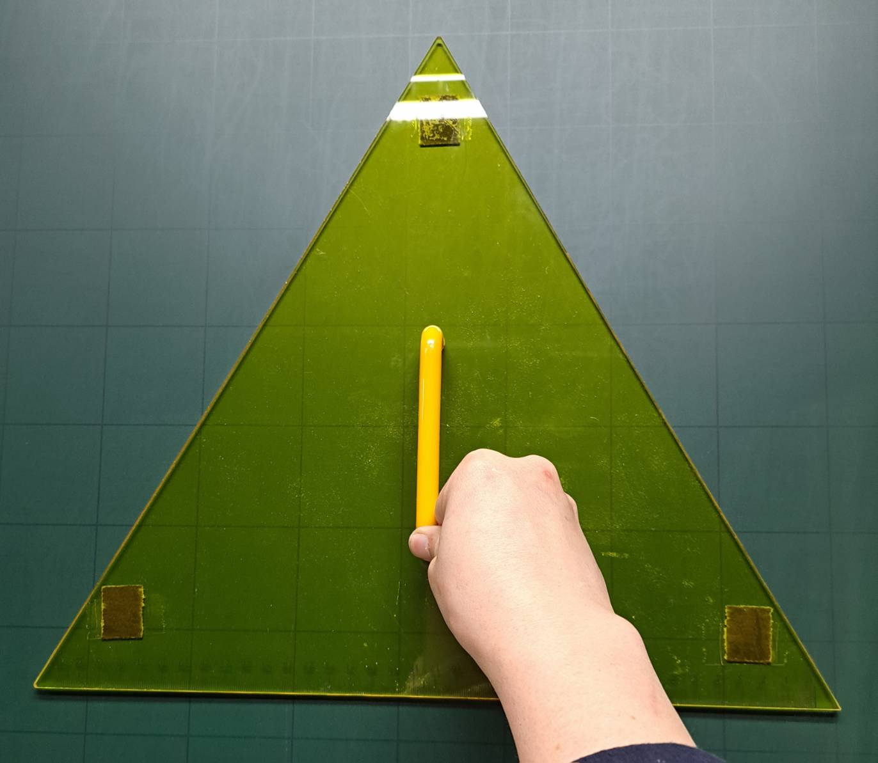
做出形狀、大小
一樣的圖形。

Slide 20
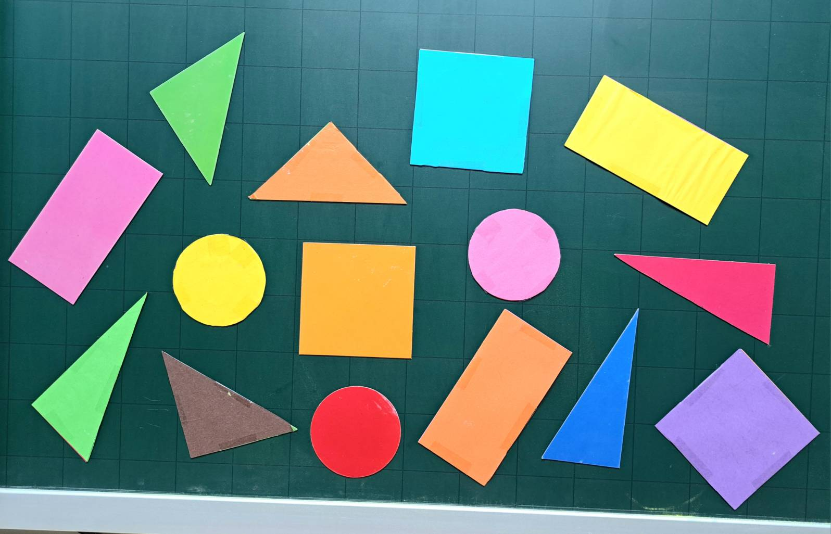
分組合作 ~ 分圖形
☺討論 :
1.可分成
幾堆?
2.如何分
工，才
能迅速
拿下圖
卡，並
整理好?

Slide 21
