Slide 1
Attitude
態 度
Determines Everything
決定一切

Slide 2
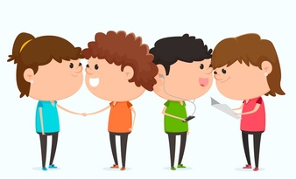
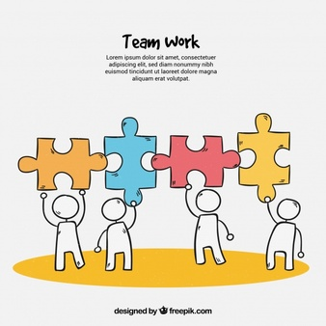
4-Be Rules
#1 Be respectful
#2 Be kind
#3 Be responsible
#4 Best teamwork

Slide 3
David Goes to School
好書推推推
No, David!
2’05’’: https://www.youtube.com/watch?v=9Wsod3lPlYY
Grow Up, David!
3’37’’:
https://www.youtube.com/watch?v=LuOJFV4PzLI
David Gets In Trouble
2’04’’:
https://www.youtube.com/watch?v=9CZ99TuAcAc&feature=youtu.be

Slide 4
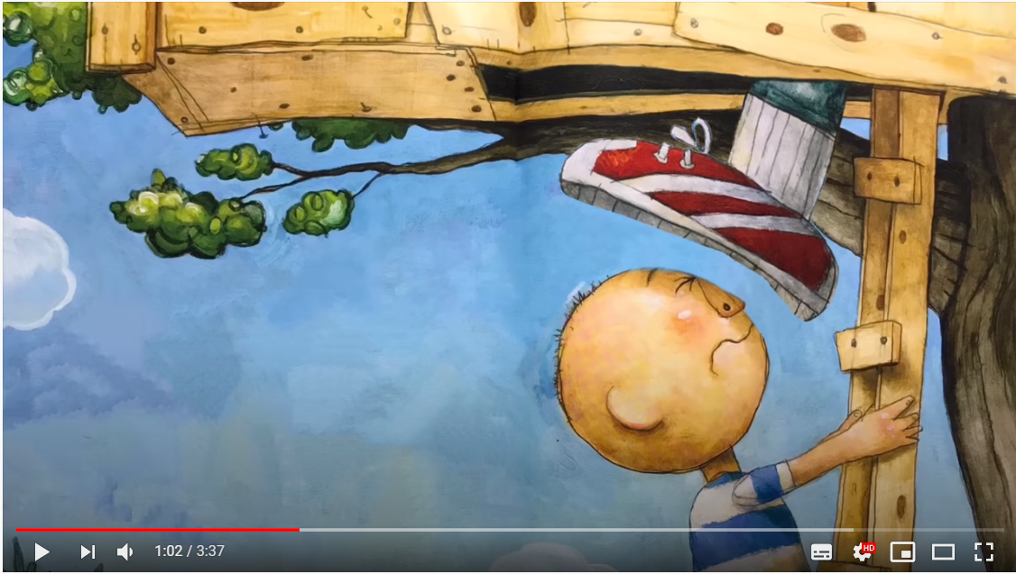
別再跟著我。
Stop following me.

Slide 5
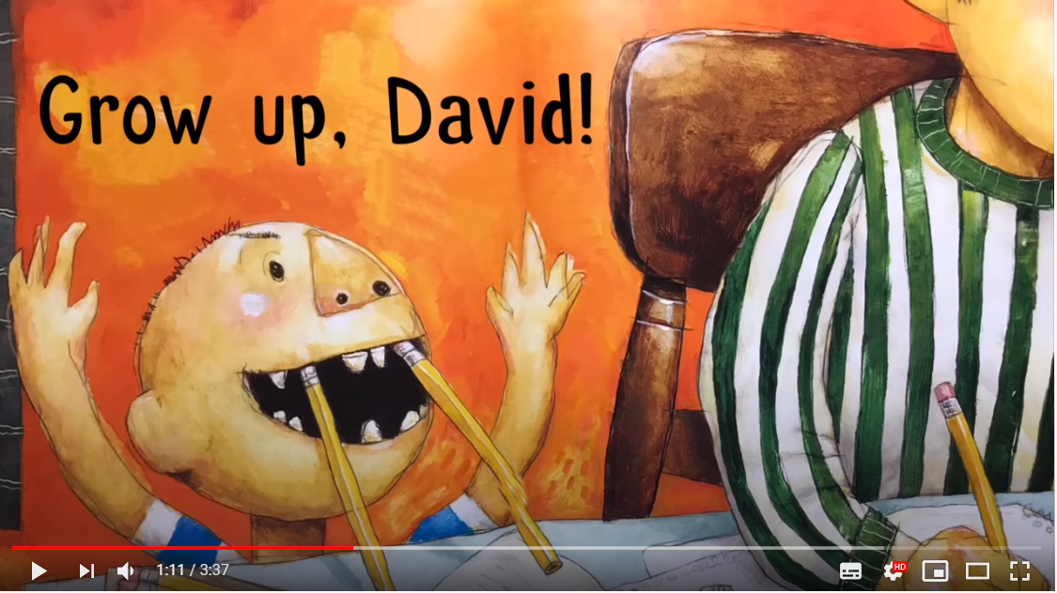
David,成熟點！
Grow up, David!

Slide 6
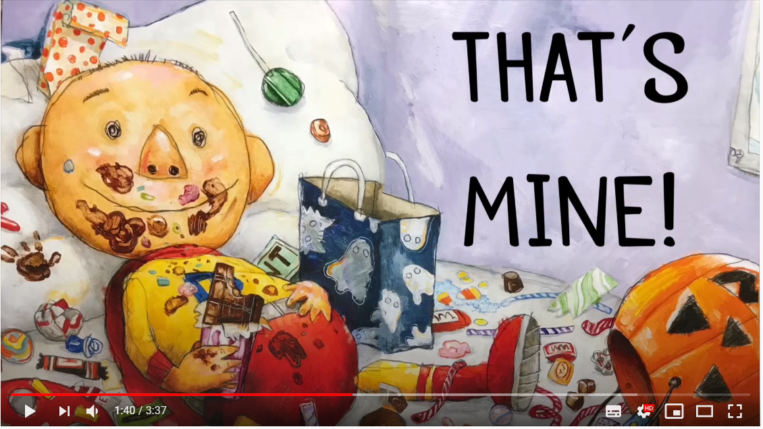
那是我的(東西)！
That’s mine!!

Slide 7
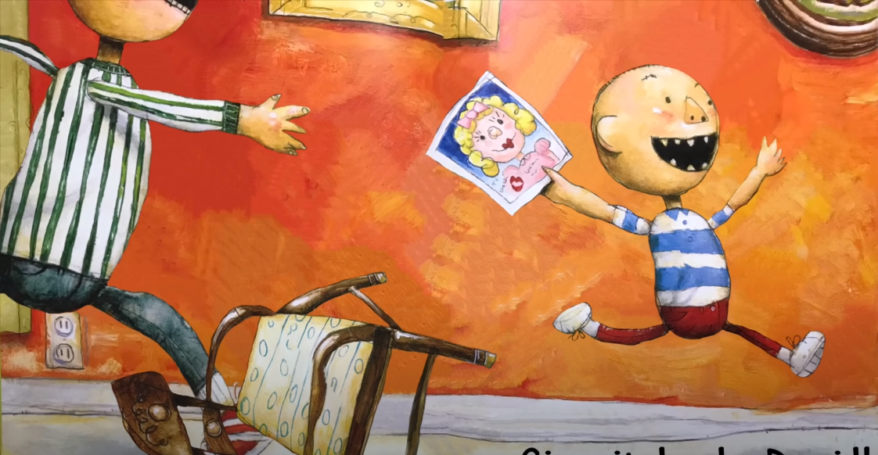
把它還給我。
Give it back.

Slide 8
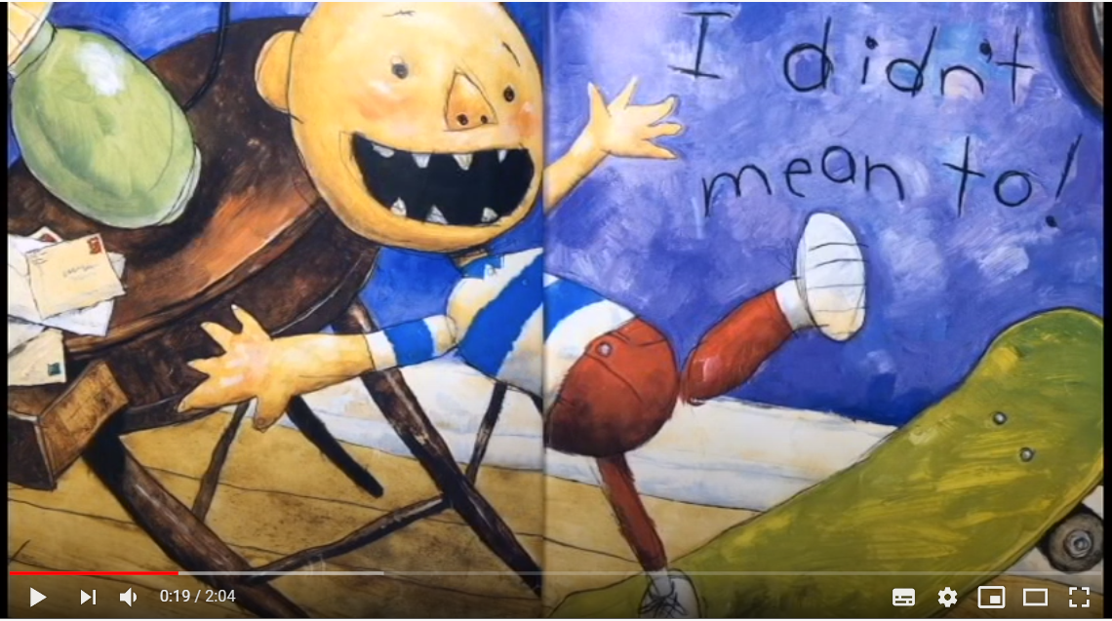
我不是故意的。
I didn’t mean to.

Slide 9
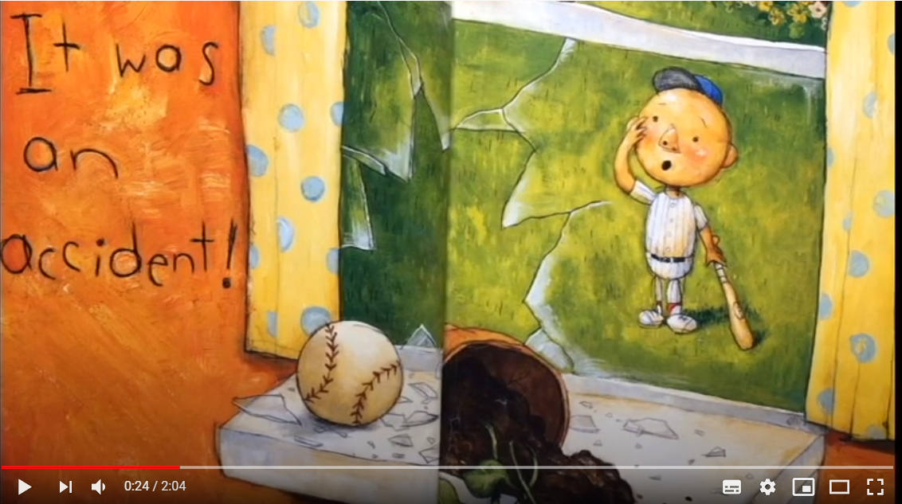
這是個意外！
It was an accident!

Slide 10
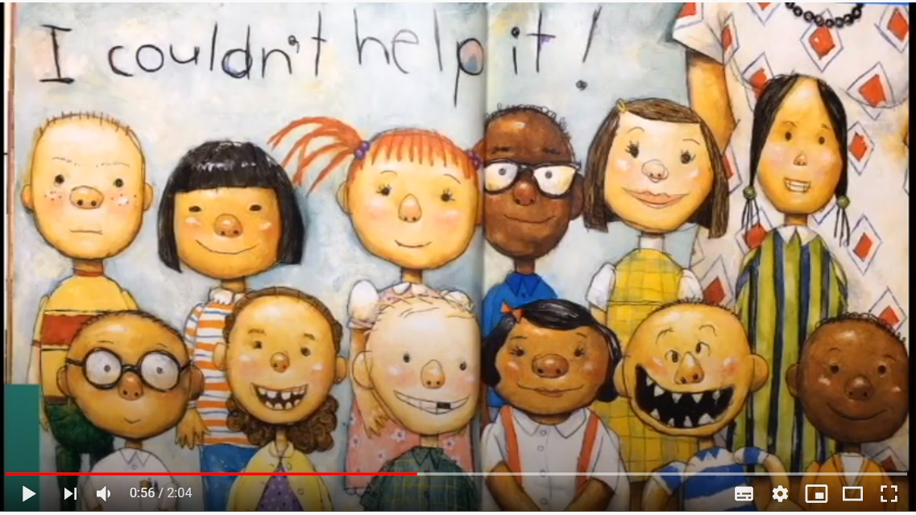
我忍不住！
I couldn’t help it!

Slide 11
110-1 八年級彈性課程
銘心繪
- Play with the Letters I -

Slide 14
Tomorrow’s Alphabet
Notes:
1. Work of 4
2. Have one person get a whiteboard and a marker
3. Figure out the rules through the following two examples

Slide 15
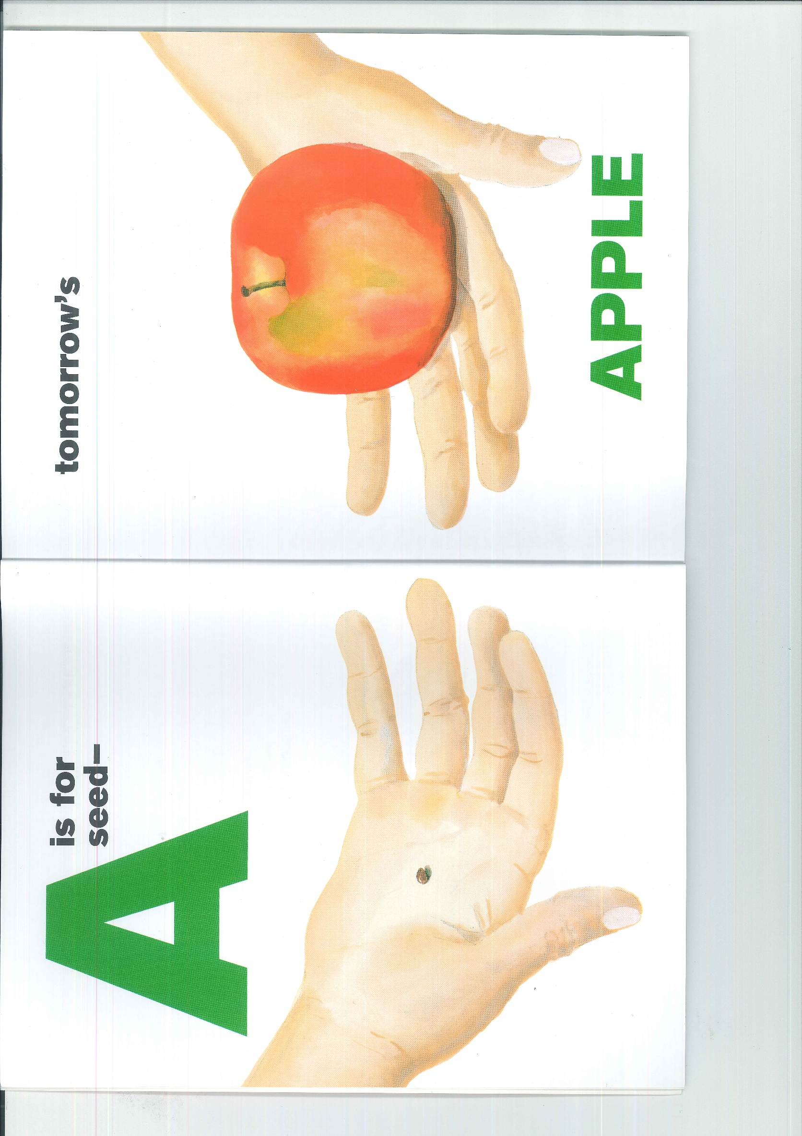

Slide 17
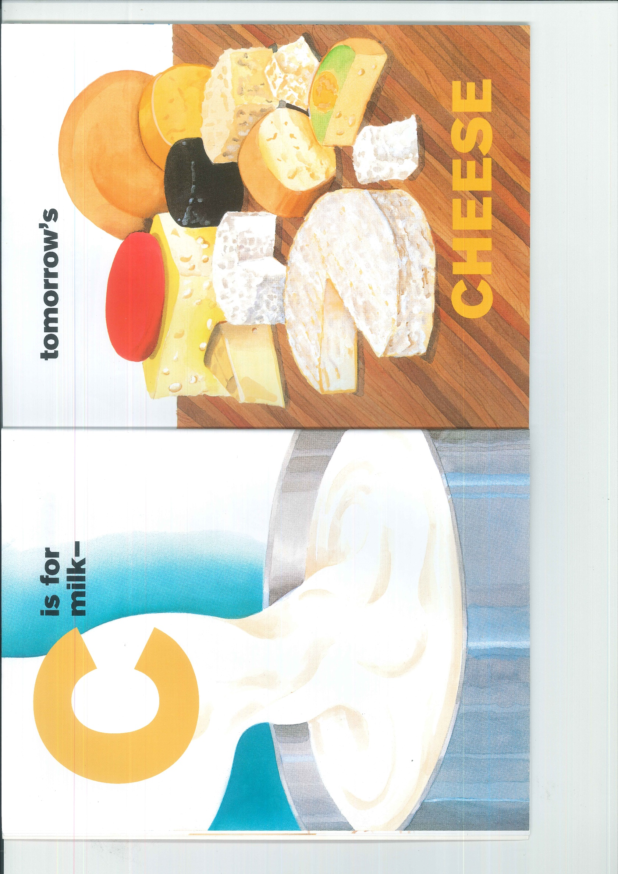

Slide 18
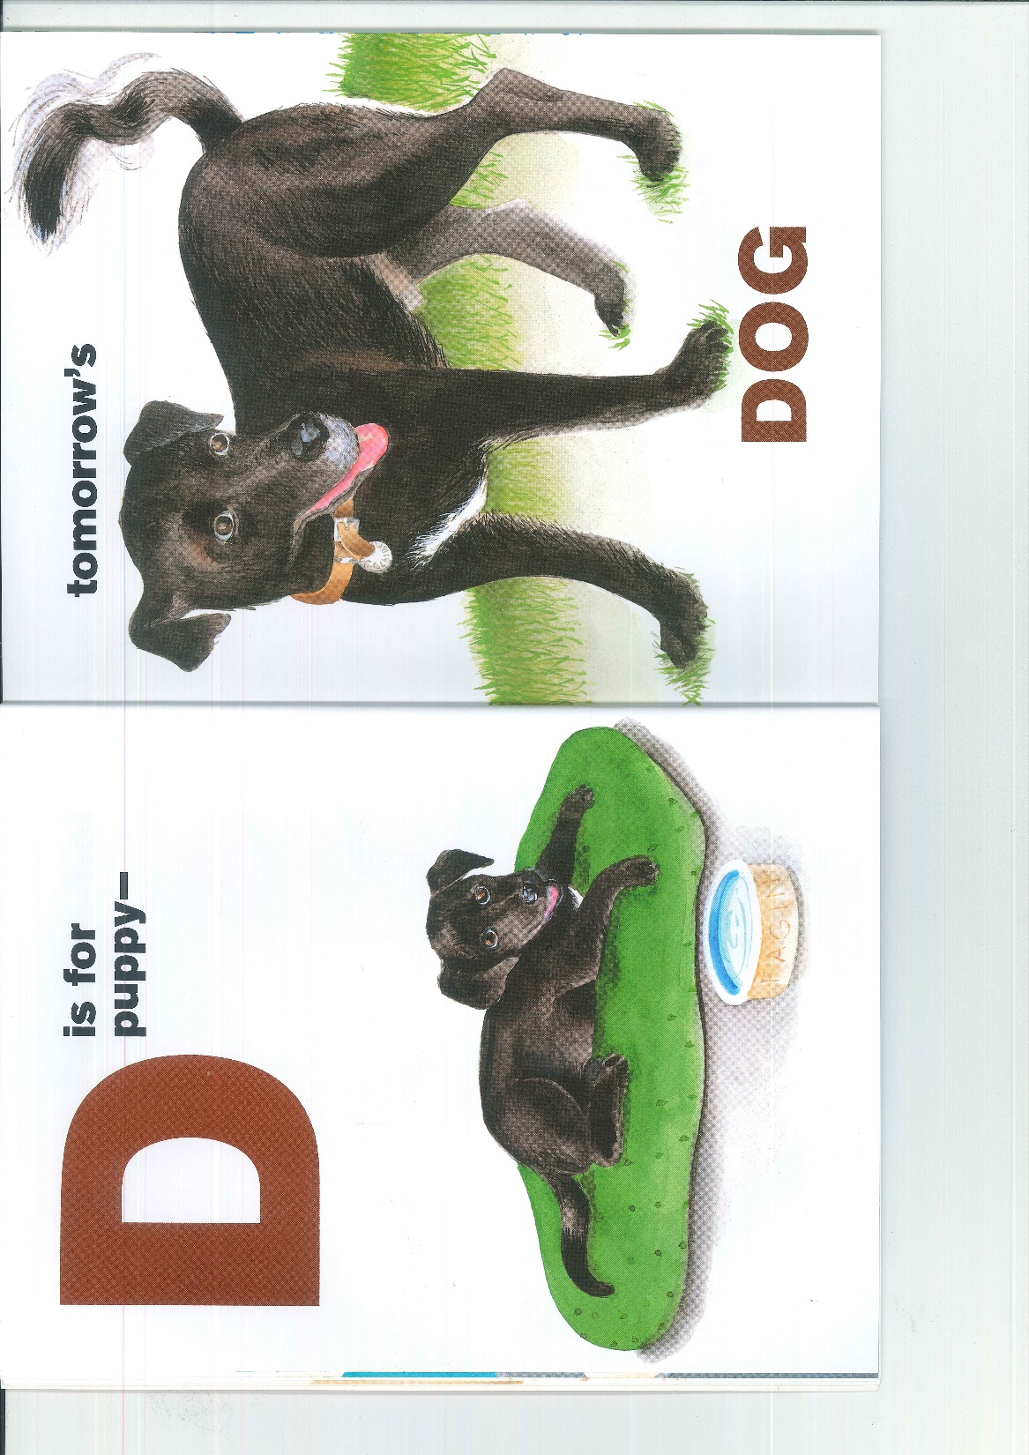

Slide 30
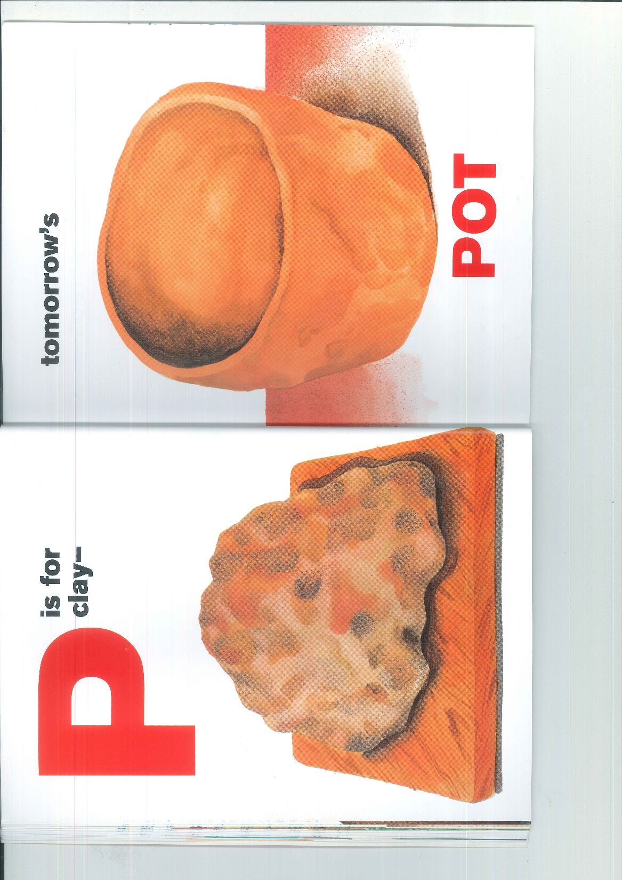

Slide 31
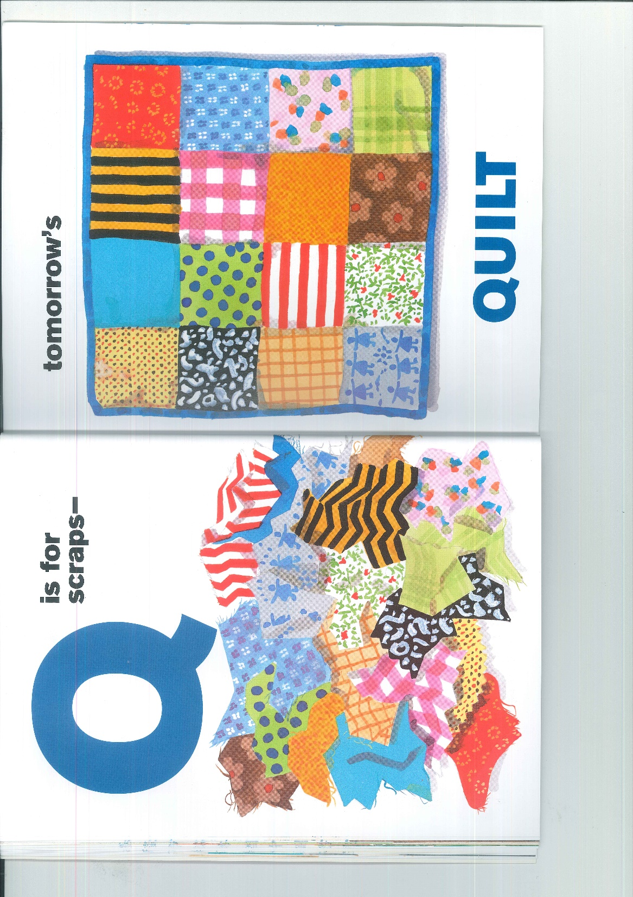

Slide 34
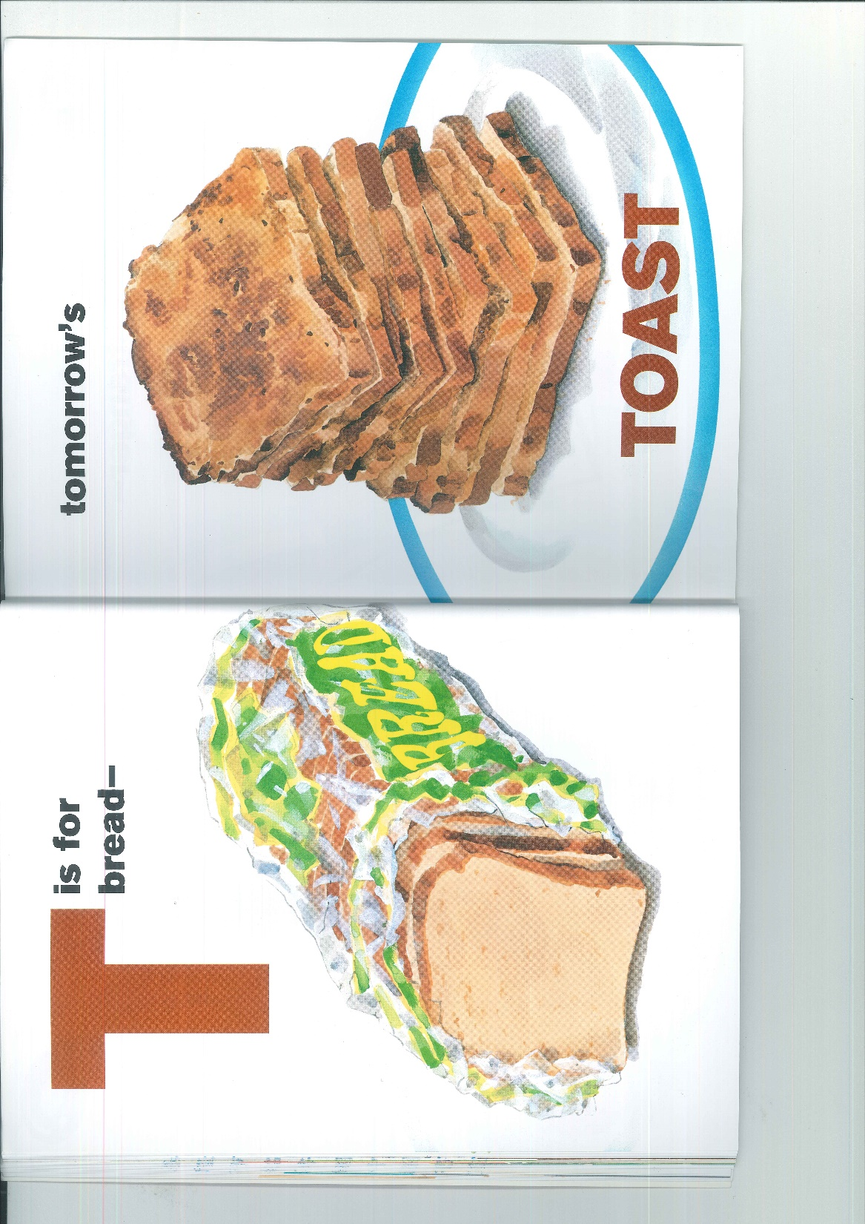

Slide 38
