Slide 1
110-1 八年級彈性課程
銘心繪
- Play with the Letters I -

Slide 2

Attitude
態 度
Determines Everything
決定一切

Slide 3
812 is the BEST team
Group | G1 | G2 | G3 | G4 | G5 | G6
No. | ? | 31 | 33 | 1 | 9 | 35
No. | 36 | 4 | 13 | ? | ? | 3
No. | ? | ? | 2 | 7 | 39 | ?
No. | 17 | 12 | ? | 38 | 5 | 37
No. | 43 | 10 | 11 | 16 | ? | 0
Total | 144 | 98 | 91 | 96 | 107 | 83

Slide 4

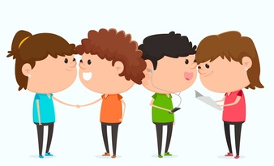


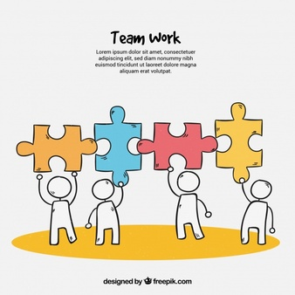
4-Be Rules
#1 Be respectful
#2 Be kind
#3 Be responsible
#4 Best teamwork

Slide 5

David Goes to School
好書推推推
No, David!
2’05’’: https://www.youtube.com/watch?v=9Wsod3lPlYY
Grow Up, David!
3’37’’:
https://www.youtube.com/watch?v=LuOJFV4PzLI
David Gets In Trouble
2’04’’:
https://www.youtube.com/watch?v=9CZ99TuAcAc&feature=youtu.be

Slide 6
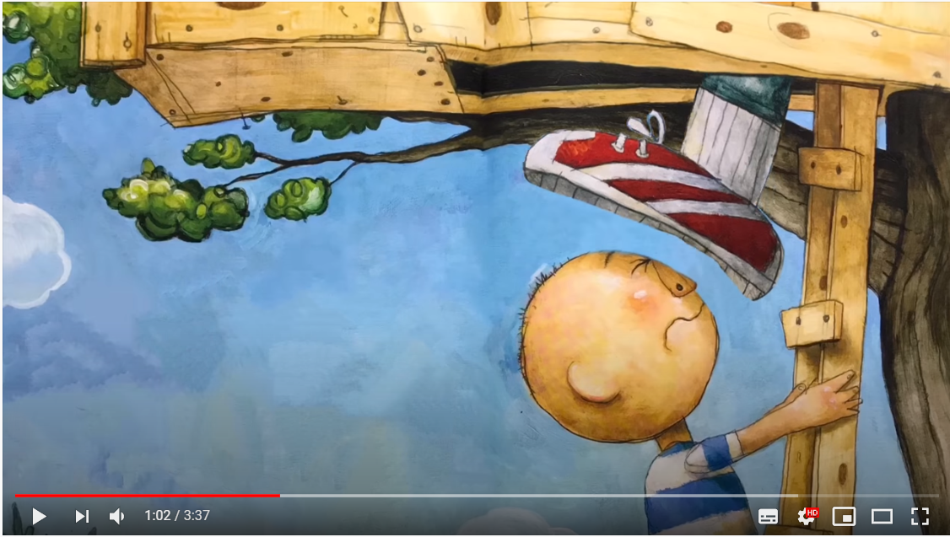
別再跟著我。
Stop following me.

Slide 7
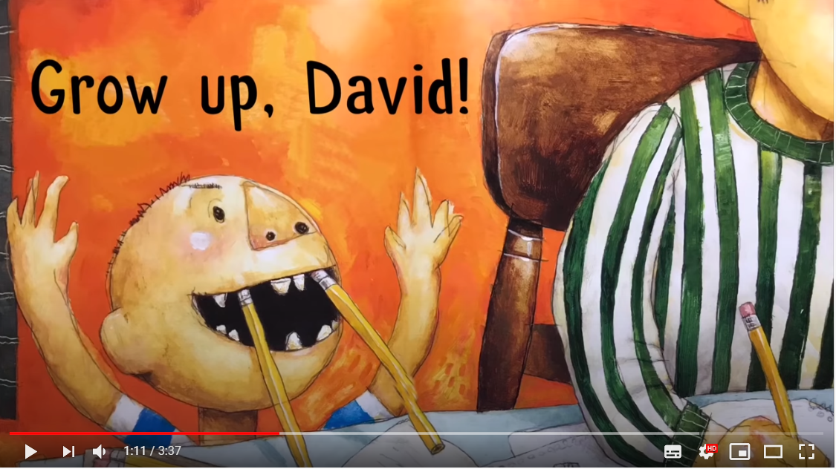
David,成熟點！
Grow up, David!

Slide 8
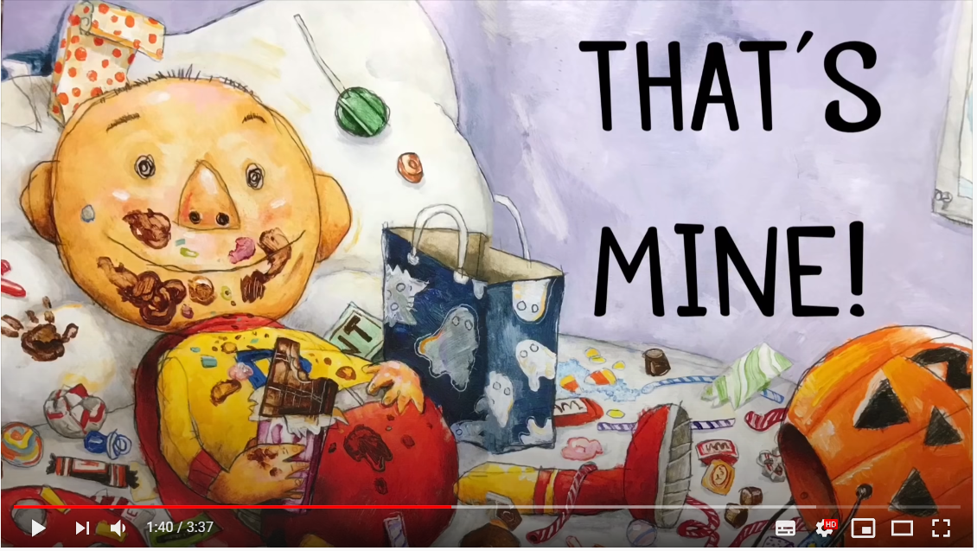
那是我的(東西)！
That’s mine!!

Slide 9
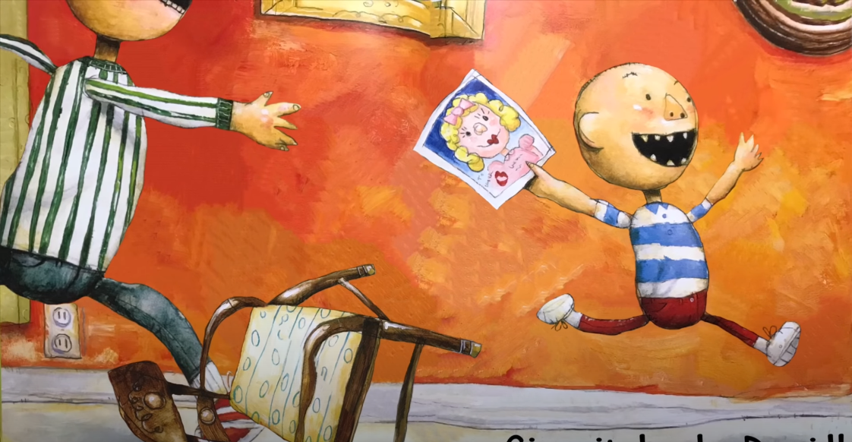
把它還給我。
Give it back.

Slide 10
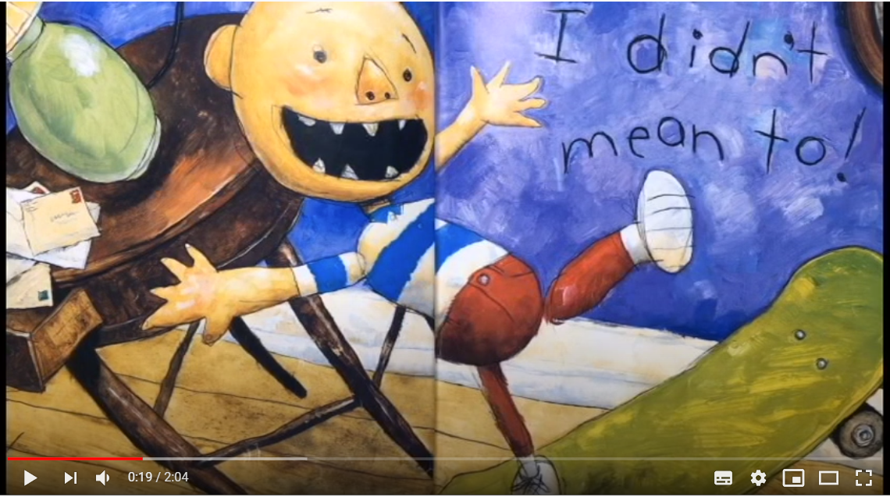
我不是故意的。
I didn’t mean to.

Slide 11
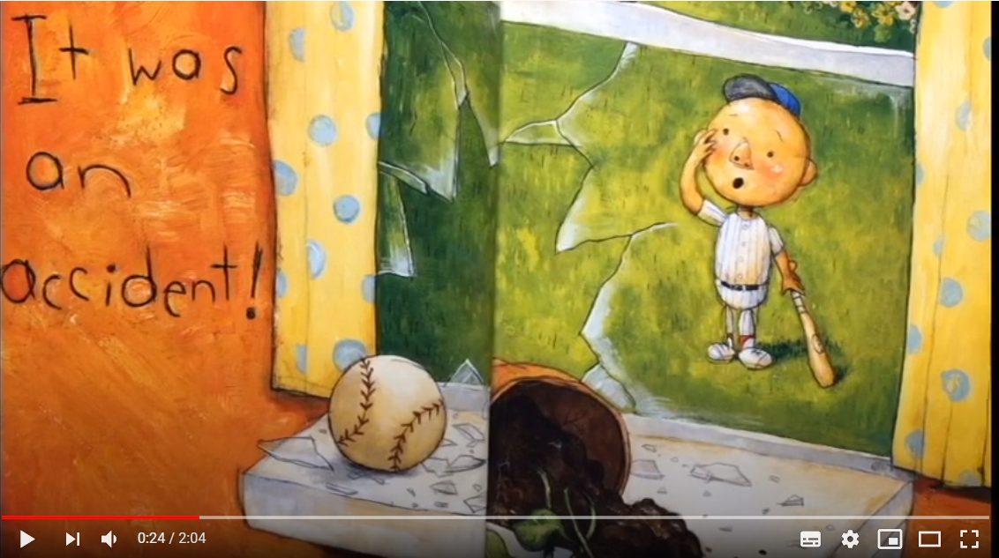
這是個意外！
It was an accident!

Slide 12
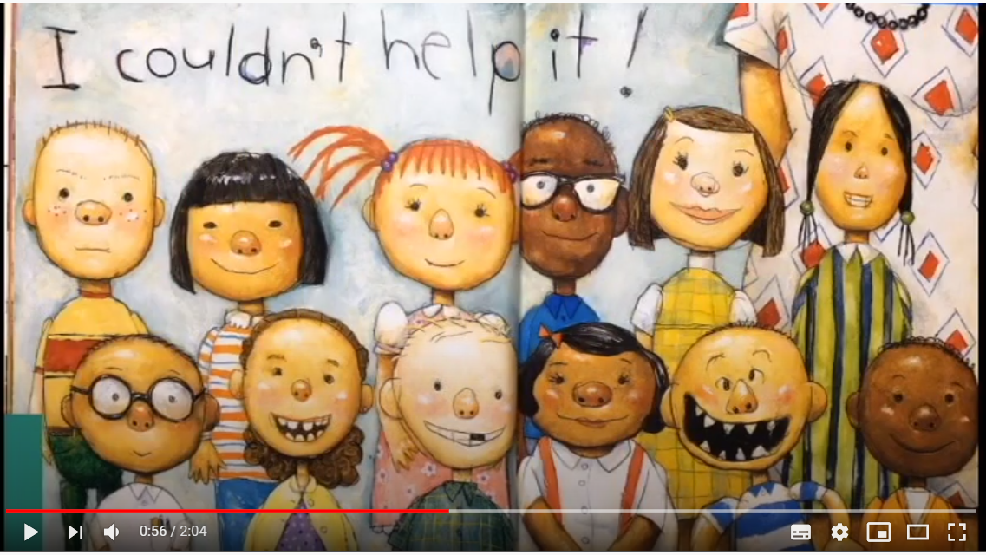
我忍不住！
I couldn’t help it!

Slide 13


Slide 14


Slide 15


Tomorrow’s Alphabet
Notes:
1. Work of 4
2. Have one person get a whiteboard and a marker
3. Figure out the rules through the following two examples

Slide 16
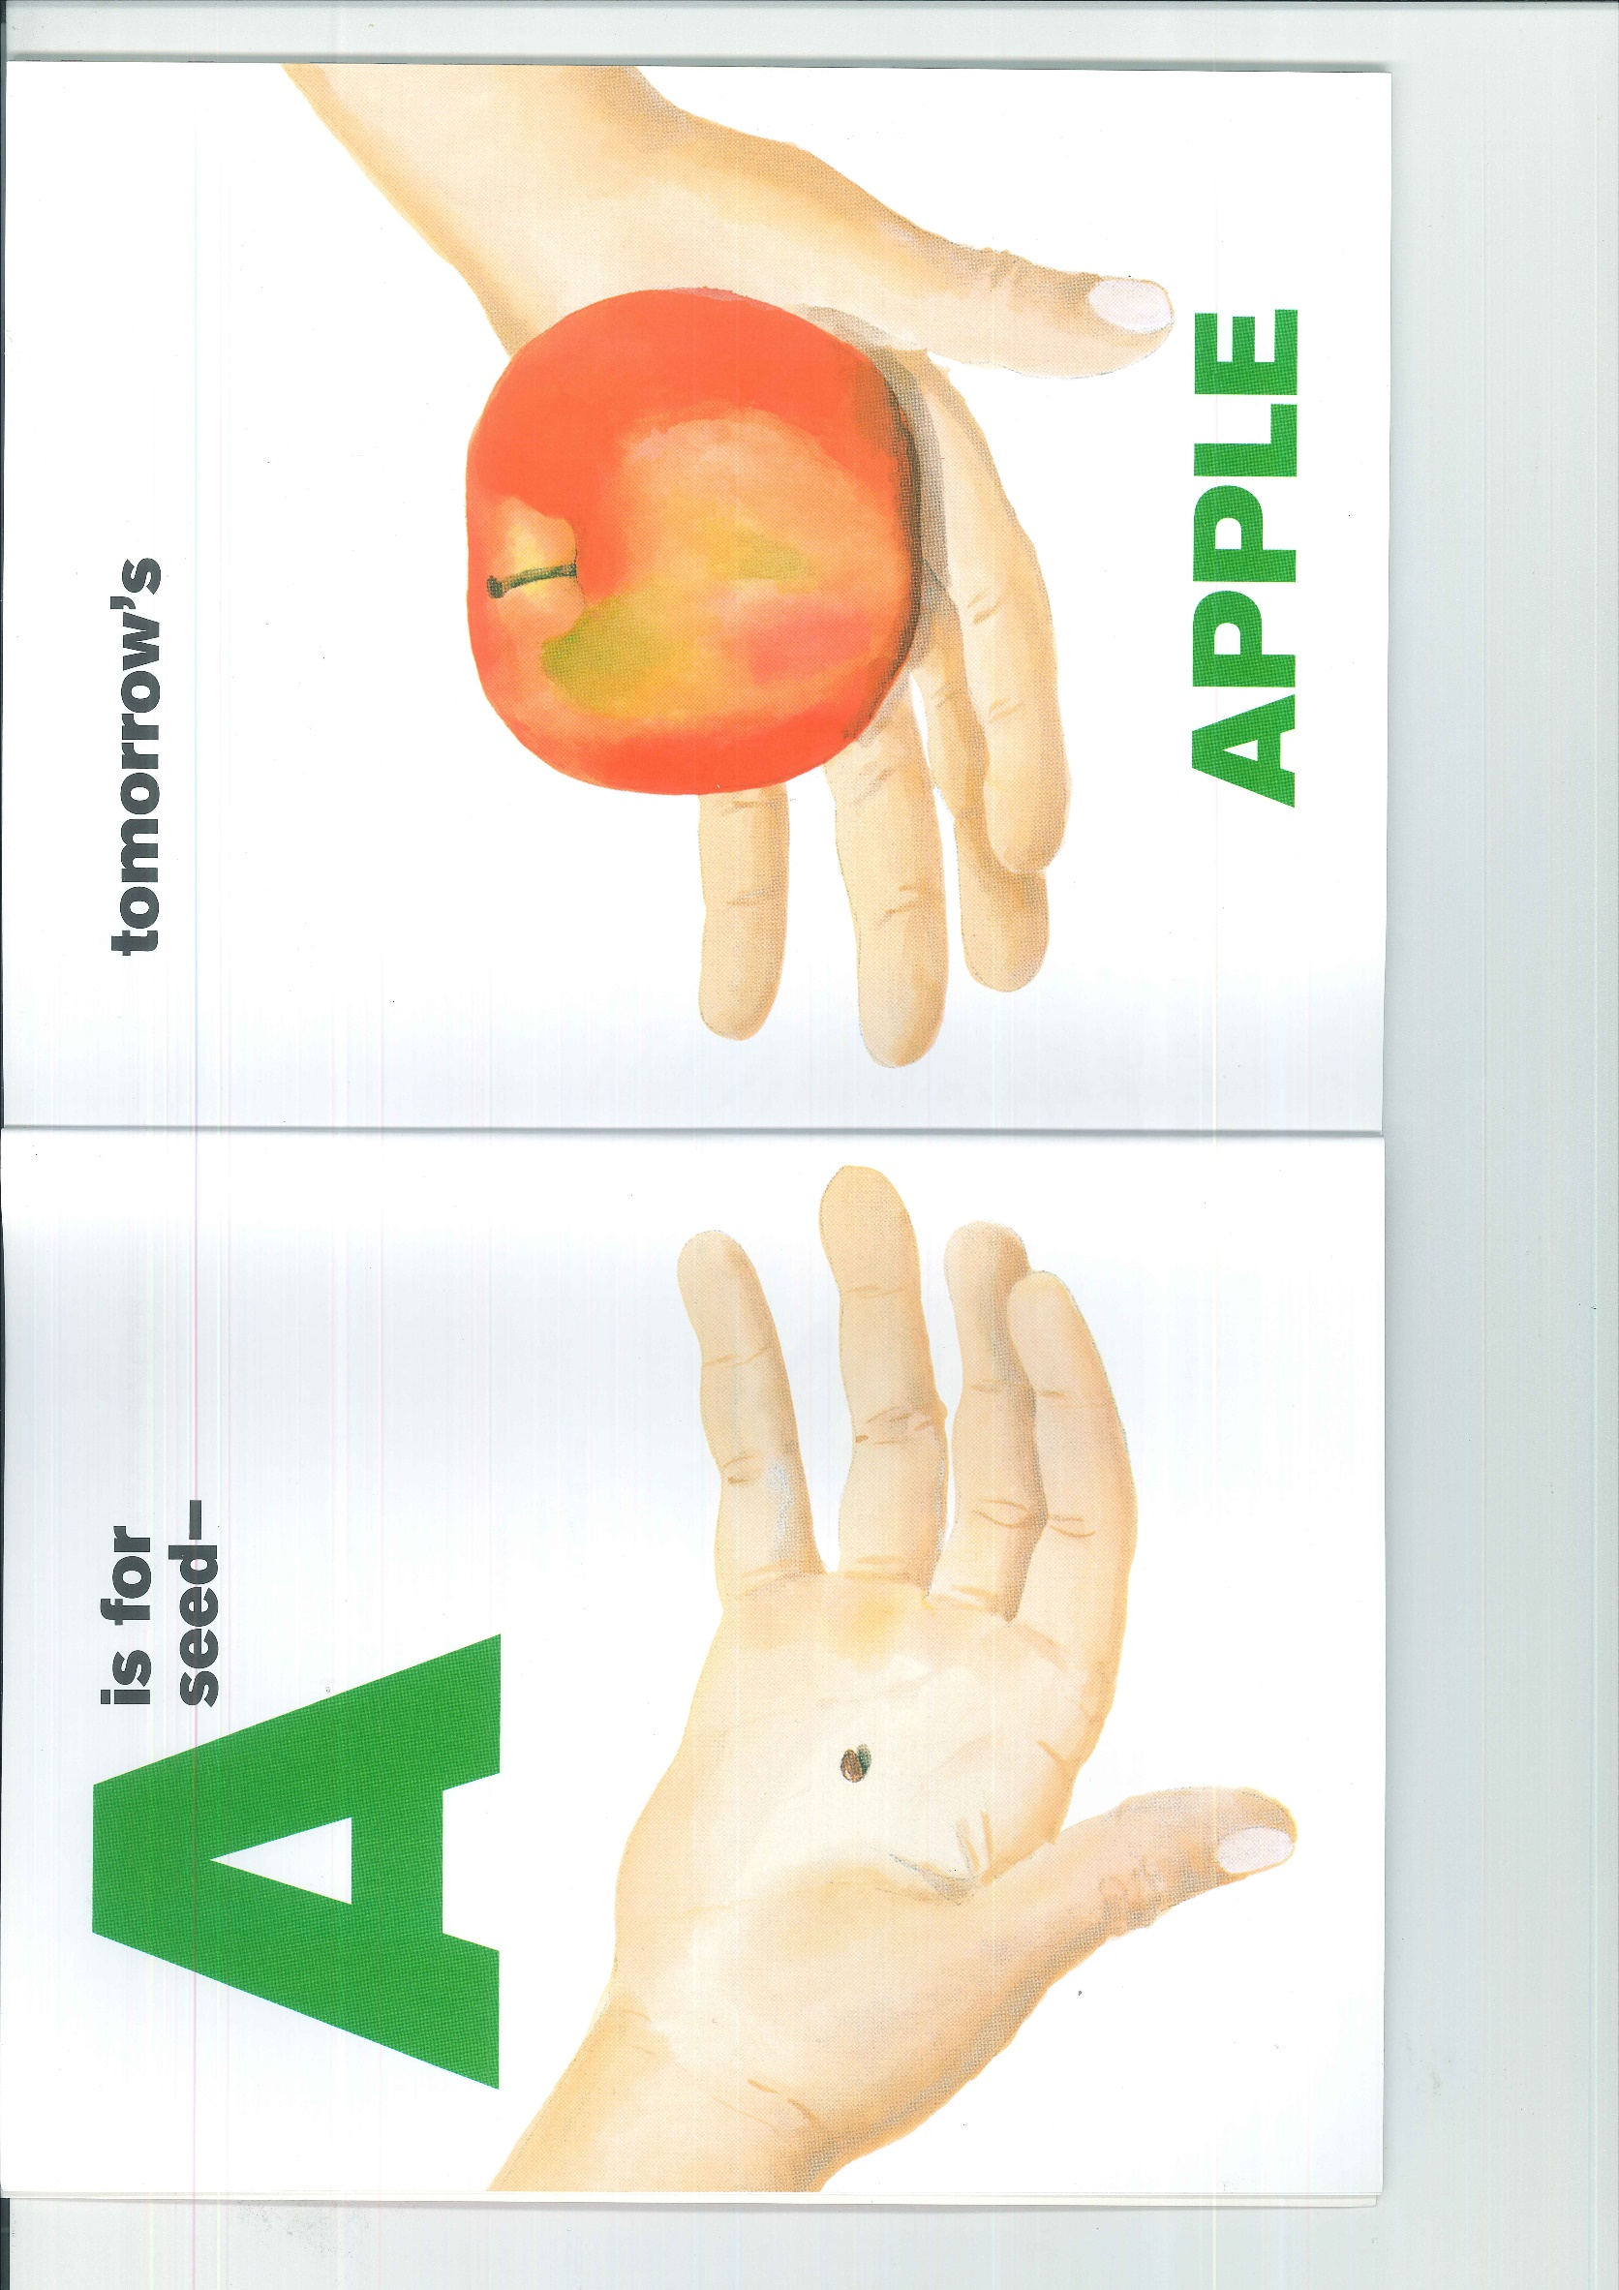

Slide 17


Slide 18
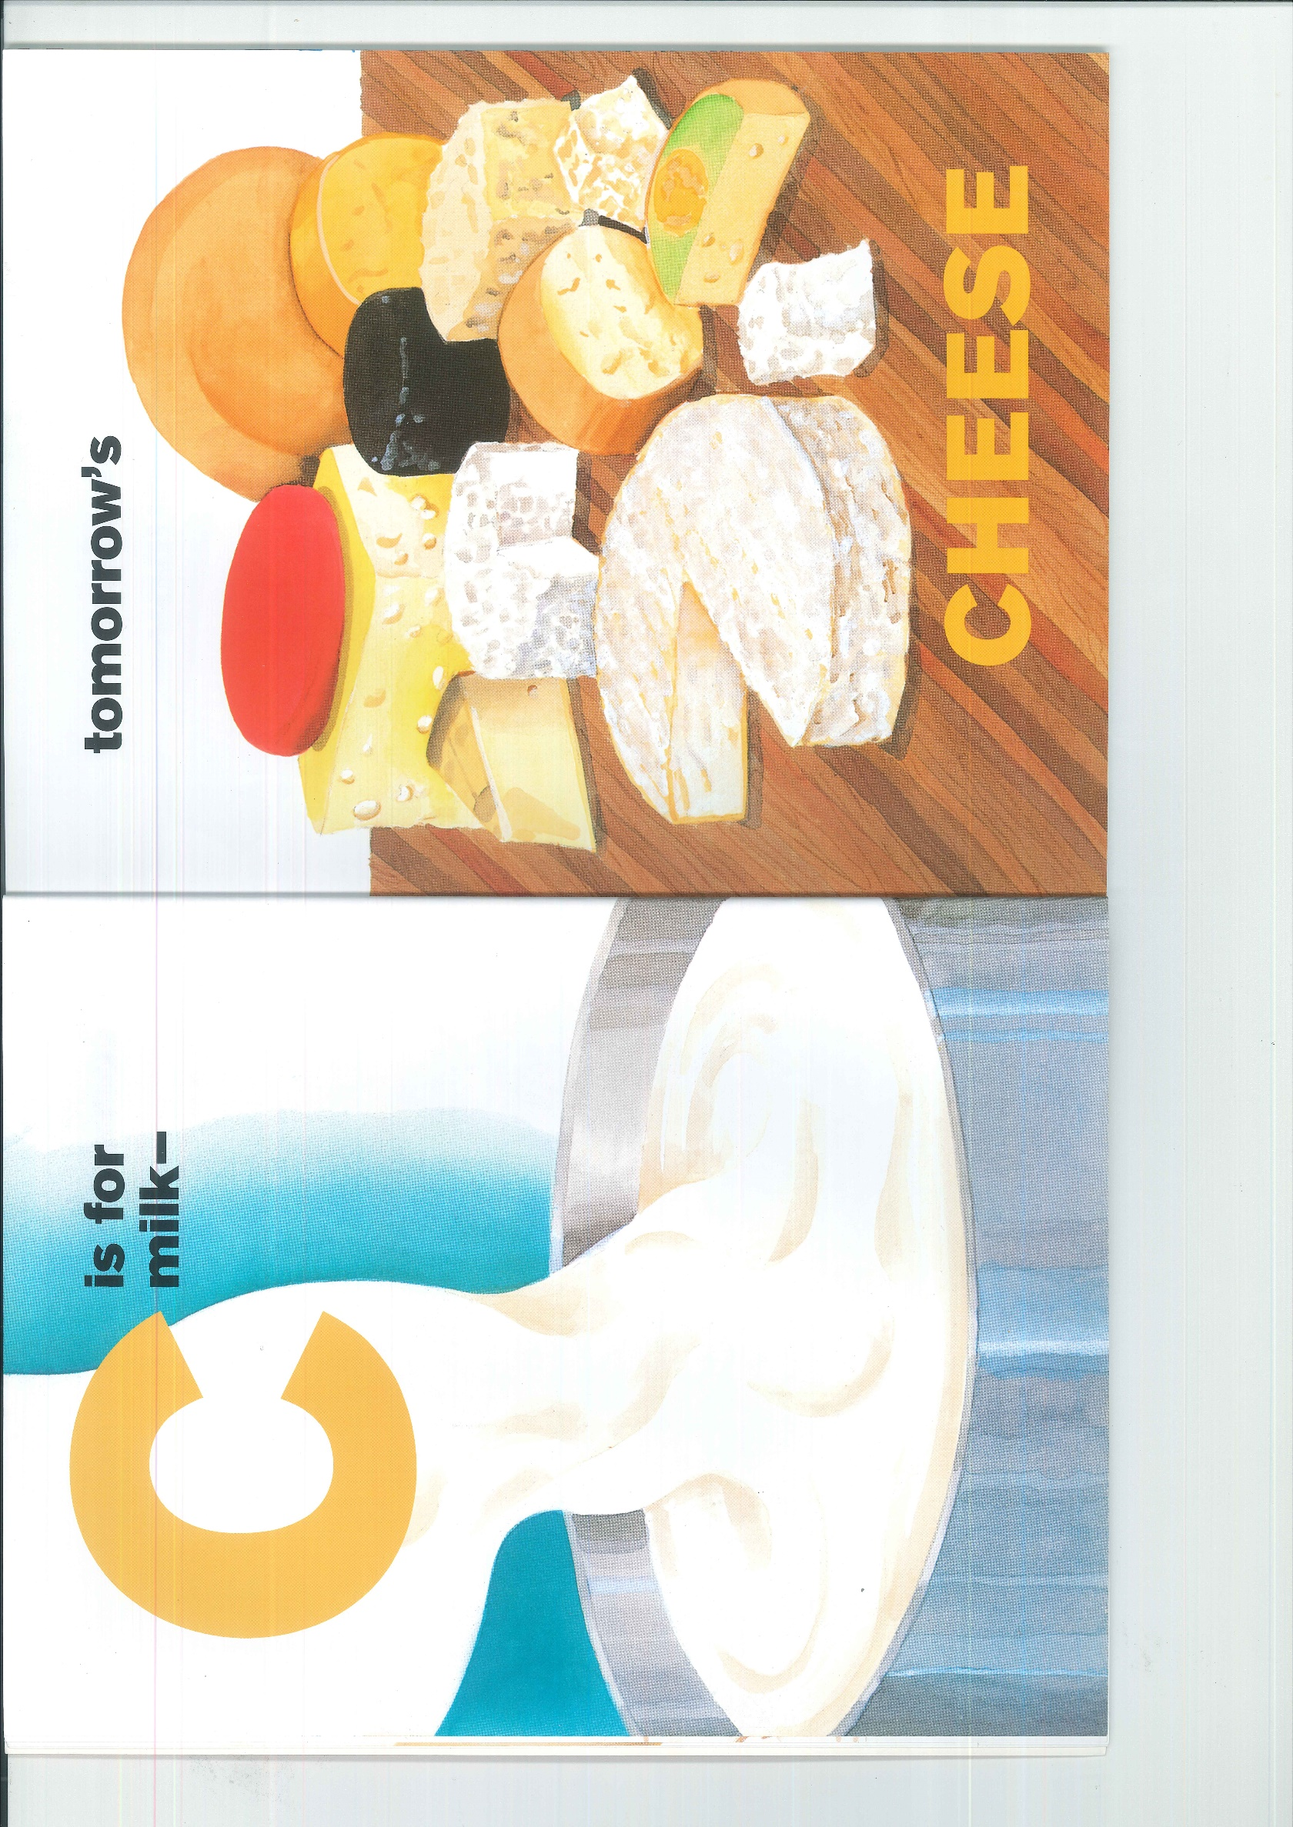

Slide 19
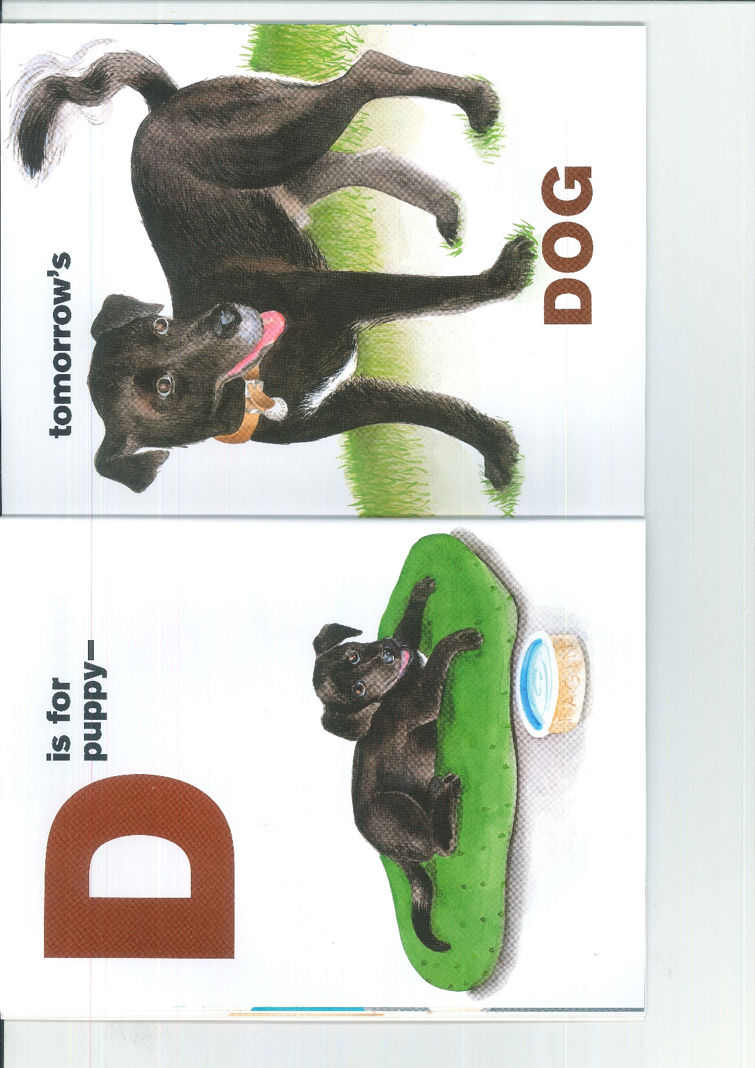

Slide 20


Slide 21
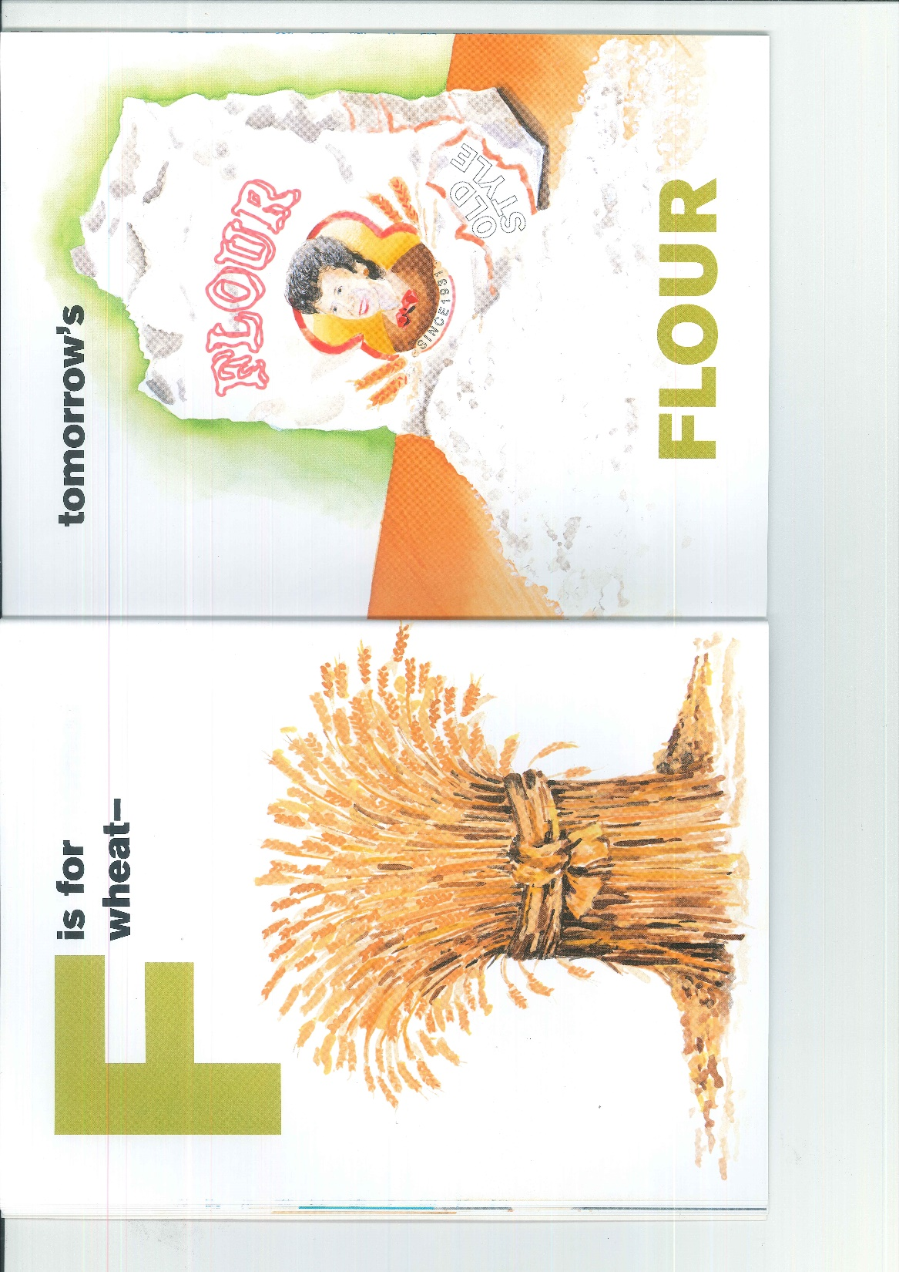

Slide 22


Slide 23


Slide 24


Slide 25


Slide 26


Slide 27
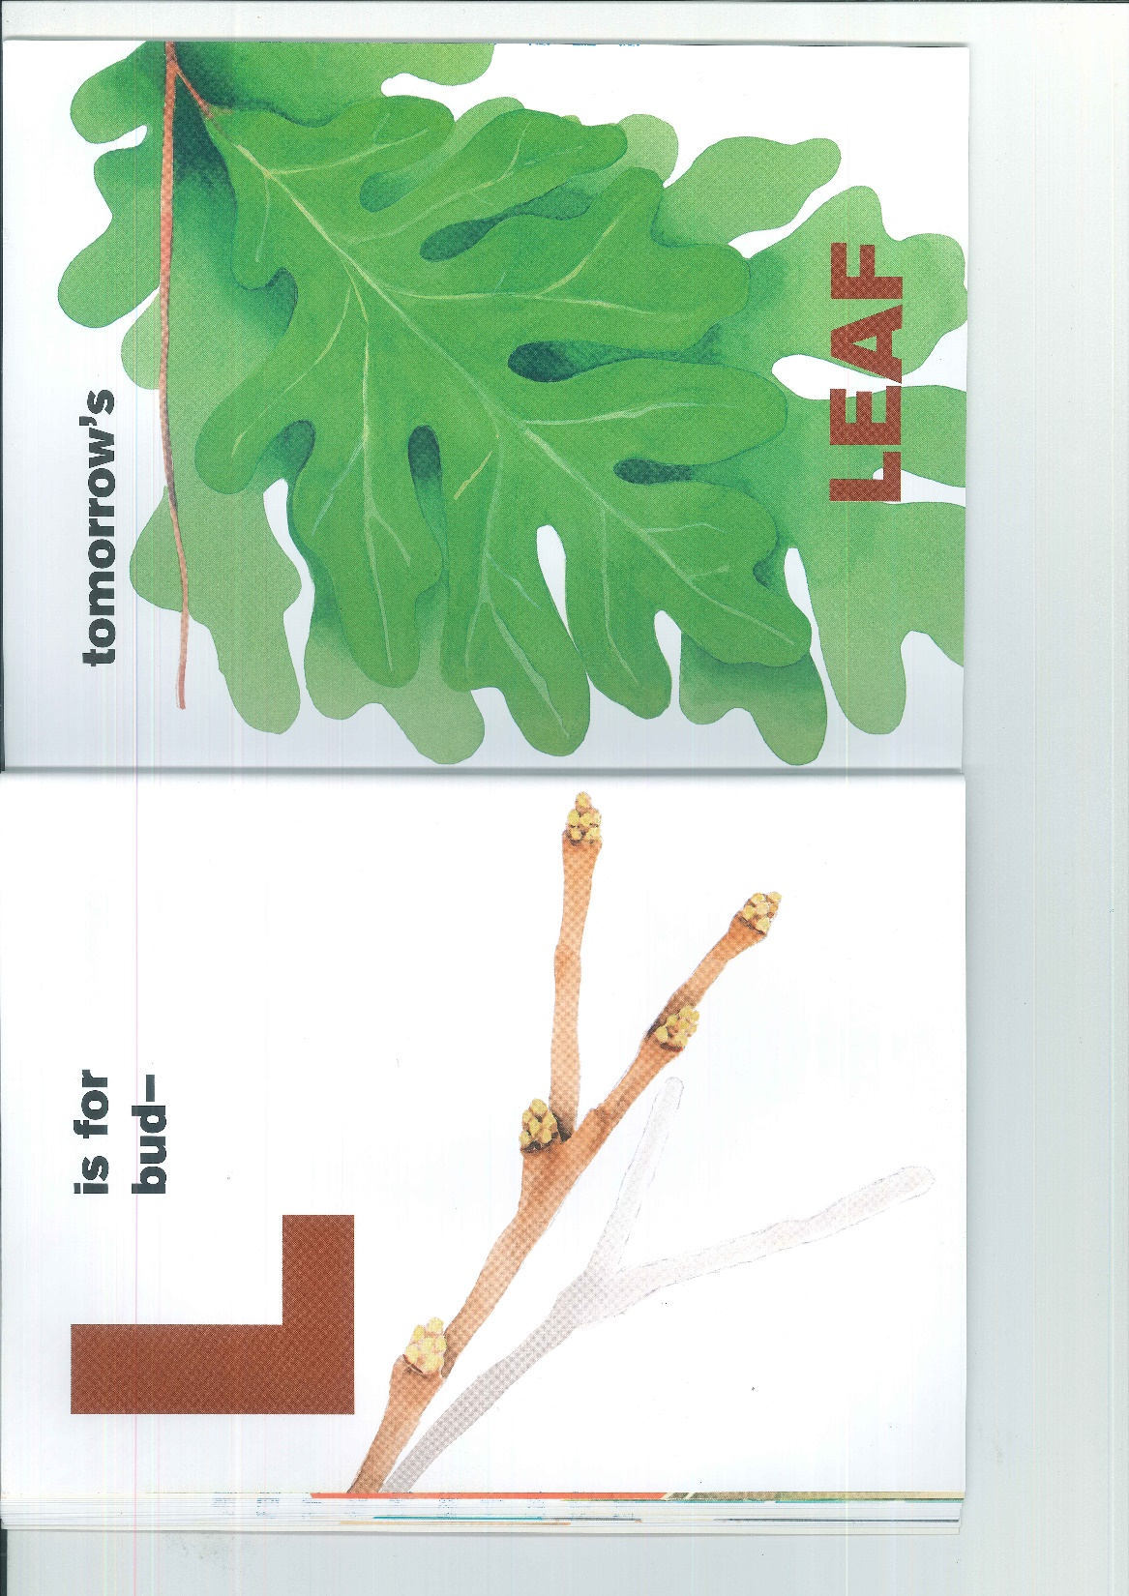

Slide 28


Slide 29


Slide 30


Slide 31
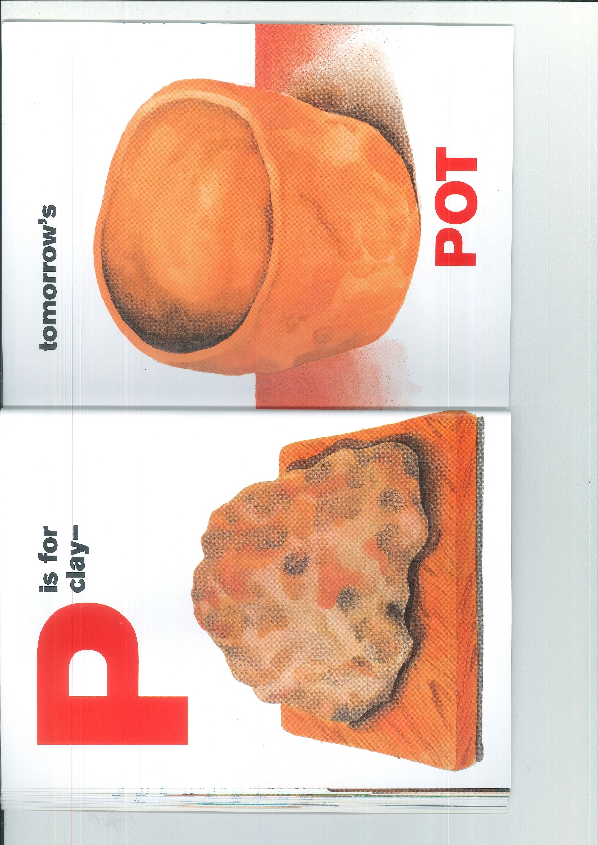

Slide 32
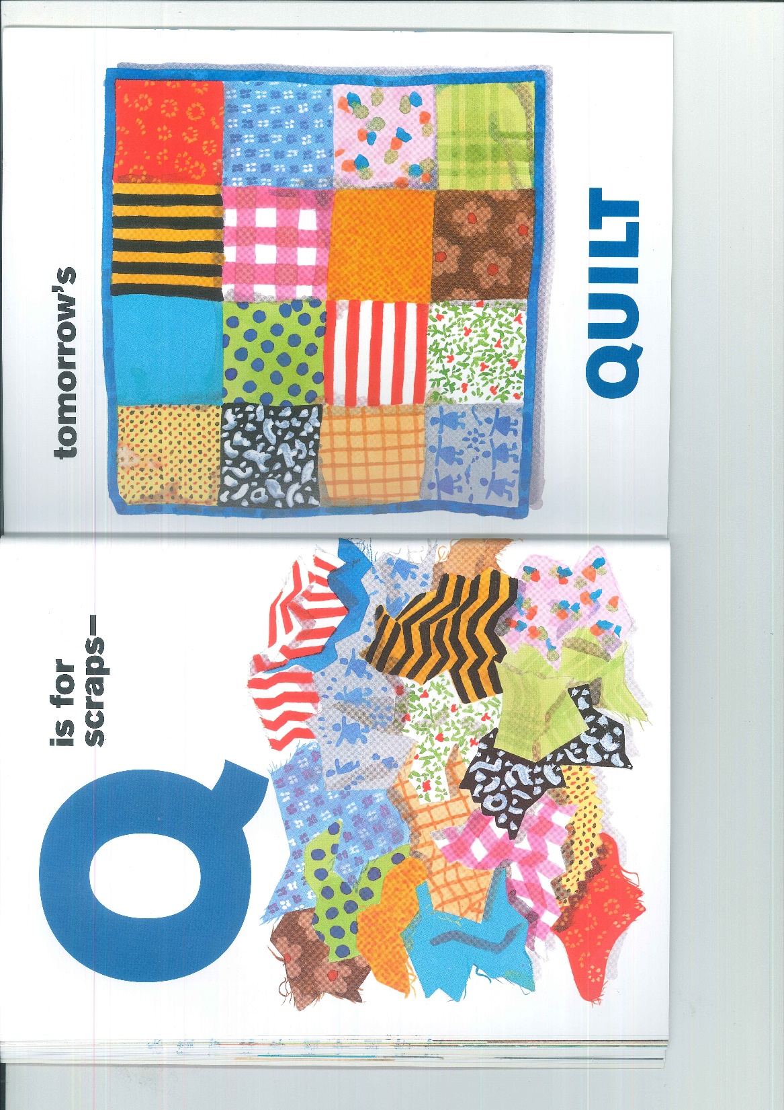

Slide 33


Slide 34


Slide 35
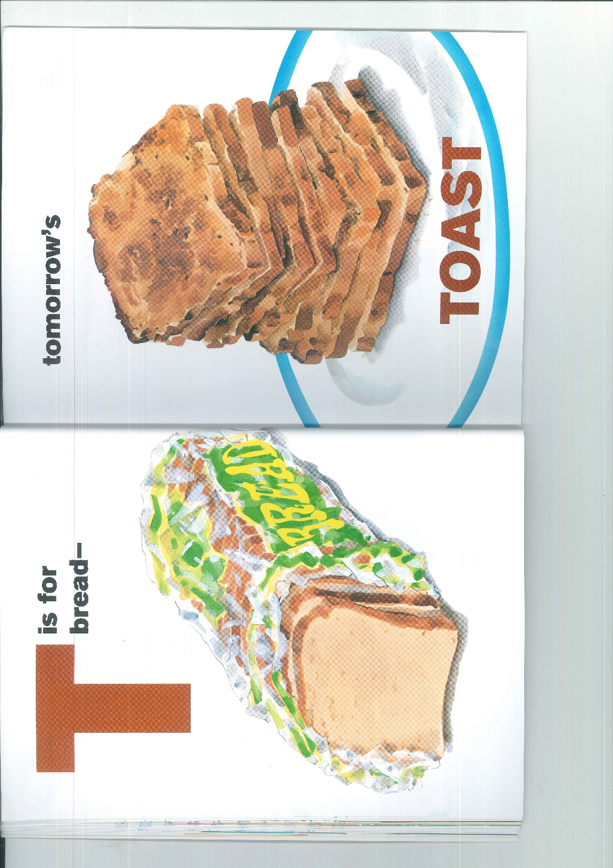

Slide 36
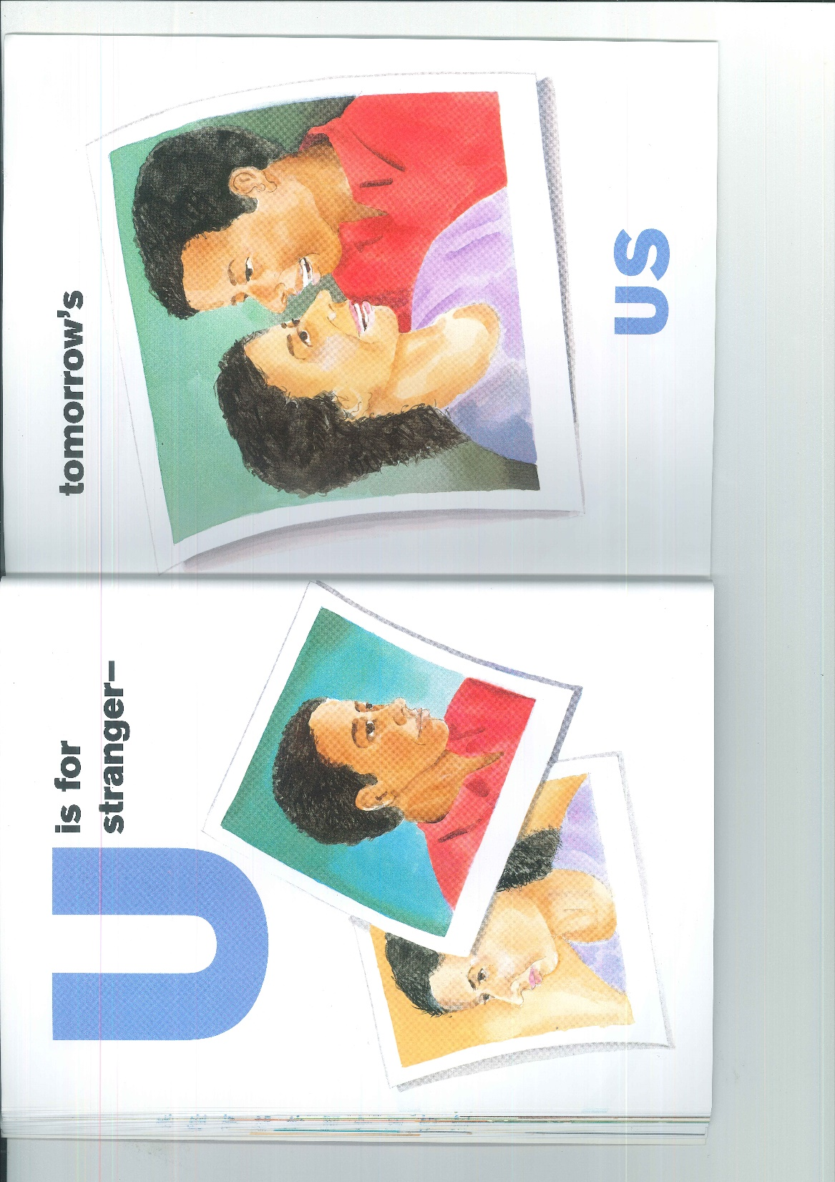

Slide 37


Slide 38


Slide 39
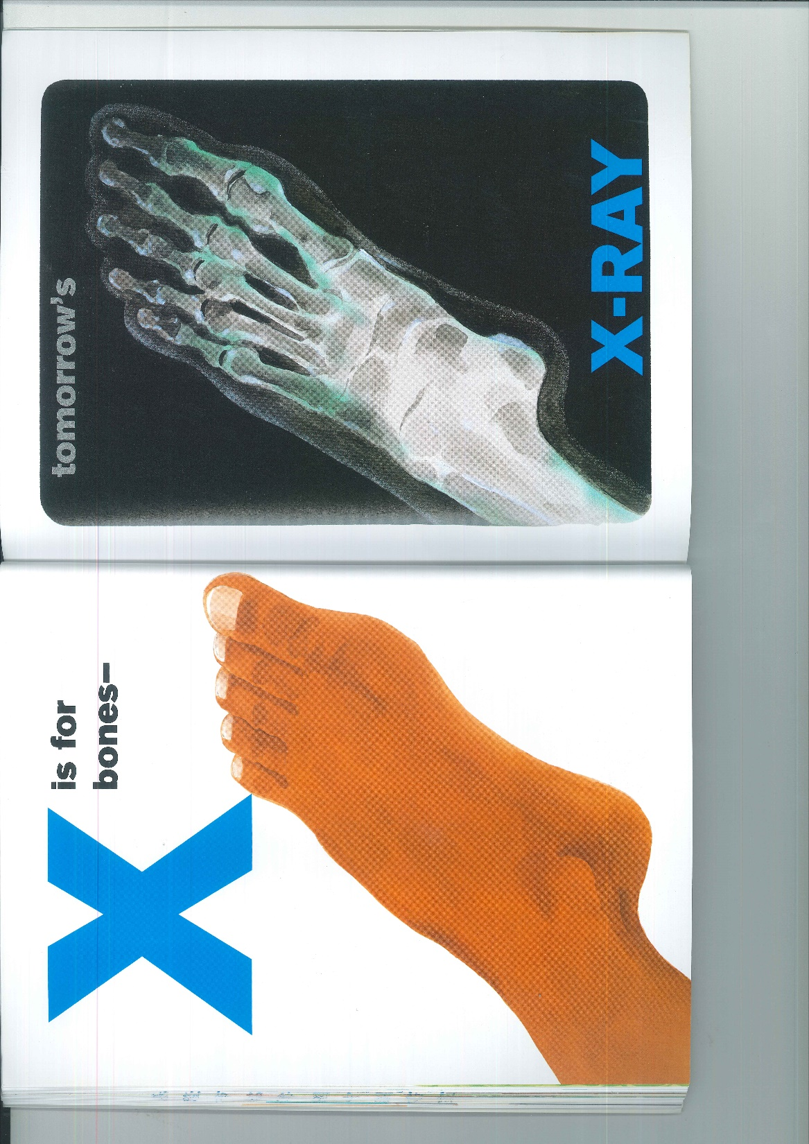

Slide 40
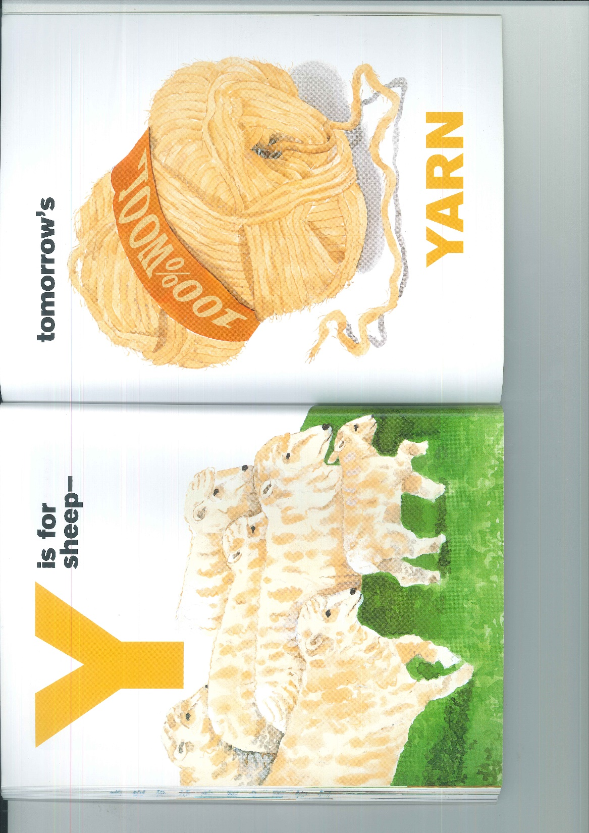

Slide 41


