Slide 1
七段數位顯示器-副程式

Slide 2
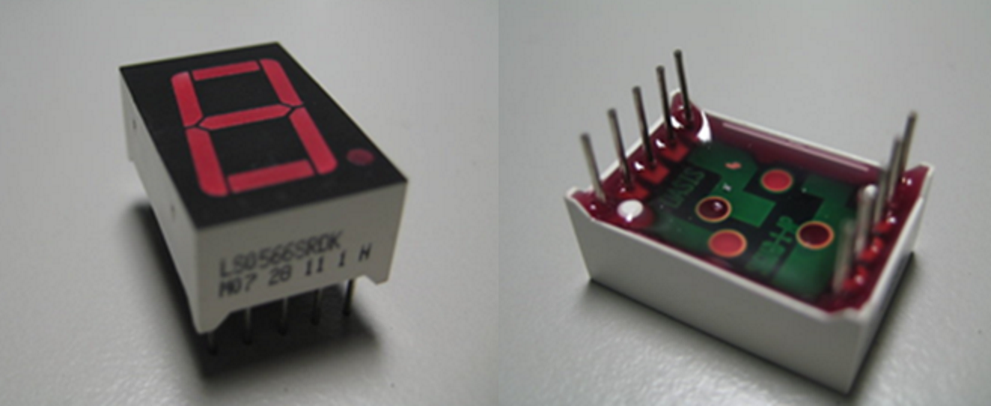
七段數字顯示器

Slide 3
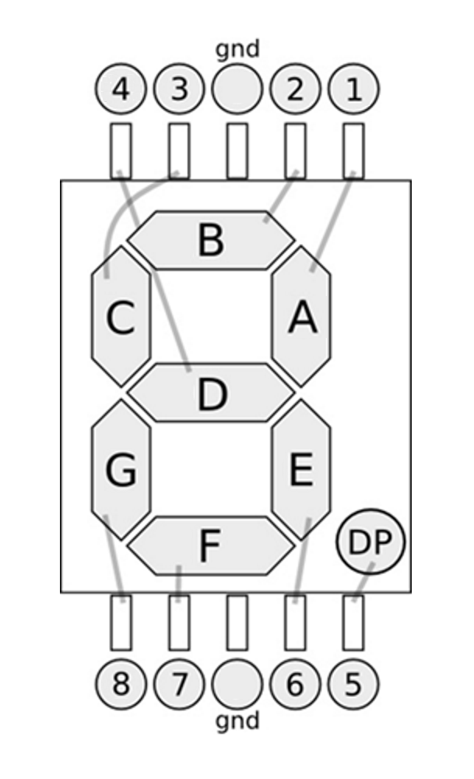
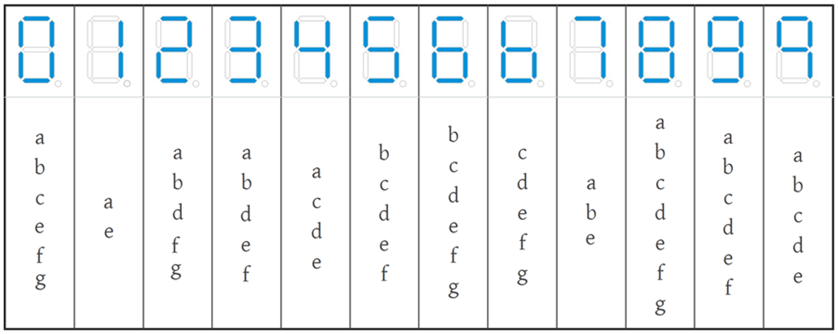
七段數字顯示器的電路
七段數字顯示器顯示數字及電路對照(參考)

Slide 4
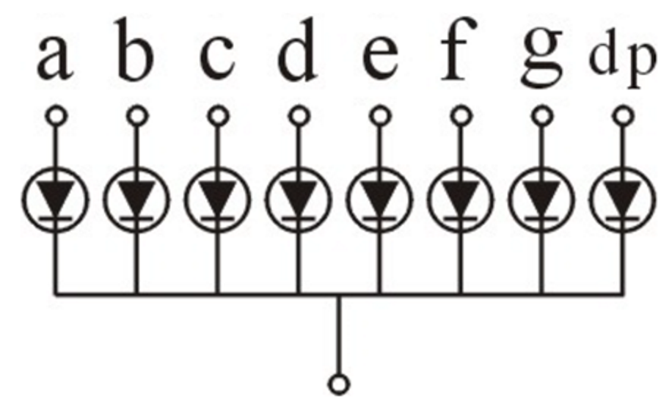
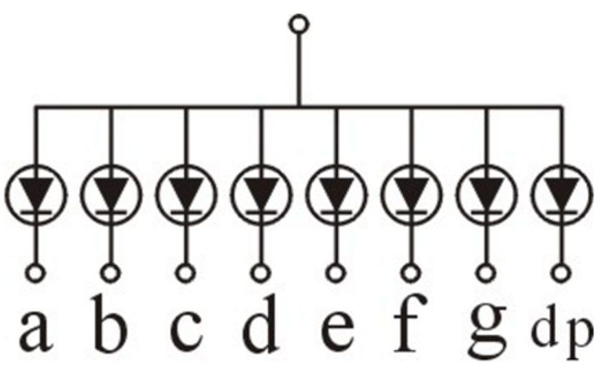
共陰極共陽極元件
共陰
共陽

Slide 5
輸入訊號產生數字
顯示數字 | a | b | c | d | e | f | g | dp
0 | 1 | 1 | 1 | 0 | 1 | 1 | 1 | 0
1 | 1 | 0 | 0 | 0 | 1 | 0 | 0 | 0
2 | 1 | 1 | 0 | 1 | 0 | 1 | 1 | 0
3 | 1 | 1 | 0 | 1 | 1 | 1 | 0 | 0
4 | 1 | 0 | 1 | 1 | 1 | 0 | 0 | 0
5 | 0 | 1 | 1 | 1 | 1 | 1 | 0 | 0
6 | 0 | 1 | 1 | 1 | 1 | 1 | 1 | 0
7 | 1 | 1 | 0 | 0 | 1 | 0 | 0 | 0
8 | 1 | 1 | 1 | 1 | 1 | 1 | 1 | 0
9 | 1 | 1 | 1 | 1 | 1 | 1 | 0 | 0

Slide 6
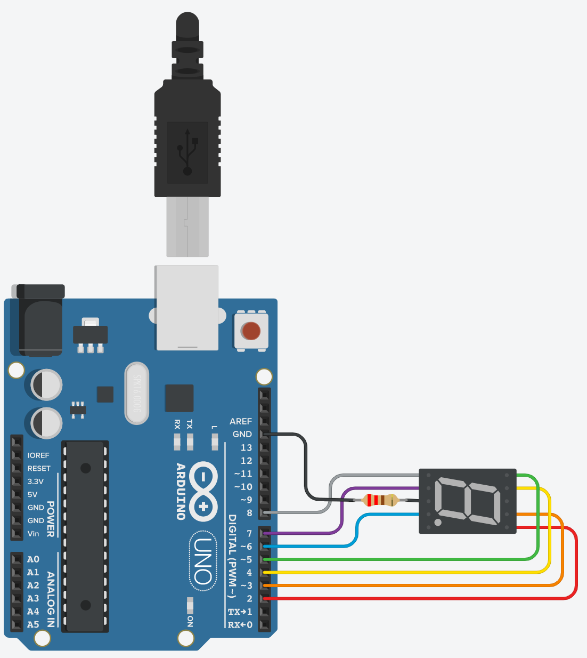
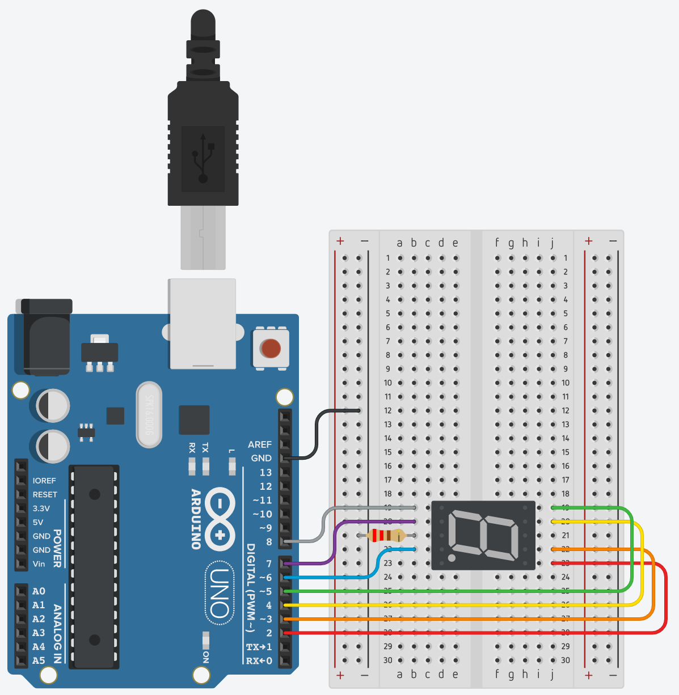
現場作業-顯示0~9數字
線路圖
連接方法

Slide 7
顯示數字 | pin2 | pin3 | pin4 | pin5 | pin6 | pin7 | pin8 | dp
0 | 1 | 1 | 1 | 0 | 1 | 1 | 1 | 0
1 | 1 | 0 | 0 | 0 | 1 | 0 | 0 | 0
2 | 1 | 1 | 0 | 1 | 0 | 1 | 1 | 0
3 | 1 | 1 | 0 | 1 | 1 | 1 | 0 | 0
4 | 1 | 0 | 1 | 1 | 1 | 0 | 0 | 0
5 | 0 | 1 | 1 | 1 | 1 | 1 | 0 | 0
6 | 0 | 1 | 1 | 1 | 1 | 1 | 1 | 0
7 | 1 | 1 | 0 | 0 | 1 | 0 | 0 | 0
8 | 1 | 1 | 1 | 1 | 1 | 1 | 1 | 0
9 | 1 | 1 | 1 | 1 | 1 | 1 | 0 | 0

Slide 8
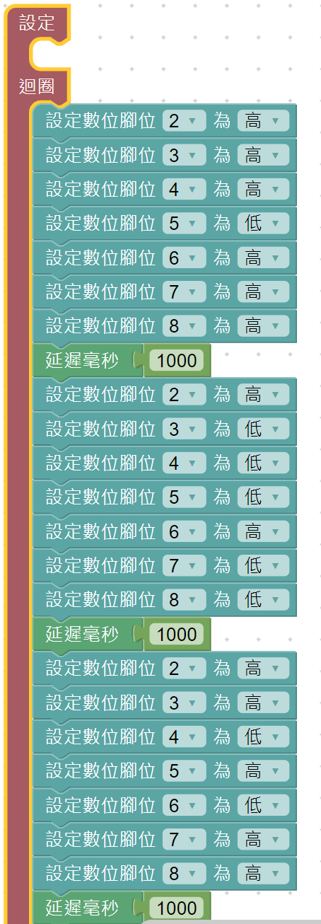
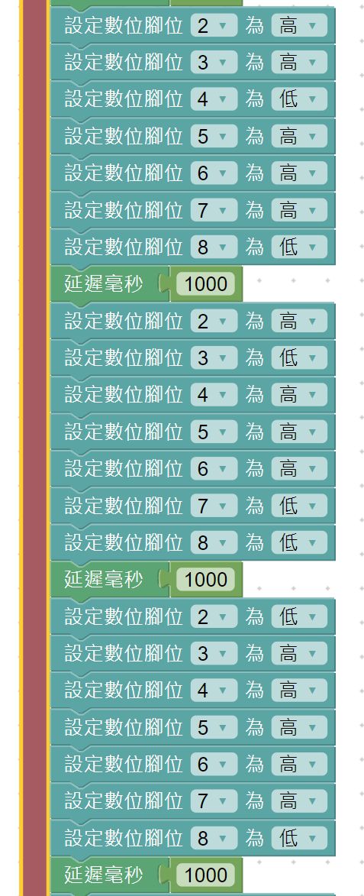
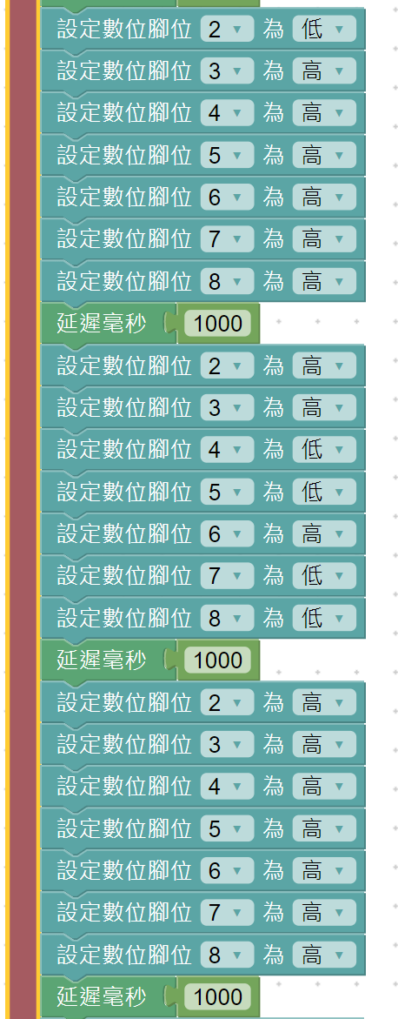
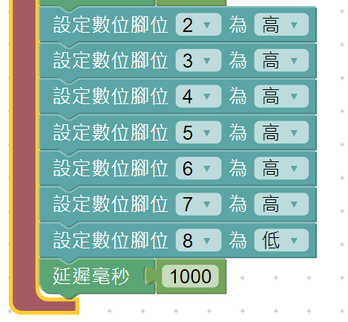

Slide 9
digitalWrite(2,HIGH);
digitalWrite(3,LOW);
digitalWrite(4,HIGH);
digitalWrite(5,HIGH);
digitalWrite(6,HIGH);
digitalWrite(7,LOW);
digitalWrite(8,LOW);
delay(1000);
digitalWrite(2,LOW);
digitalWrite(3,HIGH);
digitalWrite(4,HIGH);
digitalWrite(5,HIGH);
digitalWrite(6,HIGH);
digitalWrite(7,HIGH);
digitalWrite(8,LOW);
delay(1000);
digitalWrite(2,LOW);
digitalWrite(3,HIGH);
digitalWrite(4,HIGH);
digitalWrite(5,HIGH);
digitalWrite(6,HIGH);
digitalWrite(7,HIGH);
digitalWrite(8,HIGH);
delay(1000);
digitalWrite(2,HIGH);
digitalWrite(3,LOW);
digitalWrite(4,LOW);
digitalWrite(5,LOW);
digitalWrite(6,HIGH);
digitalWrite(7,LOW);
digitalWrite(8,LOW);
delay(1000);
digitalWrite(2,HIGH);
digitalWrite(3,HIGH);
digitalWrite(4,LOW);
digitalWrite(5,HIGH);
digitalWrite(6,LOW);
digitalWrite(7,HIGH);
digitalWrite(8,HIGH);
delay(1000);
digitalWrite(2,HIGH);
digitalWrite(3,HIGH);
digitalWrite(4,LOW);
digitalWrite(5,HIGH);
digitalWrite(6,HIGH);
digitalWrite(7,HIGH);
digitalWrite(8,LOW);
delay(1000);
digitalWrite(2,HIGH);
digitalWrite(3,HIGH);
digitalWrite(4,LOW);
digitalWrite(5,LOW);
digitalWrite(6,HIGH);
digitalWrite(7,LOW);
digitalWrite(8,LOW);
delay(1000);
digitalWrite(2,HIGH);
digitalWrite(3,HIGH);
digitalWrite(4,HIGH);
digitalWrite(5,HIGH);
digitalWrite(6,HIGH);
digitalWrite(7,HIGH);
digitalWrite(8,HIGH);
delay(1000);
digitalWrite(2,HIGH);
digitalWrite(3,HIGH);
digitalWrite(4,HIGH);
digitalWrite(5,HIGH);
digitalWrite(6,HIGH);
digitalWrite(7,HIGH);
digitalWrite(8,LOW);
delay(1000); }
void setup()
{
pinMode(2, OUTPUT);
pinMode(3, OUTPUT);
pinMode(4, OUTPUT);
pinMode(5, OUTPUT);
pinMode(6, OUTPUT);
pinMode(7, OUTPUT);
pinMode(8, OUTPUT);
}
void loop()
{
digitalWrite(2,HIGH);
digitalWrite(3,HIGH);
digitalWrite(4,HIGH);
digitalWrite(5,LOW);
digitalWrite(6,HIGH);
digitalWrite(7,HIGH);
digitalWrite(8,HIGH);
delay(1000);

Slide 10
想一想
顯示一個數字都要好多程式碼，如果數字要重複使用，都要好長一段程式碼,有沒有更好的方法讓程式不用每顯示一個數字，都要好長一段程式碼呢?

Slide 11
副程式(建立一個指令)
把同樣一段重復出現的程式碼寫成一個可用的指令，需要用到時只要”呼叫”指令即可使用該段程式碼的方法

Slide 12
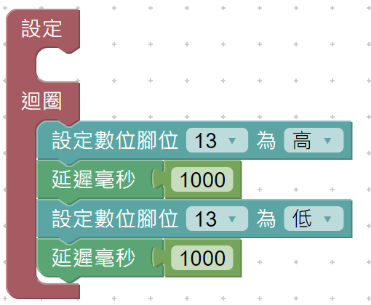
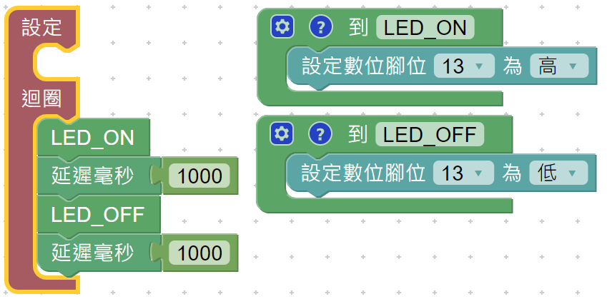
副程式範例-以開關13腳位指示燈為例

Slide 13
void LED_ON() {
digitalWrite(13,HIGH);
}
void LED_OFF() {
digitalWrite(13,LOW);
}
void setup()
{
pinMode(13, OUTPUT);
}
void loop()
{
LED_ON();
delay(1000);
LED_OFF();
delay(1000);
}
開燈副程式
關燈副程式
void setup(){
pinMode(13,OUTPUT);
}
void loop(){
digitalWrite(13, HIGH);
delay(1000);
digitalWrite(13, LOW);
delay(1000);
建立二個指令
LED_ON => 開燈
LED_OFF => 關燈
呼叫副程式(執行指令)

Slide 14
副程式指令格式
void 呼叫名稱() {執行程式碼}
範例:
void LED_ON(){
digitalWrite(13,HIGH);
}
副程式(自建指令)名稱
LED_ON

Slide 15
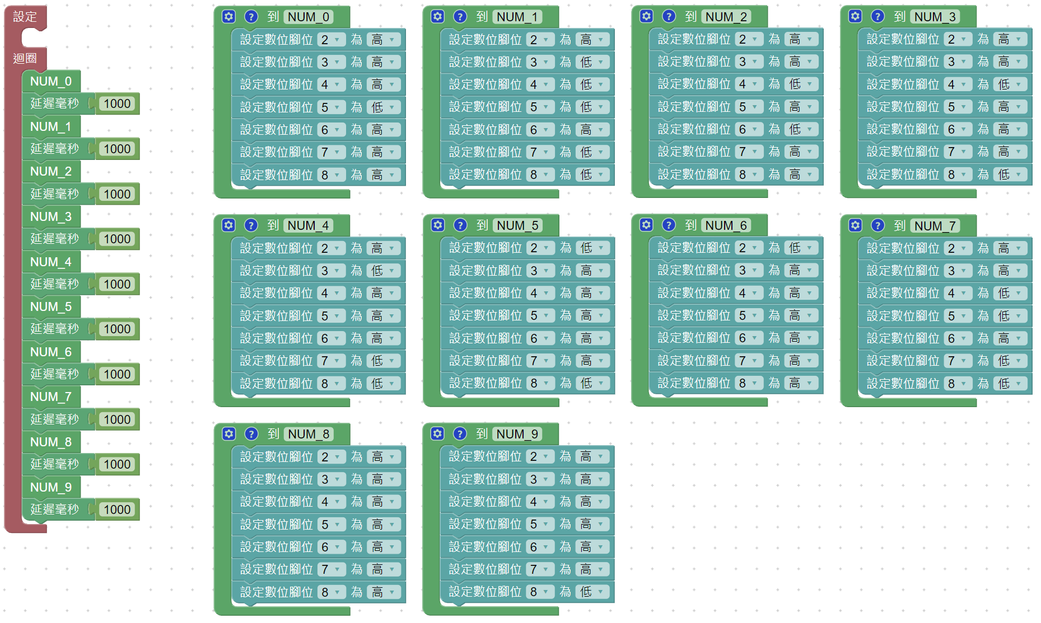
利用副程式改寫顯示0~9數字程式

Slide 16
void NUM_0() {
digitalWrite(2,HIGH);
digitalWrite(3,HIGH);
digitalWrite(4,HIGH);
digitalWrite(5,LOW);
digitalWrite(6,HIGH);
digitalWrite(7,HIGH);
digitalWrite(8,HIGH);
}
void NUM_1() {
digitalWrite(2,HIGH);
digitalWrite(3,LOW);
digitalWrite(4,LOW);
digitalWrite(5,LOW);
digitalWrite(6,HIGH);
digitalWrite(7,LOW);
digitalWrite(8,LOW);
}
void NUM_2() {
digitalWrite(2,HIGH);
digitalWrite(3,HIGH);
digitalWrite(4,LOW);
digitalWrite(5,HIGH);
digitalWrite(6,LOW);
digitalWrite(7,HIGH);
digitalWrite(8,HIGH);
}
void NUM_3() {
digitalWrite(2,HIGH);
digitalWrite(3,HIGH);
digitalWrite(4,LOW);
digitalWrite(5,HIGH);
digitalWrite(6,HIGH);
digitalWrite(7,HIGH);
digitalWrite(8,LOW);
}
void NUM_4() {
digitalWrite(2,HIGH);
digitalWrite(3,LOW);
digitalWrite(4,HIGH);
digitalWrite(5,HIGH);
digitalWrite(6,HIGH);
digitalWrite(7,LOW);
digitalWrite(8,LOW);
}
void NUM_5() {
digitalWrite(2,LOW);
digitalWrite(3,HIGH);
digitalWrite(4,HIGH);
digitalWrite(5,HIGH);
digitalWrite(6,HIGH);
digitalWrite(7,HIGH);
digitalWrite(8,LOW);
}
void NUM_6() {
digitalWrite(2,LOW);
digitalWrite(3,HIGH);
digitalWrite(4,HIGH);
digitalWrite(5,HIGH);
digitalWrite(6,HIGH);
digitalWrite(7,HIGH);
digitalWrite(8,HIGH);
}
void NUM_7() {
digitalWrite(2,HIGH);
digitalWrite(3,HIGH);
digitalWrite(4,LOW);
digitalWrite(5,LOW);
digitalWrite(6,HIGH);
digitalWrite(7,LOW);
digitalWrite(8,LOW);
}
void NUM_8() {
digitalWrite(2,HIGH);
digitalWrite(3,HIGH);
digitalWrite(4,HIGH);
digitalWrite(5,HIGH);
digitalWrite(6,HIGH);
digitalWrite(7,HIGH);
digitalWrite(8,HIGH);
}
void NUM_9() {
digitalWrite(2,HIGH);
digitalWrite(3,HIGH);
digitalWrite(4,HIGH);
digitalWrite(5,HIGH);
digitalWrite(6,HIGH);
digitalWrite(7,HIGH);
digitalWrite(8,LOW);
}
void setup()
{
pinMode(2, OUTPUT);
pinMode(3, OUTPUT);
pinMode(4, OUTPUT);
pinMode(5, OUTPUT);
pinMode(6, OUTPUT);
pinMode(7, OUTPUT);
pinMode(8, OUTPUT);
}
void loop()
{
NUM_0();
delay(1000);
NUM_1();
delay(1000);
NUM_2();
delay(1000);
NUM_3();
delay(1000);
NUM_4();
delay(1000);
NUM_5();
delay(1000);
NUM_6();
delay(1000);
NUM_7();
delay(1000);
NUM_8();
delay(1000);
NUM_9();
delay(1000);
}

Slide 17
現場作業-按鈕計數器
利用按鈕開關及7段數位顯示器做一個可以由0 - 9的計數器

Slide 18
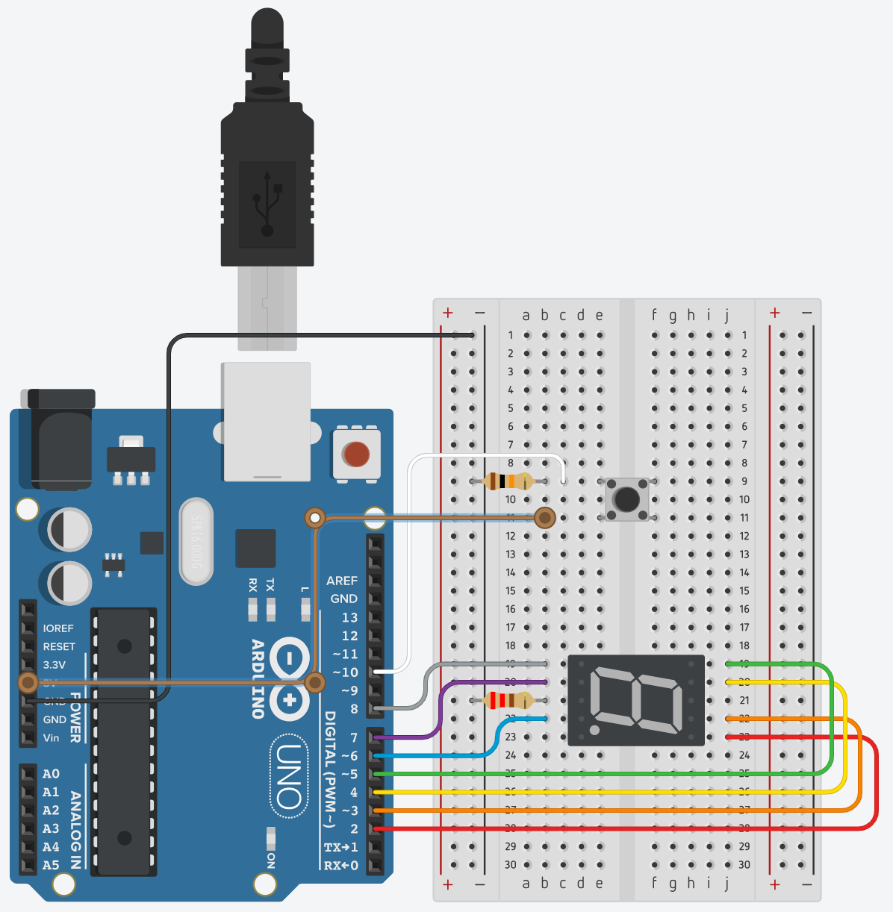
按鈕計數器

Slide 19
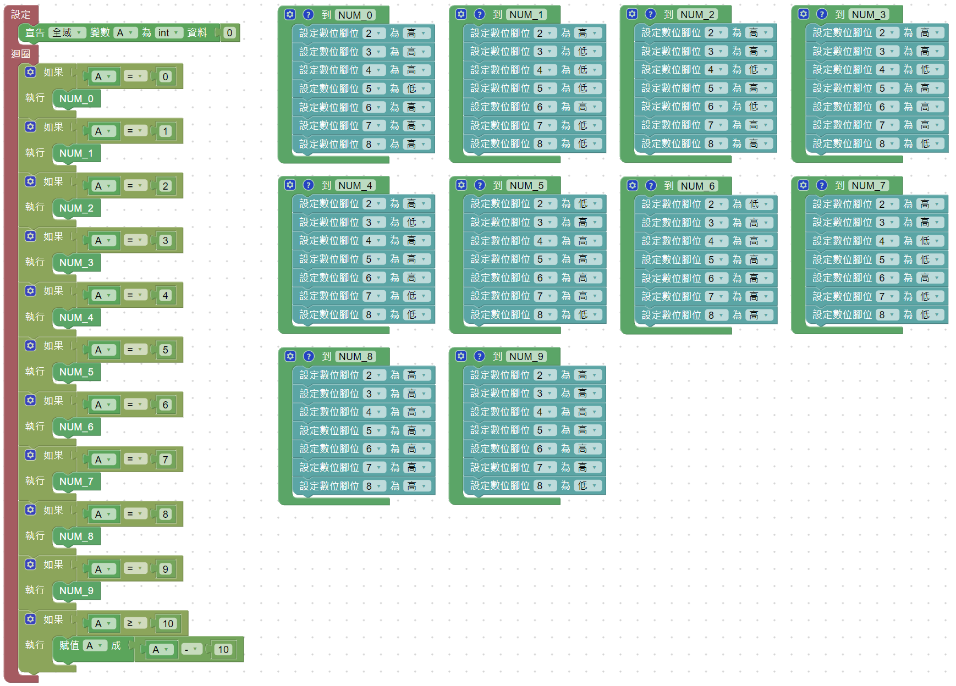

Slide 20
