Slide 1
MATH SUBJECT
fun and proficient learning with Principal Chan

Slide 2
LEARNING OBJECTIVES
Students are expected to be able to understand Mathematics lessons from Khan Academy.
CLASSROOM RULES
Arrive on time
Watch Video Carefully and Listen well
Ask the Questions Anytime
Keep having fun
Do the Exercise and Homework Hard

Slide 3
WELCOME CHILDREN!
Ready for study today?

Slide 4
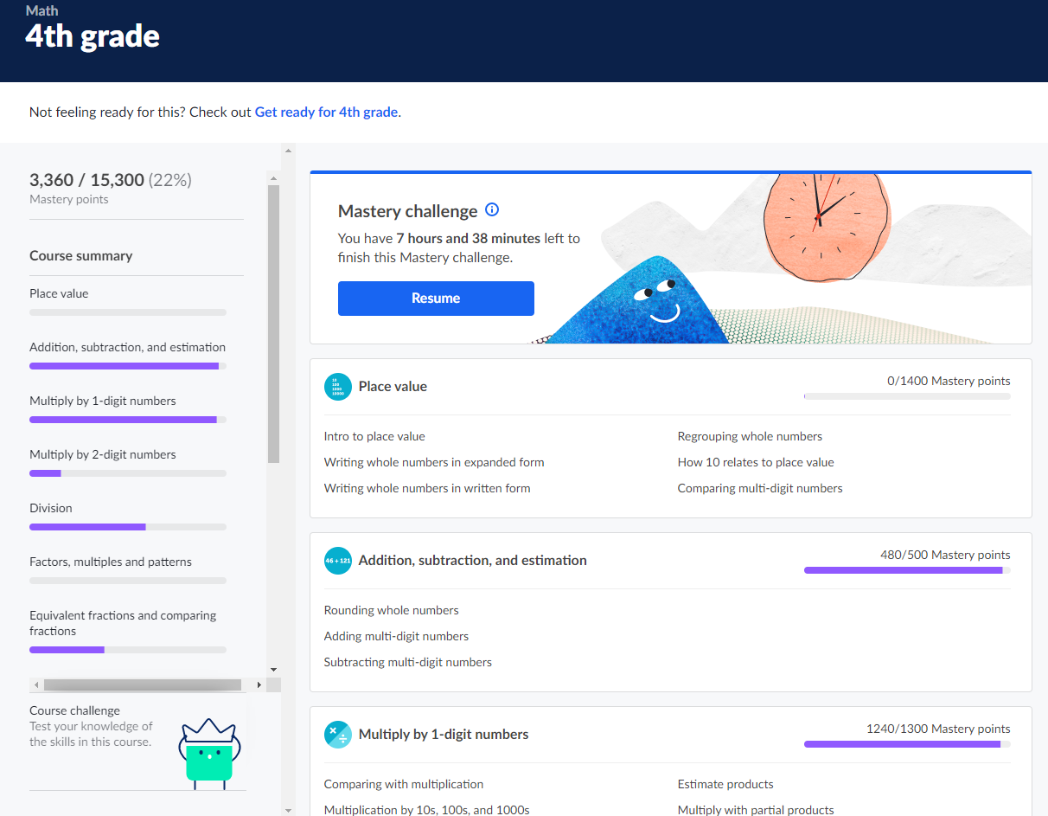

Slide 5
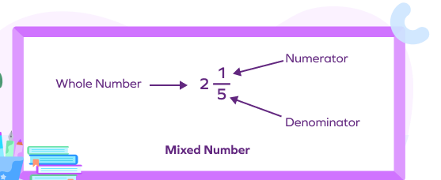
TODAY'S LESSON
IMPROPER FRACTION
MIXED NUMBER
a fraction where the numerator is greater than or equal to the denominator
a number consisting of a whole number and a proper fraction

Slide 6
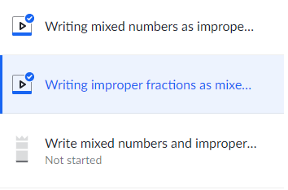
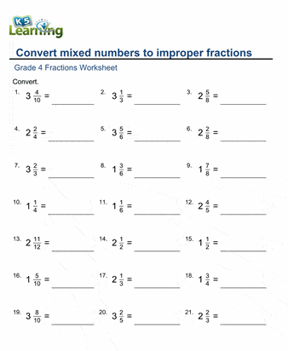
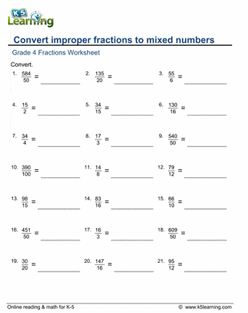
Examples
EXAMPLE 1
EXAMPLE 2
EXAMPLE 3

Slide 7
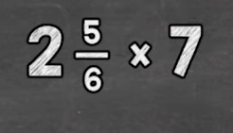
TODAY'S LESSON
HOW
MULTIPLE MIXED NUMBERS
Step 1: Convert the mixed numbers into improper fractions. Step 2: Multiply the two fractions by multiplying the numerators and denominators separately. Step 3: Convert it into simplified form if required.

Slide 8
1 3/5 x 6 = ...
3 1/4 x 8 = ...
STUDENT WORKSHEET
You will do some material related questions just now taught. do it individually in time limit already determined.
3. 6 2/18 x 6 = ...
4. 9 2/7 x 5 = ...
5. 11 4/5 x 5 = ...
6. 7 3/4 x 4 = ...

Slide 9
WORK AT HOME, YES!
Learn the next material at home and do the practice questions in the book shared exercises specified part.

Slide 10
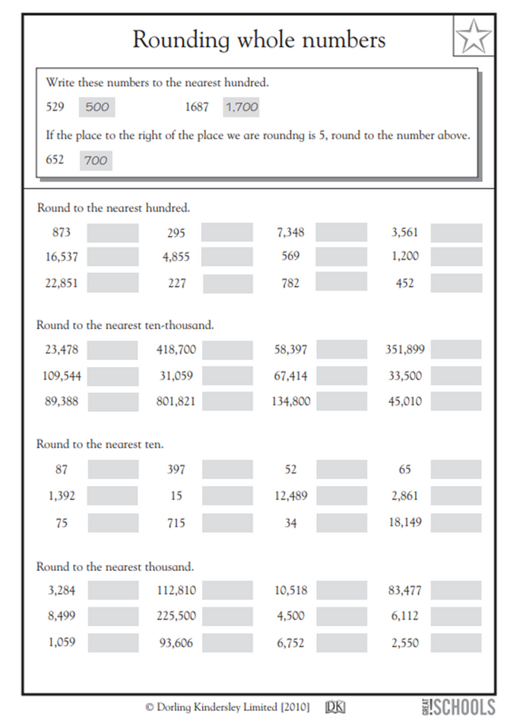
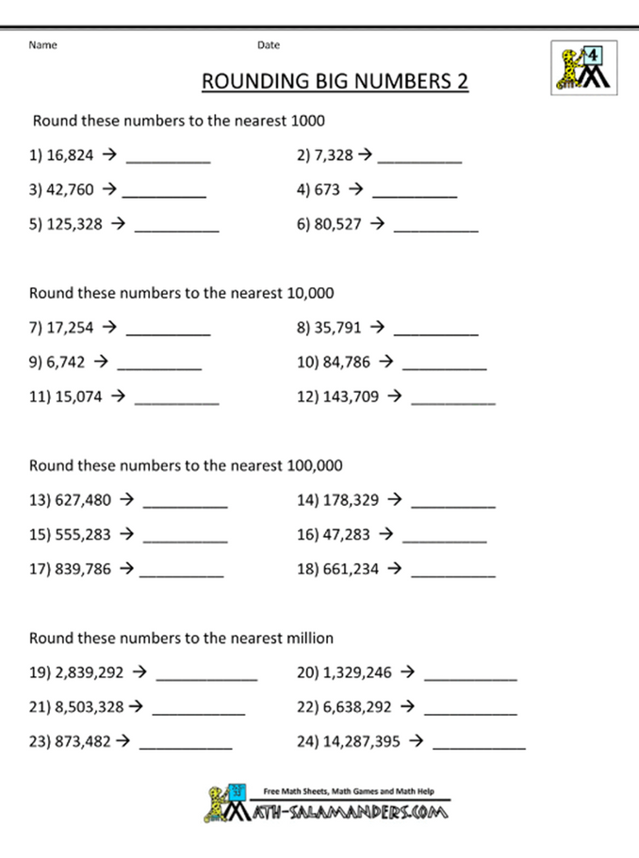
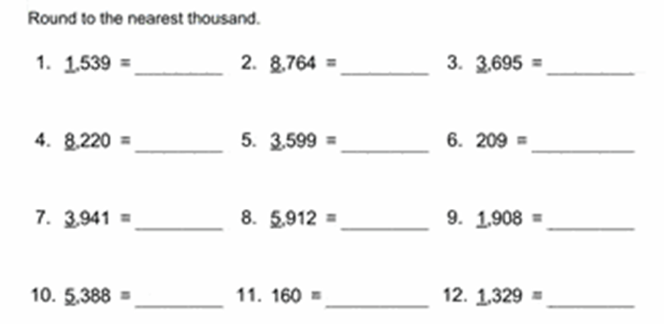
Examples
EXAMPLE 1
EXAMPLE 2
EXAMPLE 3

Slide 11
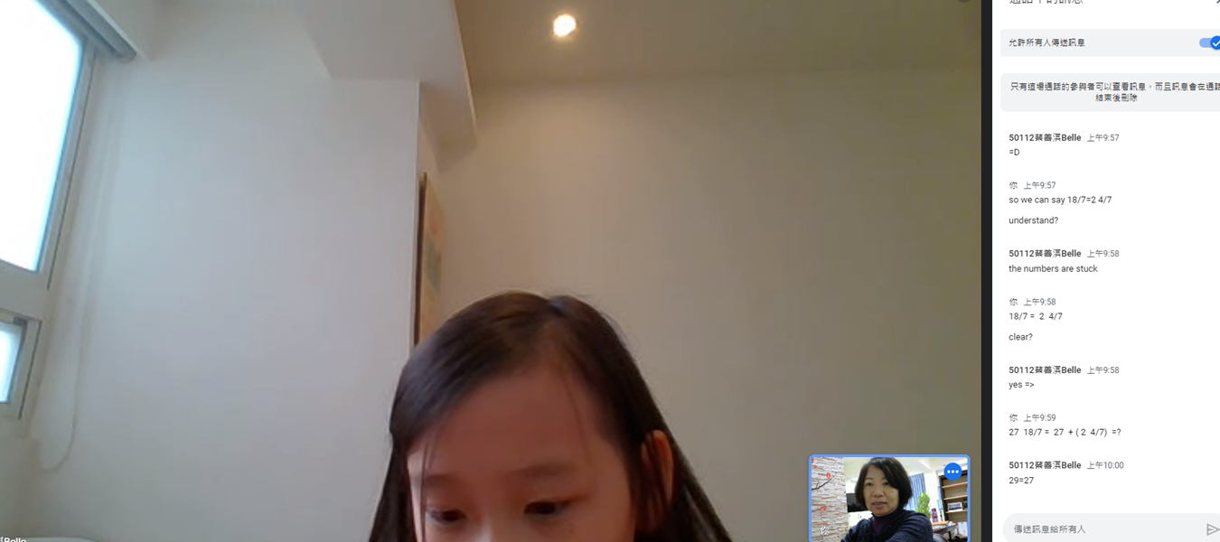

Slide 12
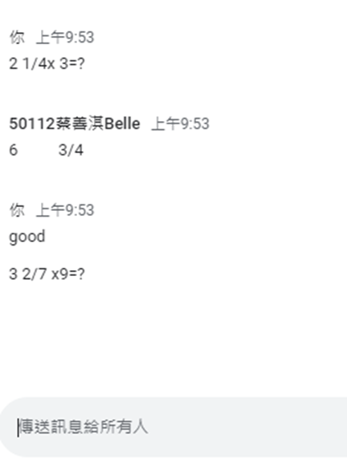
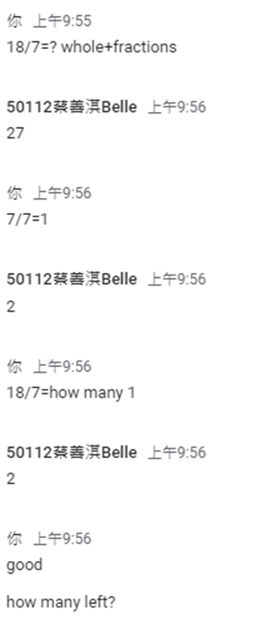
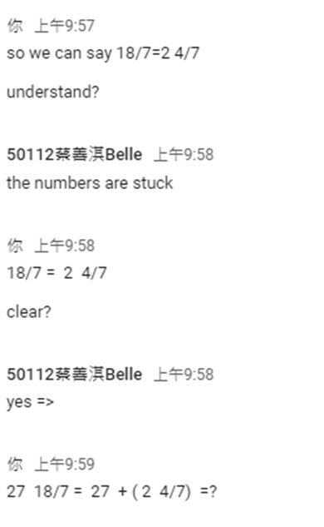
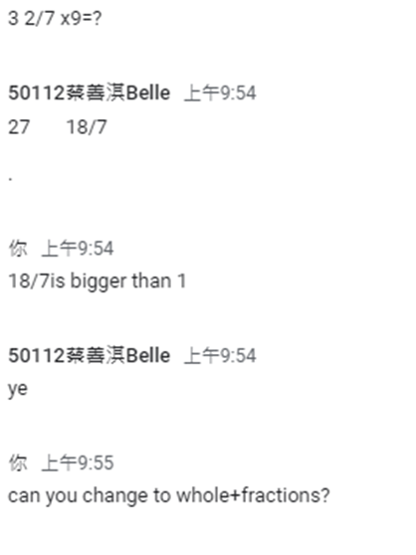

Slide 13
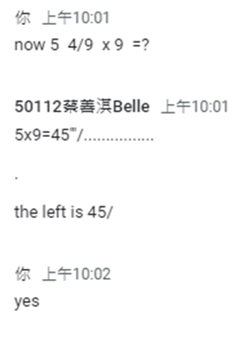
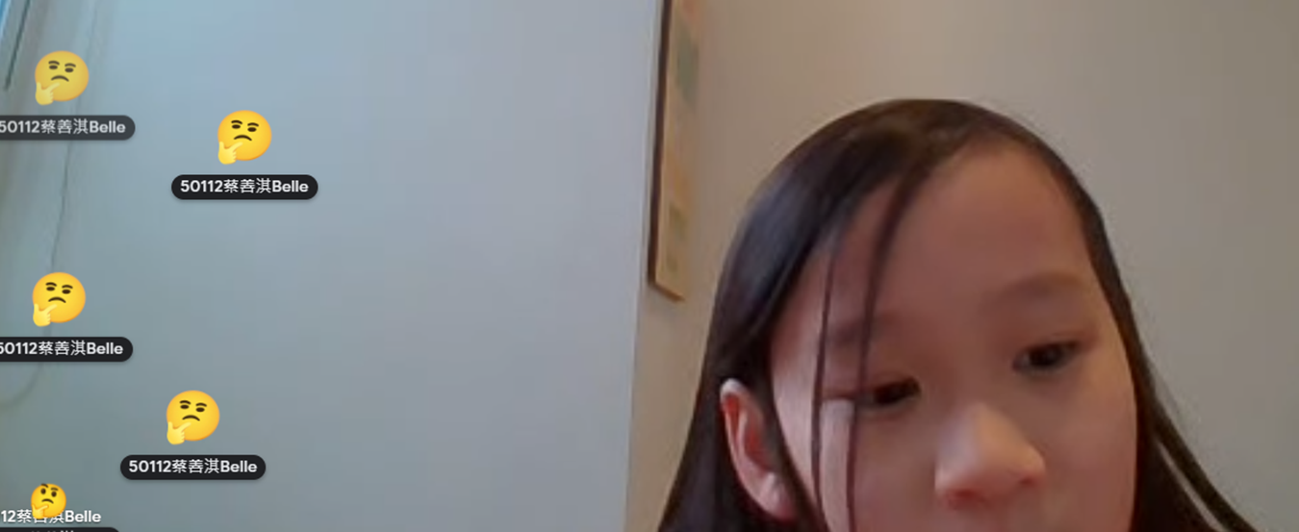

Slide 14
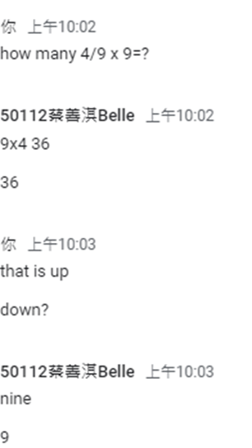
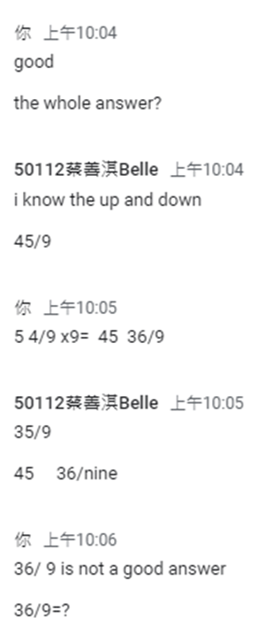
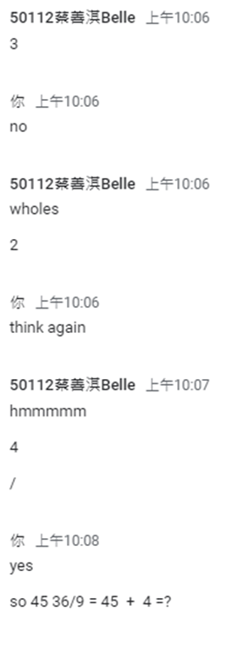
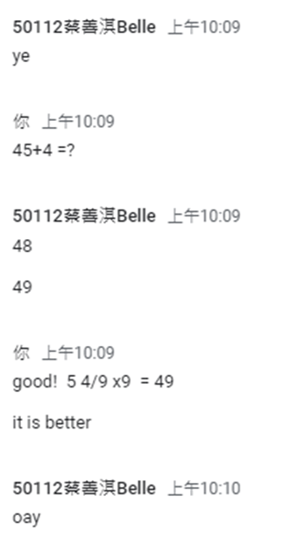

Slide 15
