Slide 1
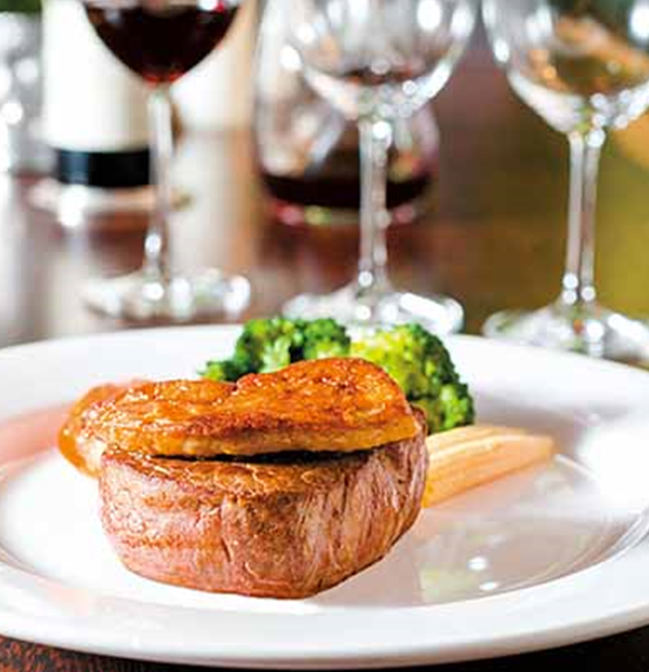
西 餐 禮 儀 western manners
日期Date: 112.06.12-112.06-16
講師Lecturer:羅安琴Lo An-Chin
協同教師Co-lecturer:
王國成Wang Kuo-Chen
王堯君 Brian

Slide 2
當你是主人時-西餐的標準作業流程SOP When you are the host - the standard operating procedure SOP of western food
為了確保每位賓客都能得到一致的服務品質，餐廳通常會訂定一套標準作業流程 (Standard Operation Procedures，SOP)
訂位 Reservation
服裝 Dressing
帶位入座 Take a seat
鋪口布 spread napkin
點餐 Order
用餐
Meals
結帳 Checkout

Slide 3
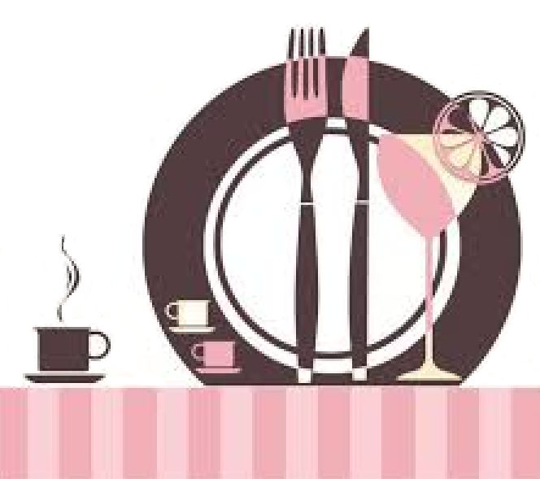
訂位 Reservation
首先要決定餐廳--西餐分類
西餐一般以刀叉為餐具，以麵包為主食，桌子多為長形桌台。
西餐的主要特點是主料突出，形色美觀，口味鮮美，營養豐富，供應方便等。
1.法式大餐－西菜之首。
The first of Western dishes - French cuisine
2. 英式西餐-簡潔與禮儀並重。
Both simplicity and etiquette-British western food
3. 意式大餐-西菜始祖。
The Ancestor of Western Cuisine-Italian Feast
4. 美式菜餚-營養快捷。
Fast nutrition - American cuisine
5. 俄式大餐-西菜經典。
Classic Western Cuisine-Russian Cuisine
6.德式菜餚-啤酒、自助。
Beer , buffet - German dishes

Slide 4
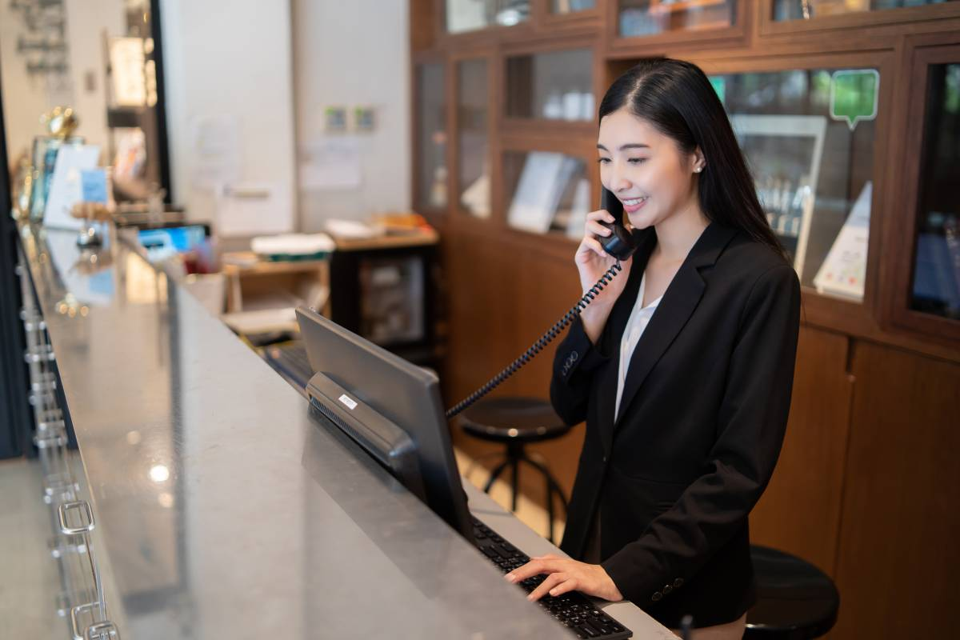
訂位 Reservation
1.選定餐廳的形式
2.預約用餐的日期及時間
3.告知用餐人數
4.留下聯絡電話及聯絡人
5.告知特殊需求
絕對要養成預定的好習慣，不想去了也要提前取消。
1.Form of selected restaurant
2.Date and time of meal reservation
3.Inform the number of diners
4.Leave a contact number and contact person
5.Advise on special needs

Slide 5
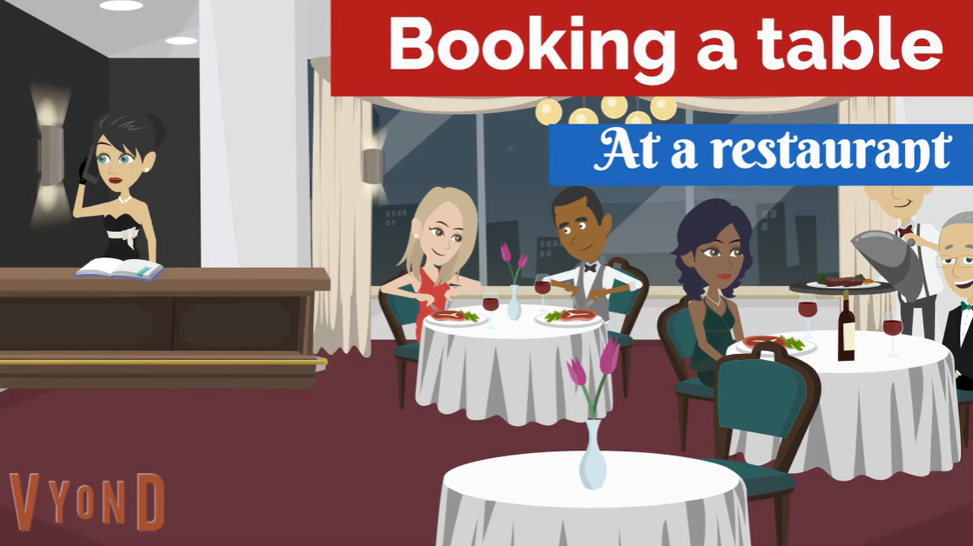
英語會話:At a restaurant. Booking a table

Slide 6
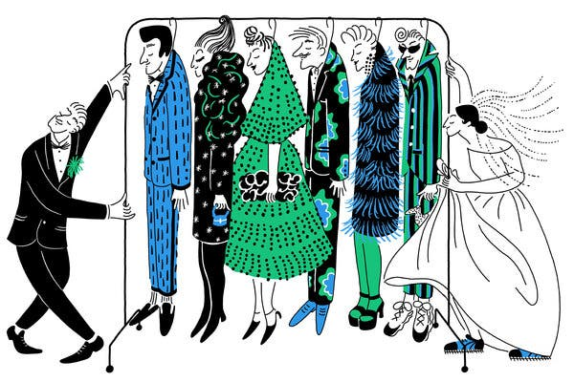
服裝 Dressing
Dress code 的中文意思就是指穿著規定、穿著規範的意思。
西方人對於服裝的要求極為慎重，馬克吐溫曾經說過：「衣服造就一個人」Clothes make the man﹒）。
Westerners are extremely cautious about clothing requirements. Mark Twain once said: "Clothes make the man." (Clothes make the man.).
不論是正式或非正式場合的餐會中，一旦接獲邀請，務必要留心邀請函上的穿衣原則（dress code）。
once you receive an invitation, you must pay attention to the dress code on the invitation letter.

Slide 7
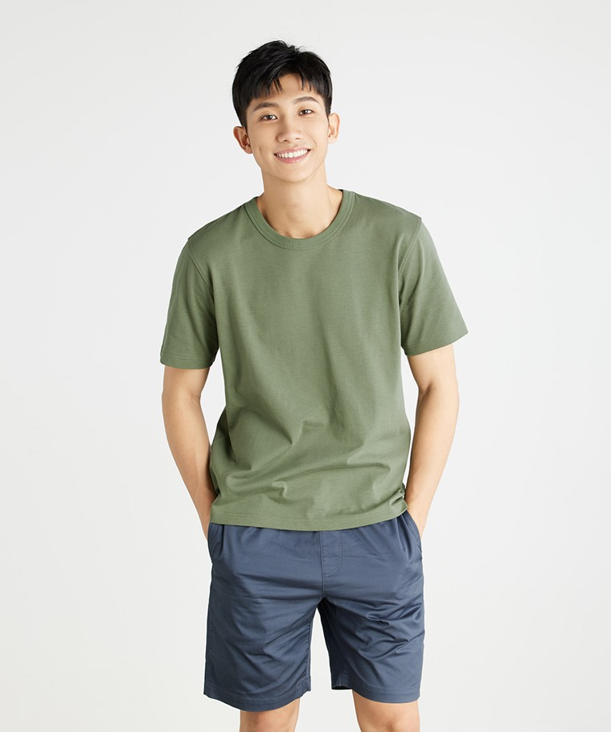
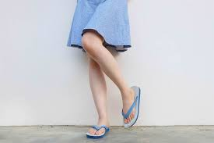
共通禁忌：無論男女都不要穿 T 恤、短褲、露腳趾的鞋子（夏天或搭配禮服時，女性高跟涼鞋除外）。
Common taboos: No T-shirts, shorts, open-toed shoes (except women’s high-heeled sandals in summer or with dresses) for both men and women.

Slide 9
Dress code
Semi-formal
Tuxedo 晚禮服 –無燕尾
* 燕尾服（英語：tailcoat）--有燕尾
Overdressing
underdressing
Dark suit
Nice tie
Business casual
Cocktail dress

Slide 10
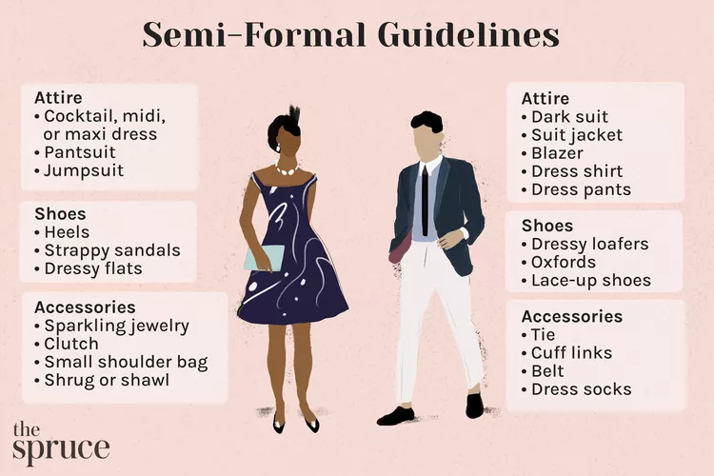

Slide 11
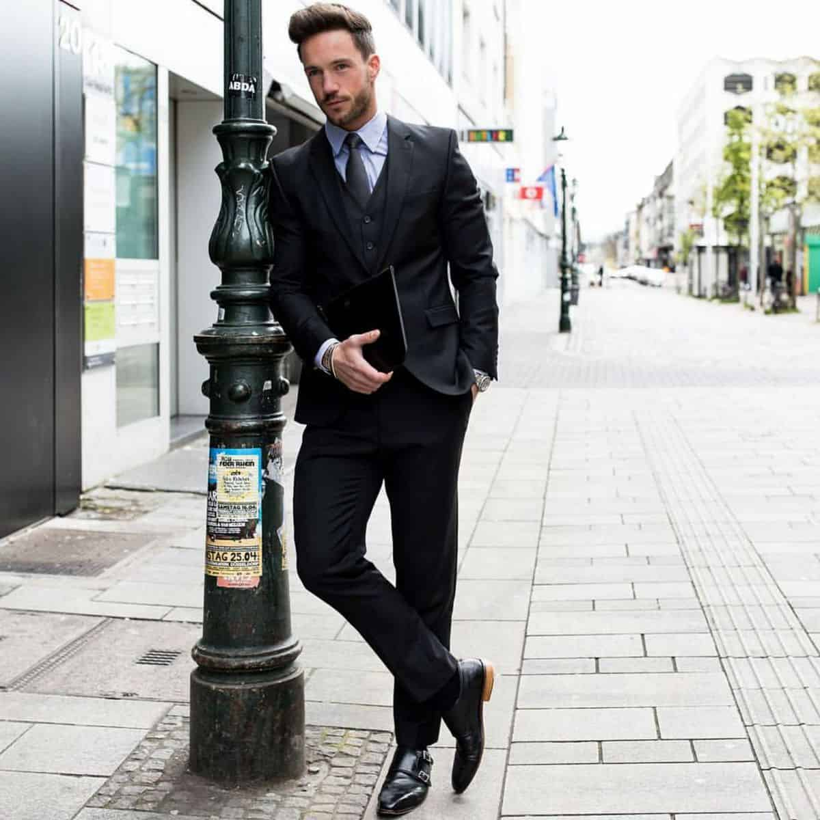

Slide 12
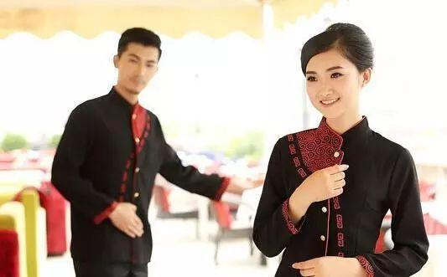
帶位入座 Take a seat
和女性朋友約會的時候，「女性優先」的觀念很重要。
用餐的時候女性應該坐「上位」，也就是可以看到整個用餐環境的位子。
When dating female friends, the concept of "women first" is very important.
Women should sit in the "upper seat" when dining, that is, the seat where you can see the entire dining environment.

Slide 13
英語會話:At the Restaurant :Reservation Table 0:34-02:35

Slide 14
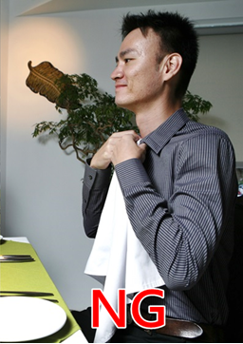
鋪口布 spread napkin
口布就是用來擦拭嘴上髒污或是清潔手指。
口布正確的使用方法應該鋪在大腿上，絕對不可以像圍兜兜一般使用！
Mouth cloth can be used to wipe the dirt on the mouth or clean the fingers with confidence.
The correct way to use the mouth cloth should be spread on the thighs。

Slide 15
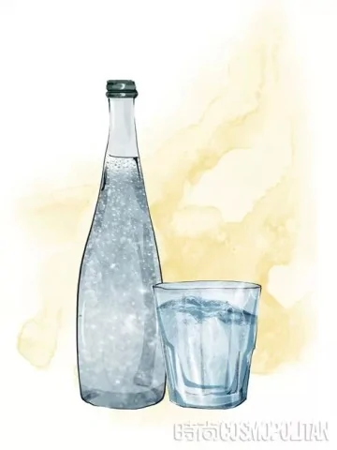
西餐廳一般不提供免費的水，要知道，水是完美一餐的一部分，服務員會問你，still or sparkling(沒有氣泡的水還是氣泡水)?

Slide 16
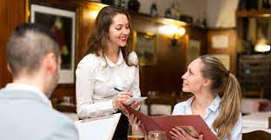
點餐 Order
菜單先給女士後給男士；若服務生忘了先給男士，男士則要馬上遞給女士。
可先討論菜單；男士先問女士可否點餐了，再請服務生點餐。
Give the menu to the ladies first and then the men; if the waiter forgets to give it to the men first, hand it to the women immediately.
You can discuss the menu first; the men ask the women if they can order first, and then ask the waiter to order.

Slide 17
英語會話:At the Restaurant : Order Food 4:24-06:13

Slide 18
點餐-西餐出餐順序 The usual order of serving western food is
1.開胃菜(Appetizers)
2.沙拉(Salad)
3.湯(Soup)
4.麵包(Bread)
5.副菜(side dish)
主菜(Main Course)
6.點心(Dessert)
7.水果(Fruit)
8.飲料(Beverages)

Slide 19
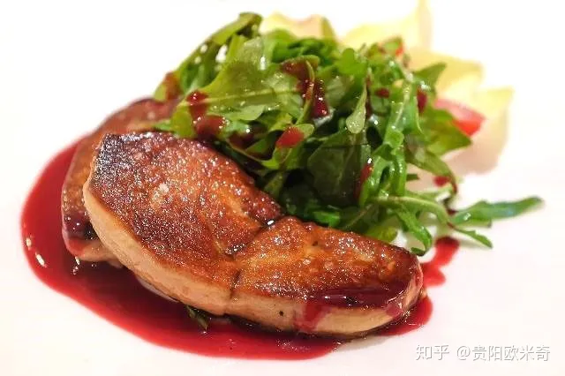
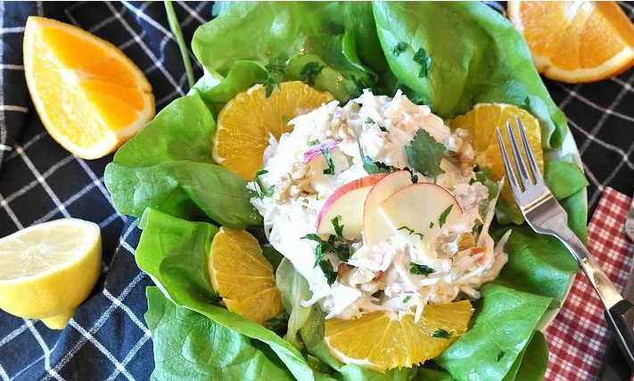
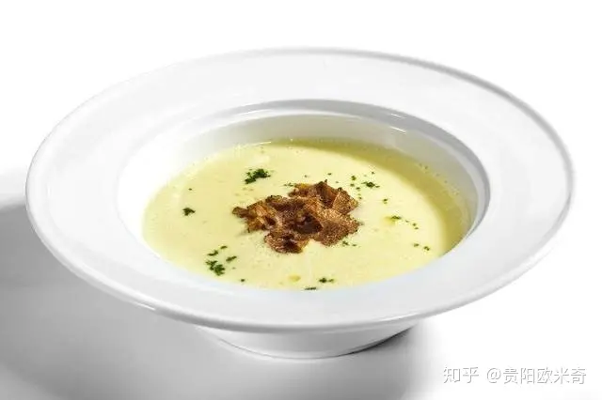
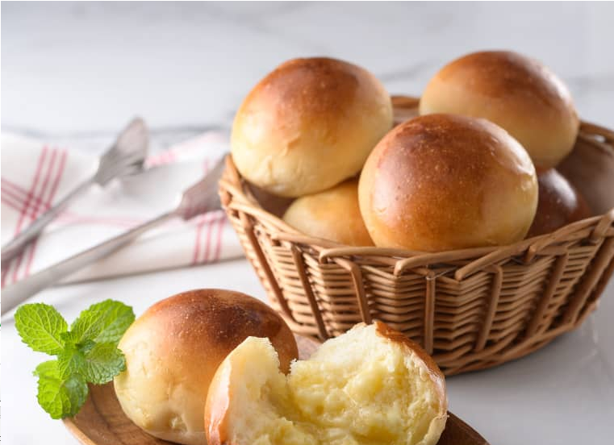
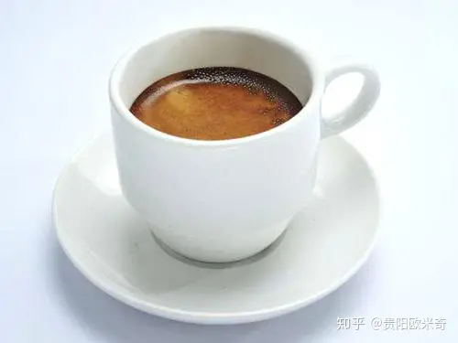
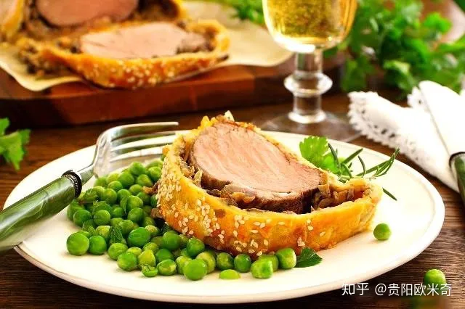
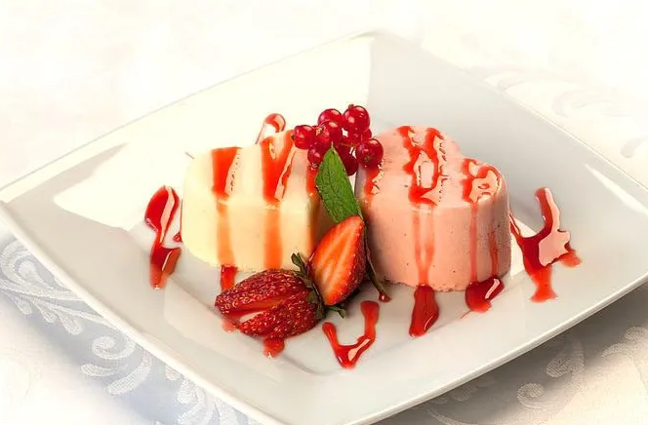
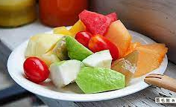
西餐出餐順序
(Appetizers)
(Salad)
(Soup)
(Bread)
(Main Course)
(Dessert)
(Fruit)
(Beverages)
https://slidesplayer.com/slide/11239915/

Slide 20
用餐Meals 一、開胃菜(Appetizers)
開胃菜的目的是刺激味蕾、增加食慾。
The purpose of appetizers is to stimulate our taste buds and increase appetite.

Slide 21
用餐Meals 二、沙拉(Salad)
沙拉多已可以直接生吃的蔬菜為主。
Salad are composed of vegetables that can be eaten raw.

Slide 22
用餐Meals 三、湯 (Soup)
西餐中的湯有冷湯、清湯、奶油湯、蔬菜湯四大類。
There are four types of soup in Western food: cold soup, clear soup, cream soup, and vegetable soup.

Slide 23
用餐Meals 四、麵包 (Bread)
若麵包籃上裝著多款麵包，吃麵包的食用次序應是先吃奶油麵包條、法國麵包、小圓甜麵包，最後是帶堅果的麵包。
If there are multiple types of bread in the bread basket. The order of consumption should be brioche bread sticks, baguettes, sweet buns and finally bread with nuts .

Slide 24
用餐Meals 五、副菜(side dish)
西餐中的副菜通常是海鮮和雞肉，因為烹煮後其為白色，所以副菜又稱為白肉。
The side dishes in Western food are usually seafood and chicken, because they are white after cooking, so the side dishes are also called white meat.

Slide 25
用餐Meals 五、主菜 (Main Course)
主菜是西餐的門面，同時也展現主人的品味與涵養，西餐中的主菜多以精緻的肉類為主。
The main course is the facade of Western food. The main dishes in Western food are mostly exquisite meat dishes, and they often represent the level and grade of a meal.

Slide 26
拿高腳酒杯的時候應該拿著杯腳位置，這樣拿不會讓手的溫度影響到酒的口感，但拿水杯則沒這個顧慮。
https://kknews.cc/zh-hk/news/kvyjr6v.html

Slide 27
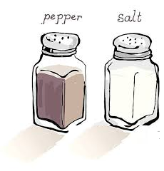
鹽和胡椒則只在有人問起的時候才傳，即使別人問的只是「Would you please pass the salt (/pepper) ?」 也應該將鹽和胡椒兩樣一起傳；可以放在自己右邊桌上的空位上，等坐在右邊的人自己拿起，這樣不容易出現接不好的意外。
https://kknews.cc/news/kvyjr6v.html

Slide 28
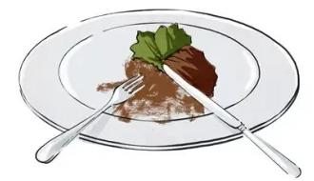
尚未吃完要暫時離席時
Is not finished and you want to leave the table for a while
https://tw.pixtastock.com/illustration/77563092

Slide 29
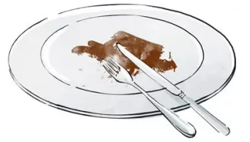
已經吃完要侍者收走時
Is finished and the waiter has to take it away
https://tw.pixtastock.com/illustration/77563303

Slide 30
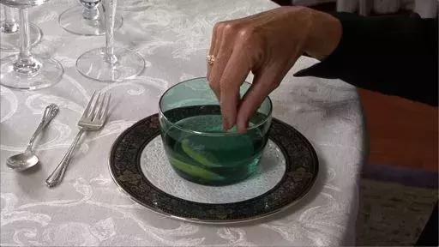
在高級餐廳里，在吃完主菜後和上點心之前，服務員會上一小碗水（水裏通常還有一小片檸檬），叫洗指盅「finger bowl」。
通常是在一個碟子上鋪一塊紙巾，然後再在上面放這個水碗，這是給客人淨手用的。
使用方法是單手稍微搓洗，然後將手拿到大腿上的餐巾上擦乾。
洗手之後應該雙手將紙巾連同水碗拿開放到左上角（原來放麵包碟的位置），等服務員過來收走。
洗指盅內的水切勿拿來飲用。
https://kknews.cc/news/kvyjr6v.html

Slide 31
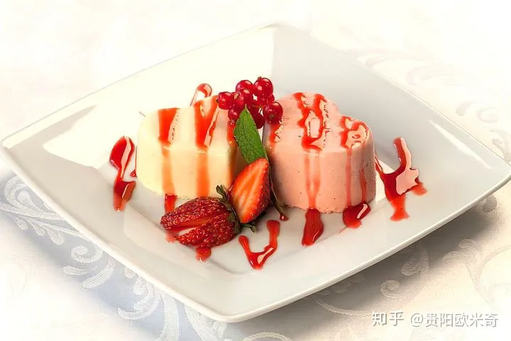
用餐Meals 六、點心 (Dessert)
在幾世紀前的歐洲，用餐尾聲的甜品是宴請賓客的最高禮遇，這一點在西餐的傳承就被保留下來。
Desserts are mainly composed of sugar, which was once a very luxurious food in Europe. Therefore, in Europe several centuries ago, the dessert at the end of a meal was regarded as the highest courtesy for entertaining guests, and this point has been preserved with the inheritance of Western food.

Slide 32
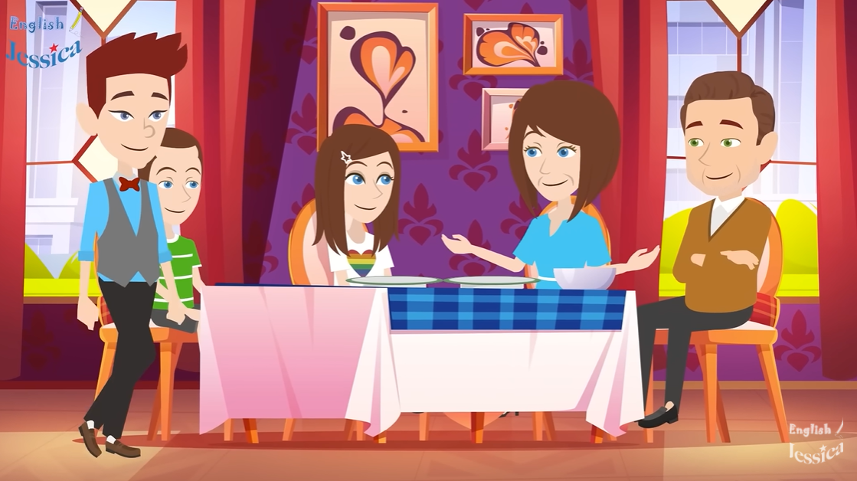
英語會話:At the Restaurant : Order a Dessert 6:24-07:50

Slide 33
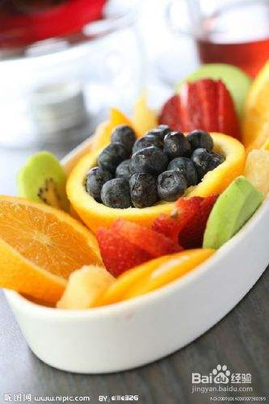
用餐Meals 七、水果(Fruit)
水果用小勺吃即可，水果的果殼不能直接吐出來。
The fruit can be eaten with a small spoon, and the fruit shell cannot be spit out directly.

Slide 34
用餐Meals 八、飲料 (Beverages)
飲料通常被視為此次用餐結束的暗示。一杯熱乎乎的飲品是西餐的壓軸戲，目的是幫助消化。
正宗的西餐選用的是黑咖啡或是紅茶，在美國不少西餐廳，黑咖啡是可以免費續杯的。
Hot drinks are usually seen as a sign of the end of a meal.
Authentic western food uses black coffee or black tea. In many western restaurants in the United States, black coffee can be refilled for free.

Slide 35
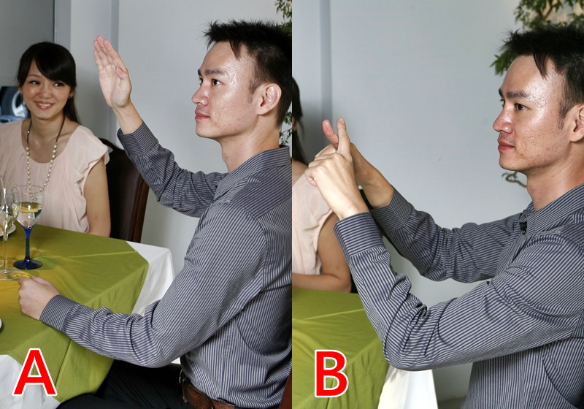
結帳 Checkout
如果想買單，可以圖B的方式向服務生示意，這是全世界通用的肢體預言！
"If you want to pay the bill, you can signal to the waiter in the way of picture B. This is a body prophecy that is common all over the world.

Slide 36
英語會話:At the Restaurant : Pay the Bill 8:00-09:50

Slide 37
英語會話:At the Restaurant : Customer’s feedback 08:00-09:50

Slide 38
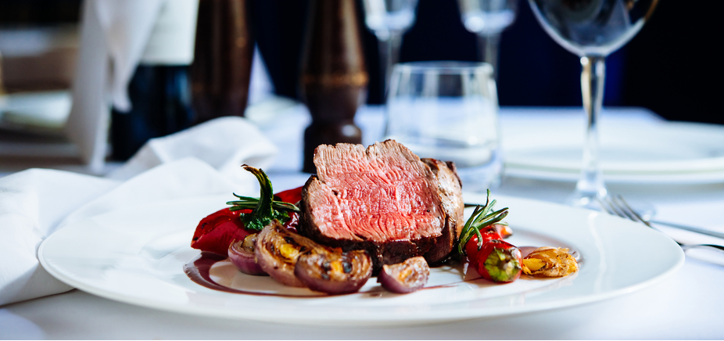
關於牛排 About of steak
https://wushare.tw/articles-how-to-order-steak/

Slide 41
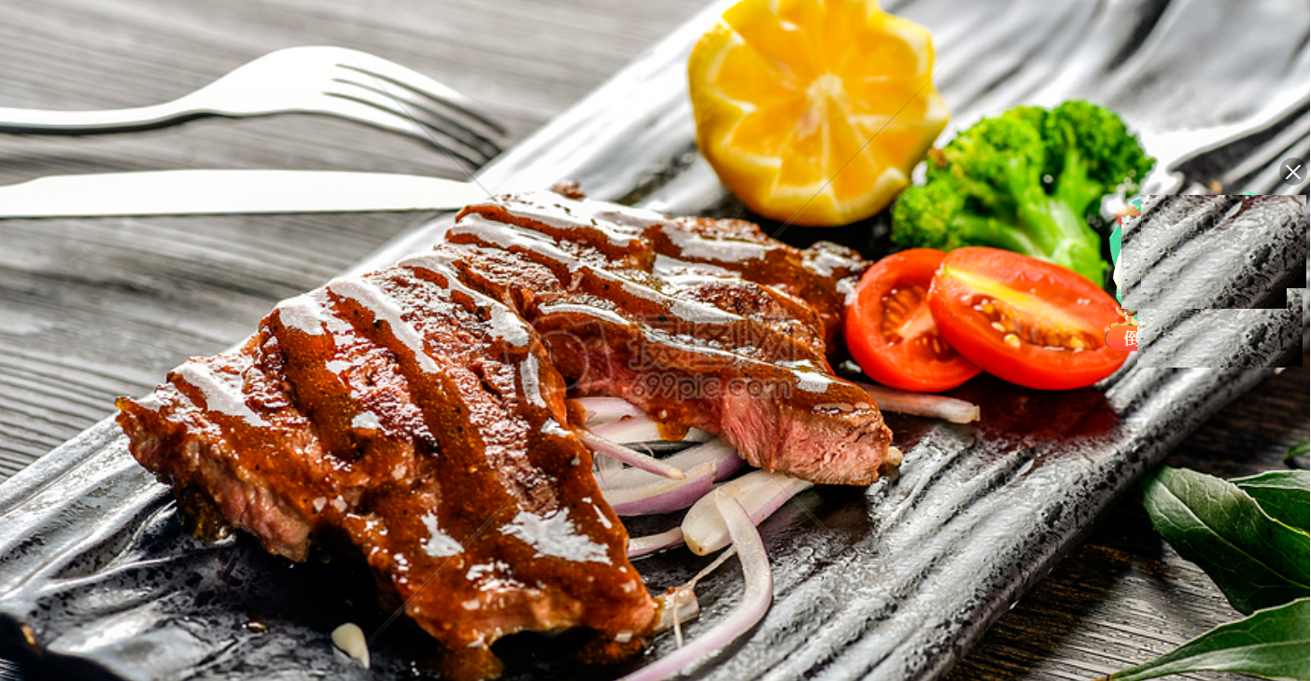
6/16
吃西餐-實作
Eat western food
6/12

Slide 42
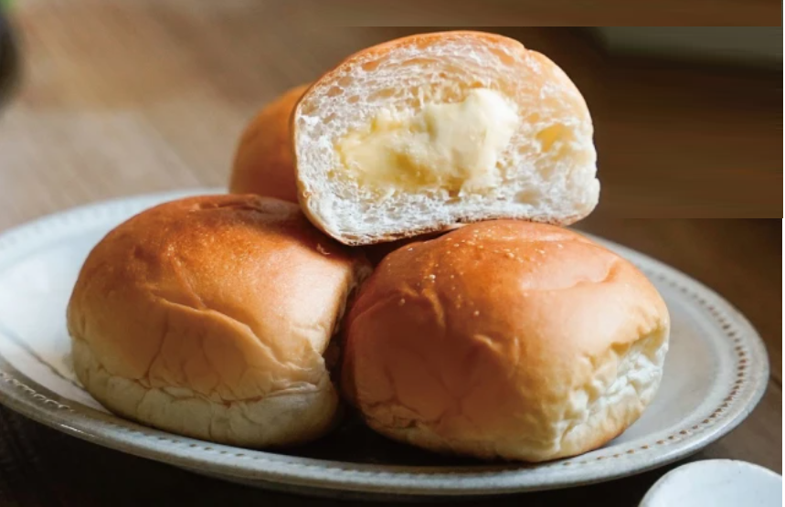
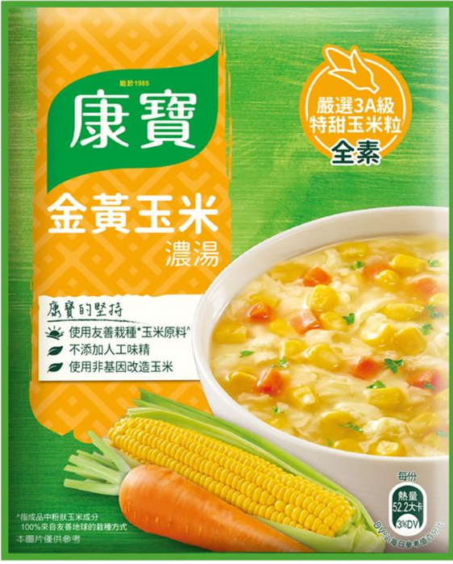
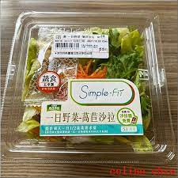
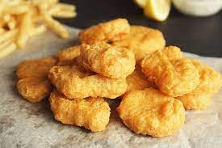
A.實作 Practice
1.烤麵包-現成的小餐包 Baked Bread - Ready-made Meal Kits
2.煮湯-康寶濃湯 Soup - Campbell's Soup
3.沙拉-分食現成的沙拉 Salads – share ready-made Salads
4.炸雞塊-現成的雞塊 Chicken Nuggets – fried chicken nuggets
B.學習西餐禮儀 Learn western food manners

Slide 43
1. Napkin in your lap

Slide 44
2. Wait your turn to talk

Slide 45
3. Elbows off the table and sit up tall

Slide 46
4. Use your indoor voice

Slide 47
5. Use please and thank you

Slide 48
6. Food to mouth . Not mouth to food.

Slide 49
7. Chew with your mouth closed.

Slide 50
8. Take “just right” bites.

Slide 51
9. Don’t complain about the food.

Slide 52
10. Take up your dishes when finished eating.

