Slide 1
111-1 八年級彈性課程
銘心繪
- Play with the Letters I -

Slide 2

Attitude
態 度
Determines Everything
決定一切

Slide 3
813 is the BEST team
Group | G1 | G2 | G3 | G4 | G5 | G6
No. | ? | 40 | 4 | 10 | 45 | 41
No. | 3 | 1 | 34 | ? | ? | 13
No. | ? | ? | ? | 12 | 7 | ?
No. | 37 | 9 | ? | 31 | 5 | 32
No. | 39 | 14 | 6 | 0 | 44 | 0
Total | 126 | 97 | 89 | 91 | 143 | 94

Slide 4
813 is the BEST team
Group | G1 | G2 | G3 | G4 | G5 | G6
No. | 11 | 40 | 4 | 10 | 45 | 41
No. | 3 | 1 | 34 | 38 | 42 | 13
No. | 36 | 33 | 2 | 12 | 7 | 8
No. | 37 | 9 | 43 | 31 | 5 | 32
No. | 39 | 14 | 6 | 0 | 44 | 0
Total | 126 | 97 | 89 | 91 | 143 | 94

Slide 5

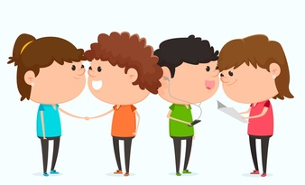



4-Be Rules
#1 Be respectful
#2 Be kind
#3 Be responsible
#4 Best teamwork

Slide 6


Slide 7


Slide 8


Tomorrow’s Alphabet
Notes:
1. Work of 4
2. Have one person get a whiteboard and a marker
3. Figure out the rules through the following two examples

Slide 9
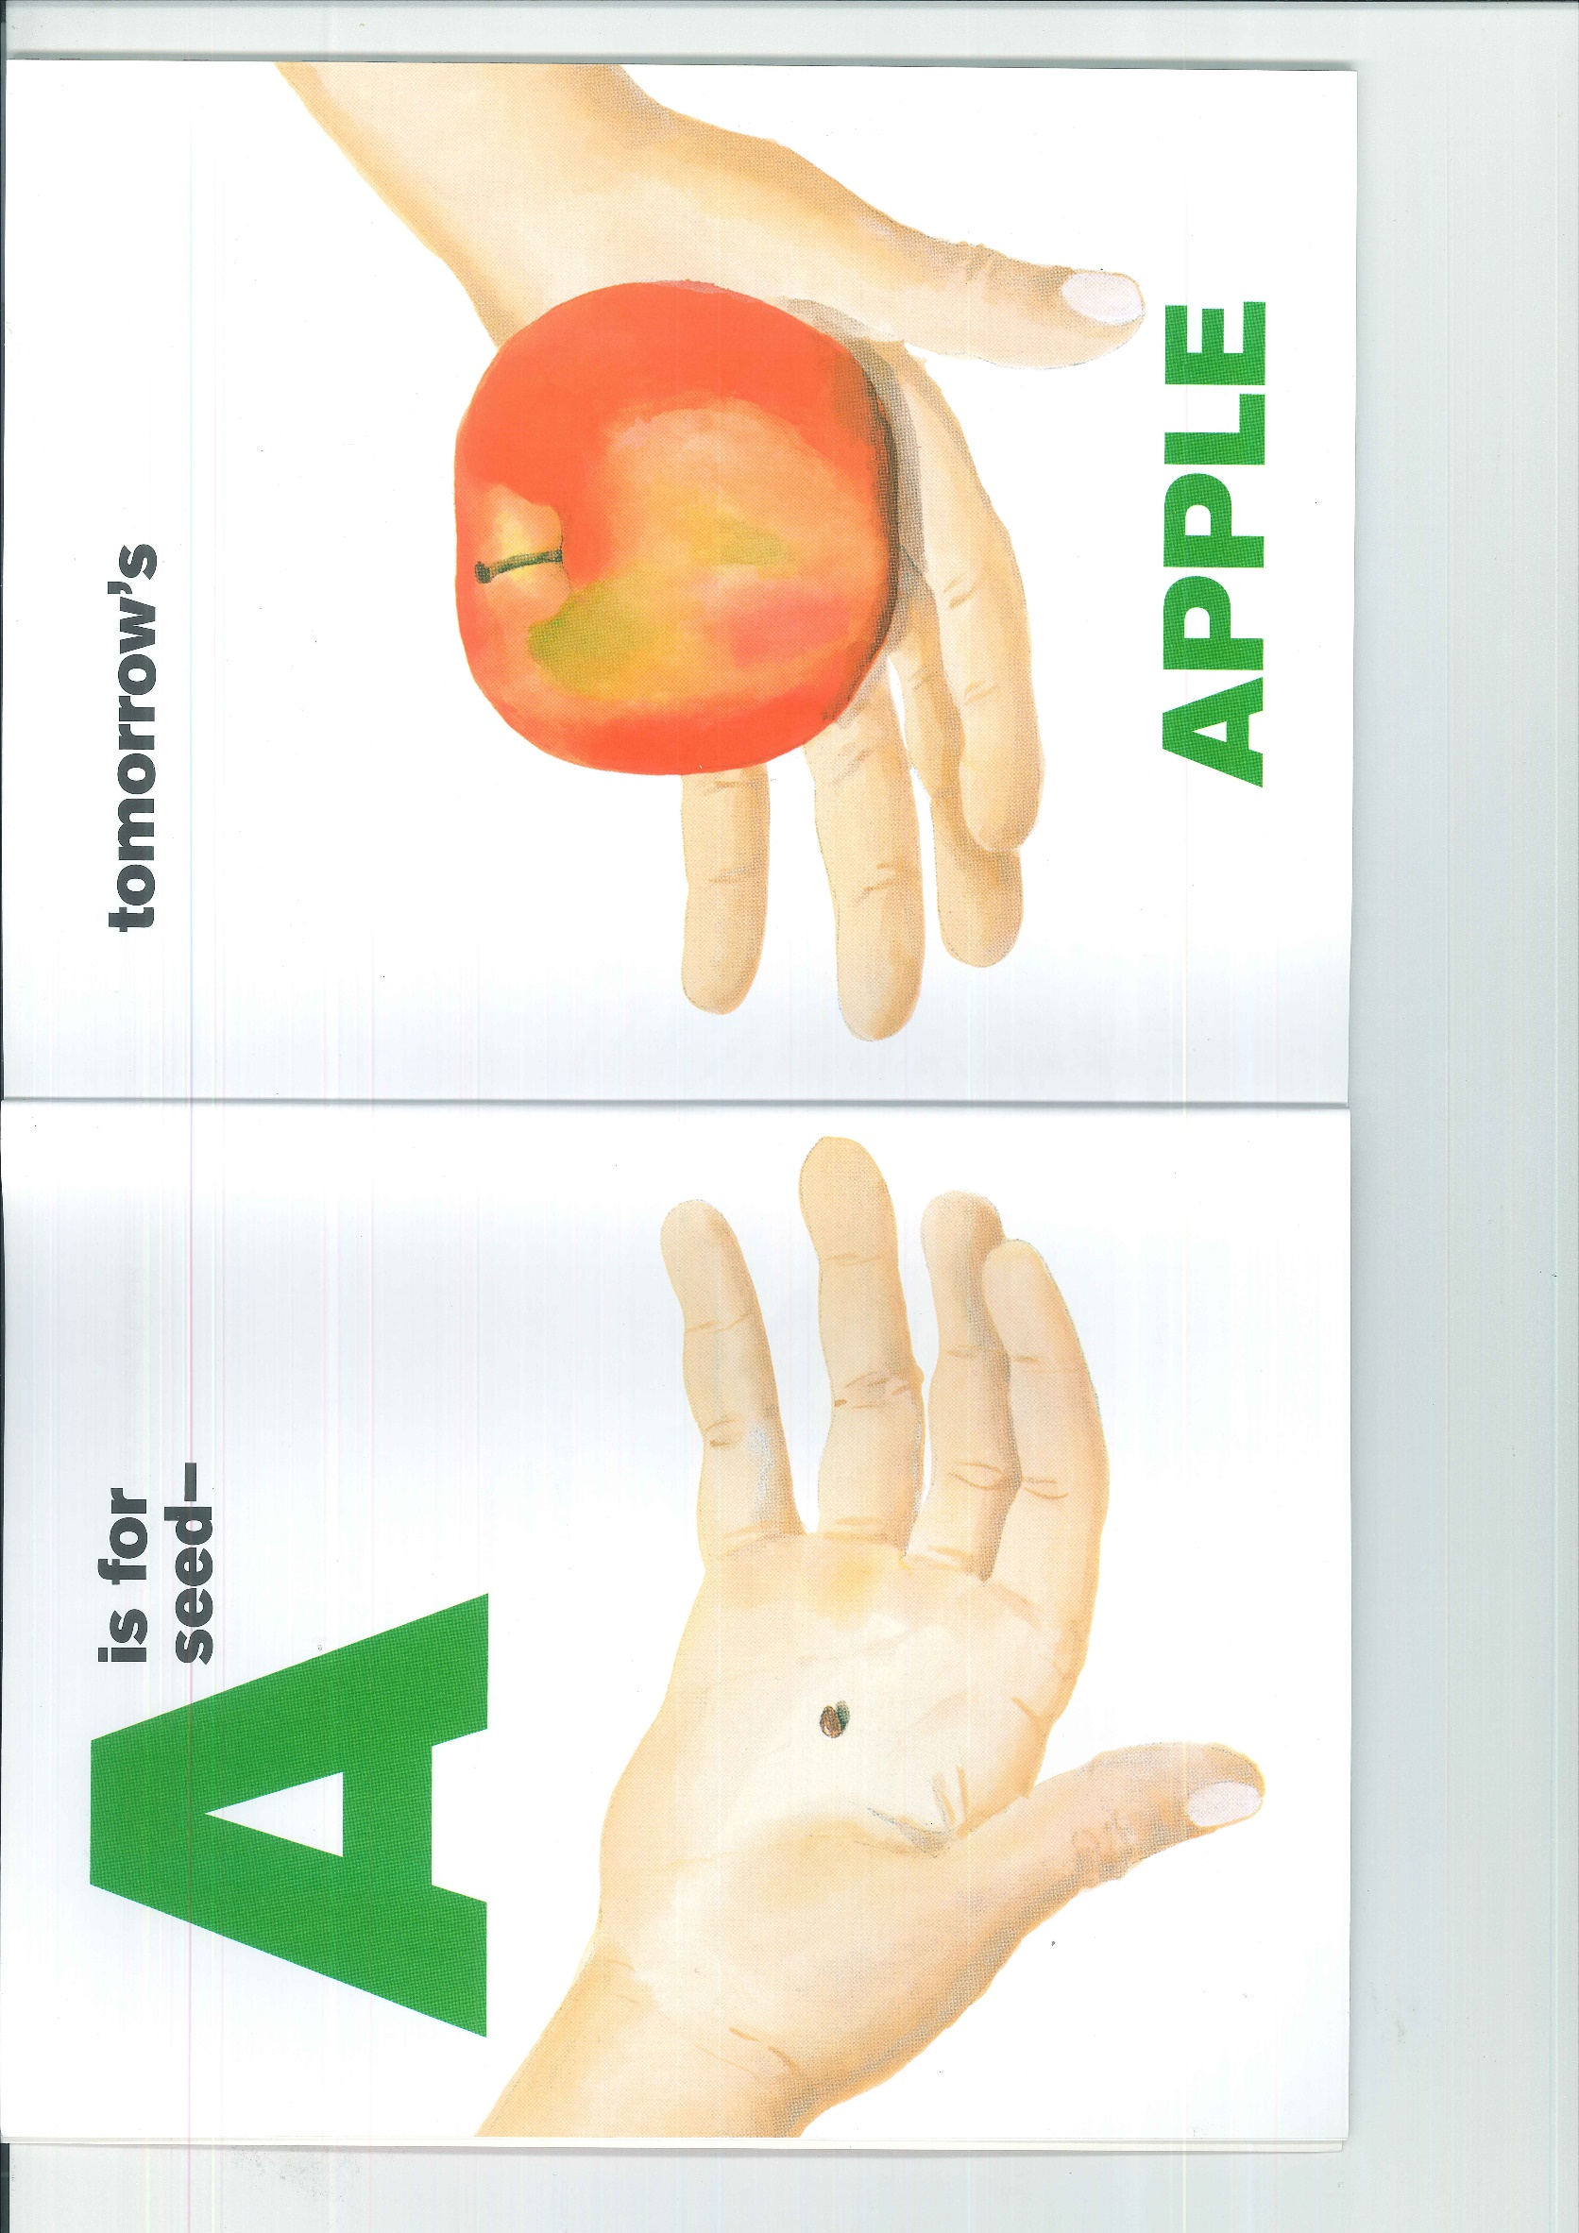

Slide 10


Slide 11
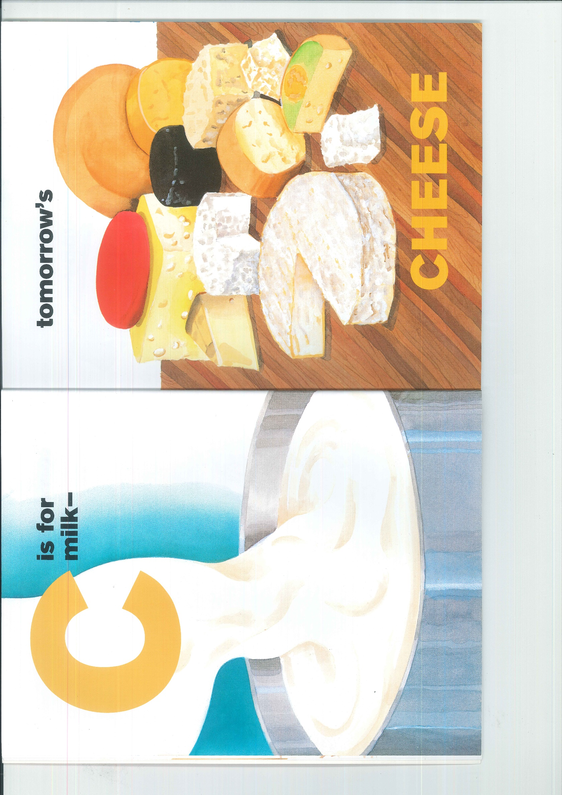

Slide 12
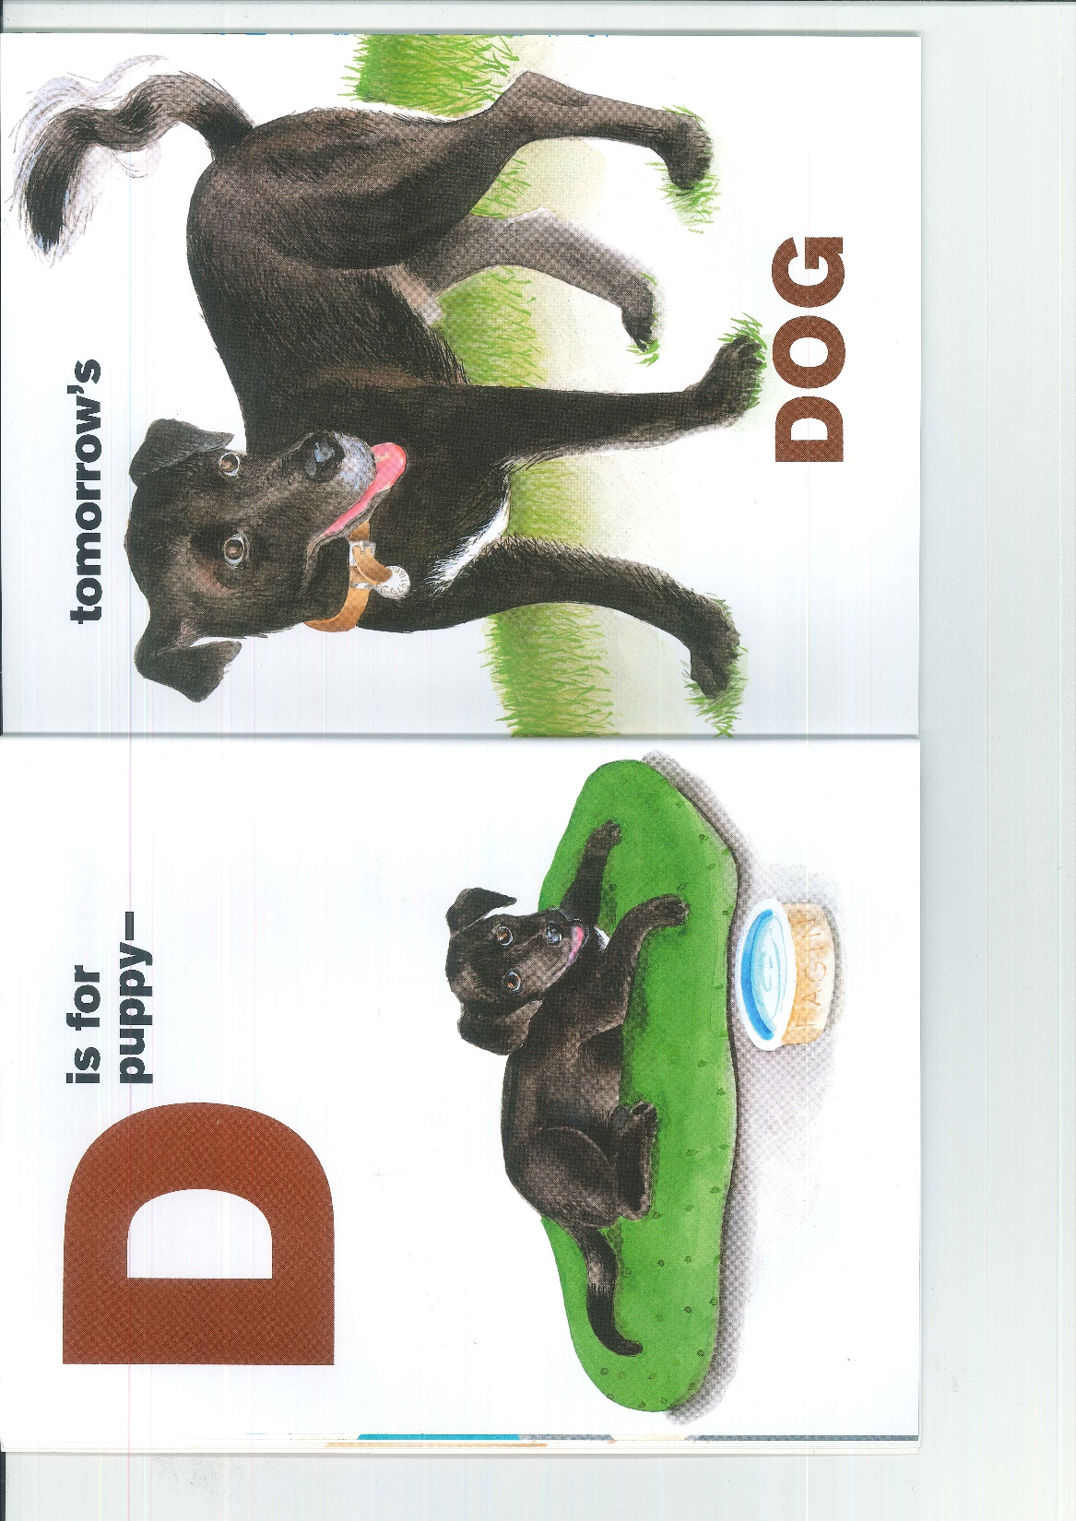

Slide 13


Slide 14


Slide 15


Slide 16


Slide 17


Slide 18


Slide 19
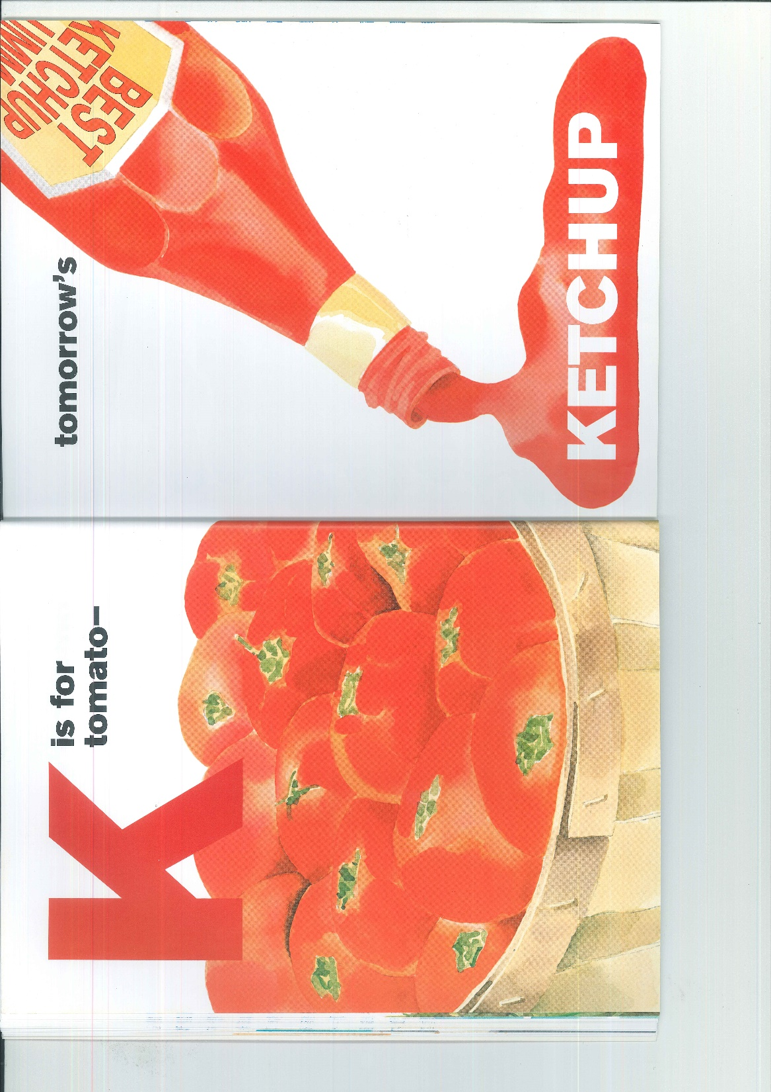

Slide 20
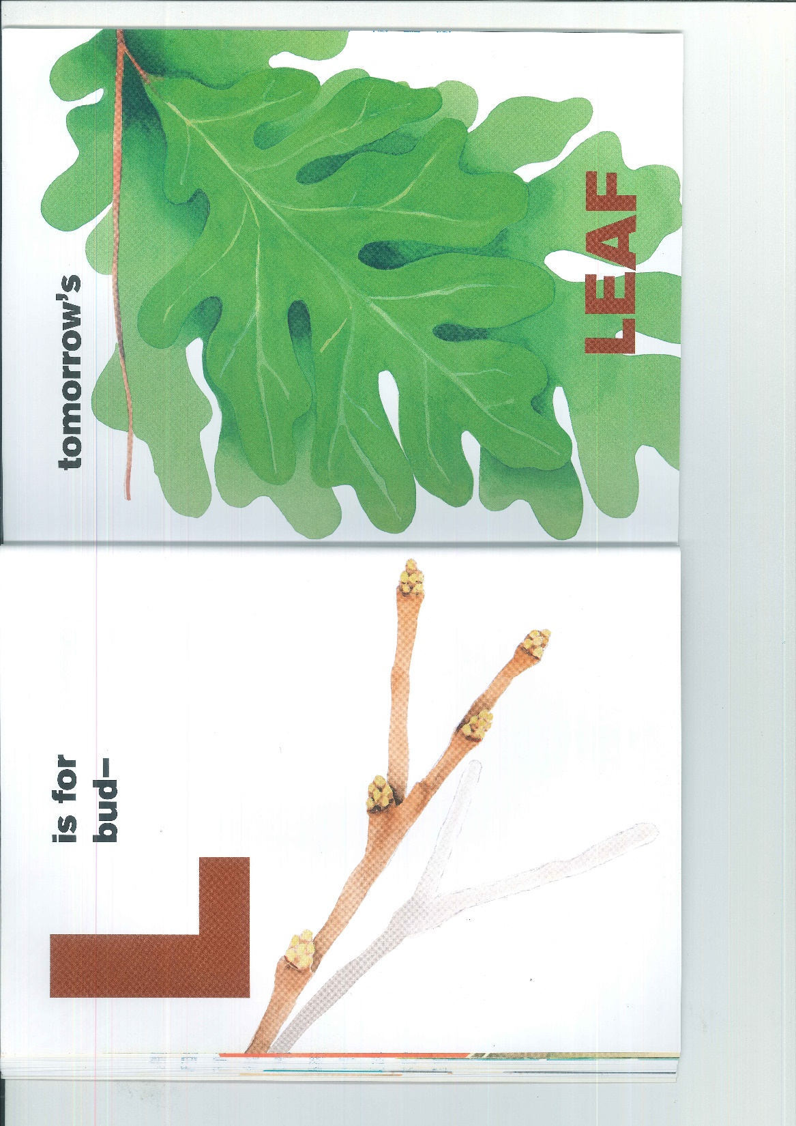

Slide 21


Slide 22


Slide 23


Slide 24
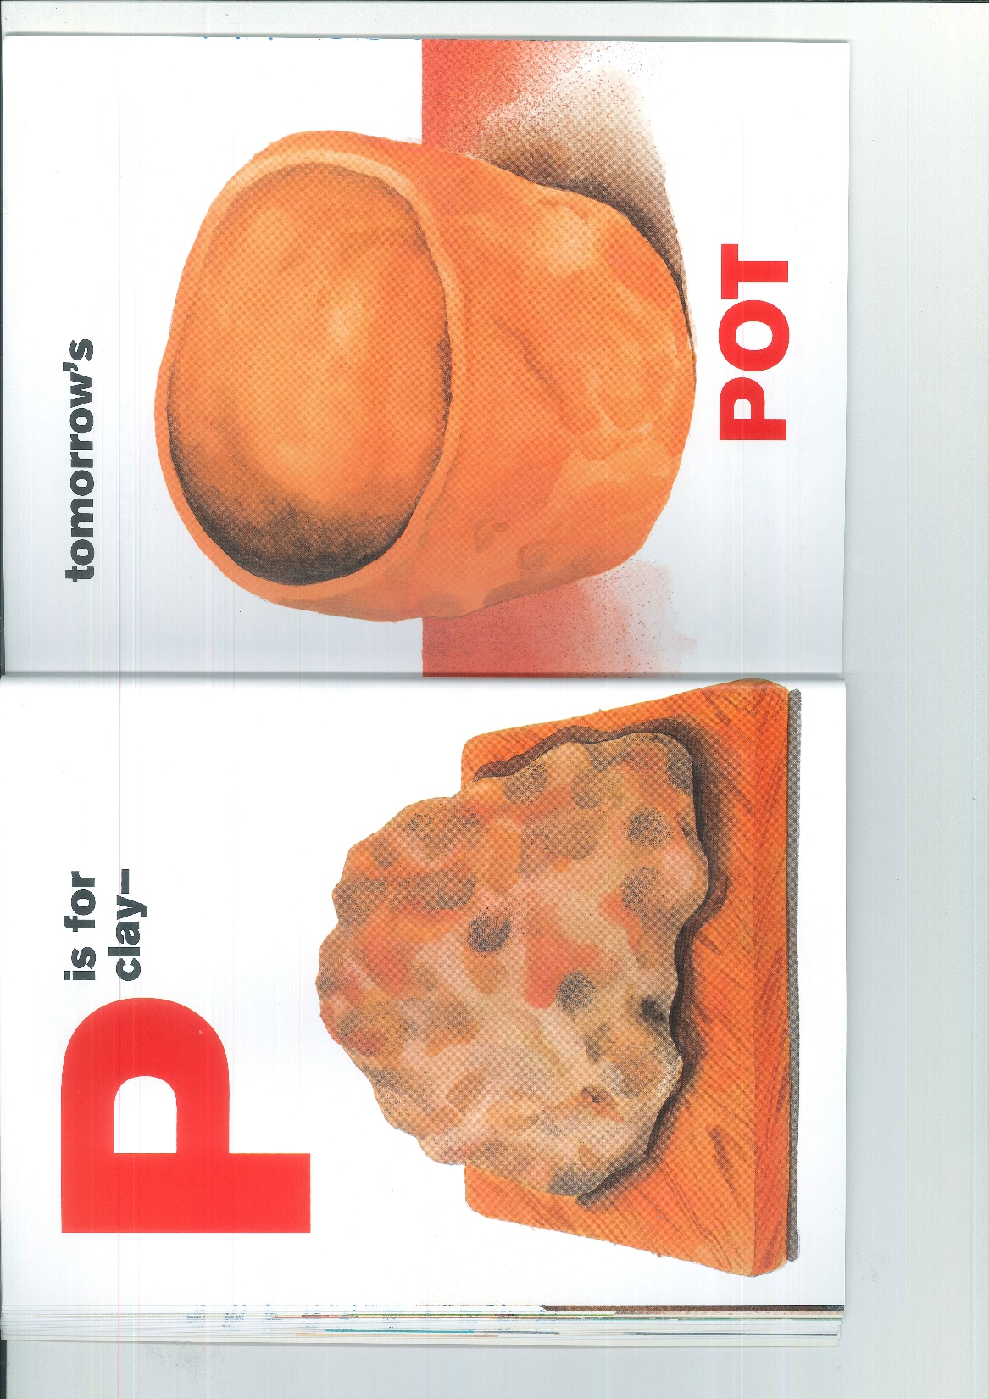

Slide 25
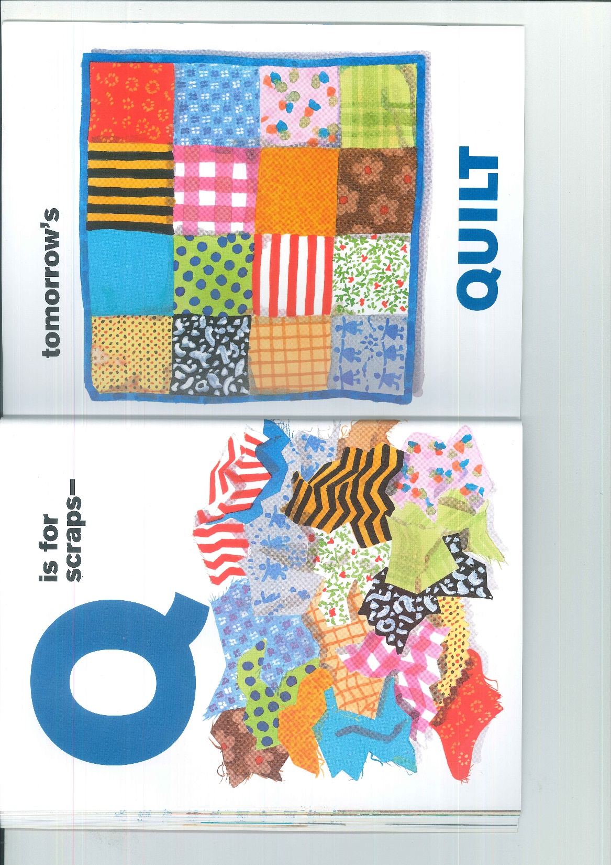

Slide 26
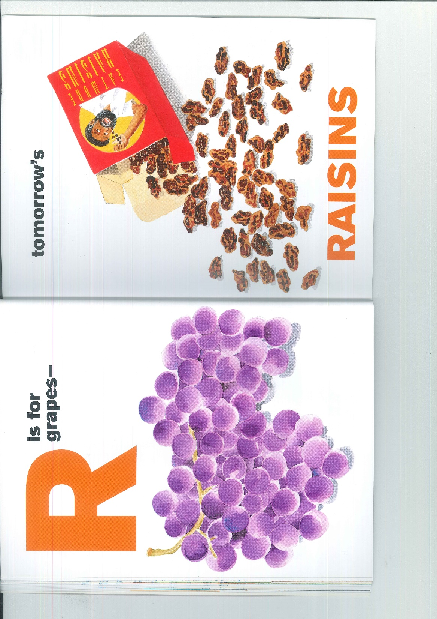

Slide 27


Slide 28
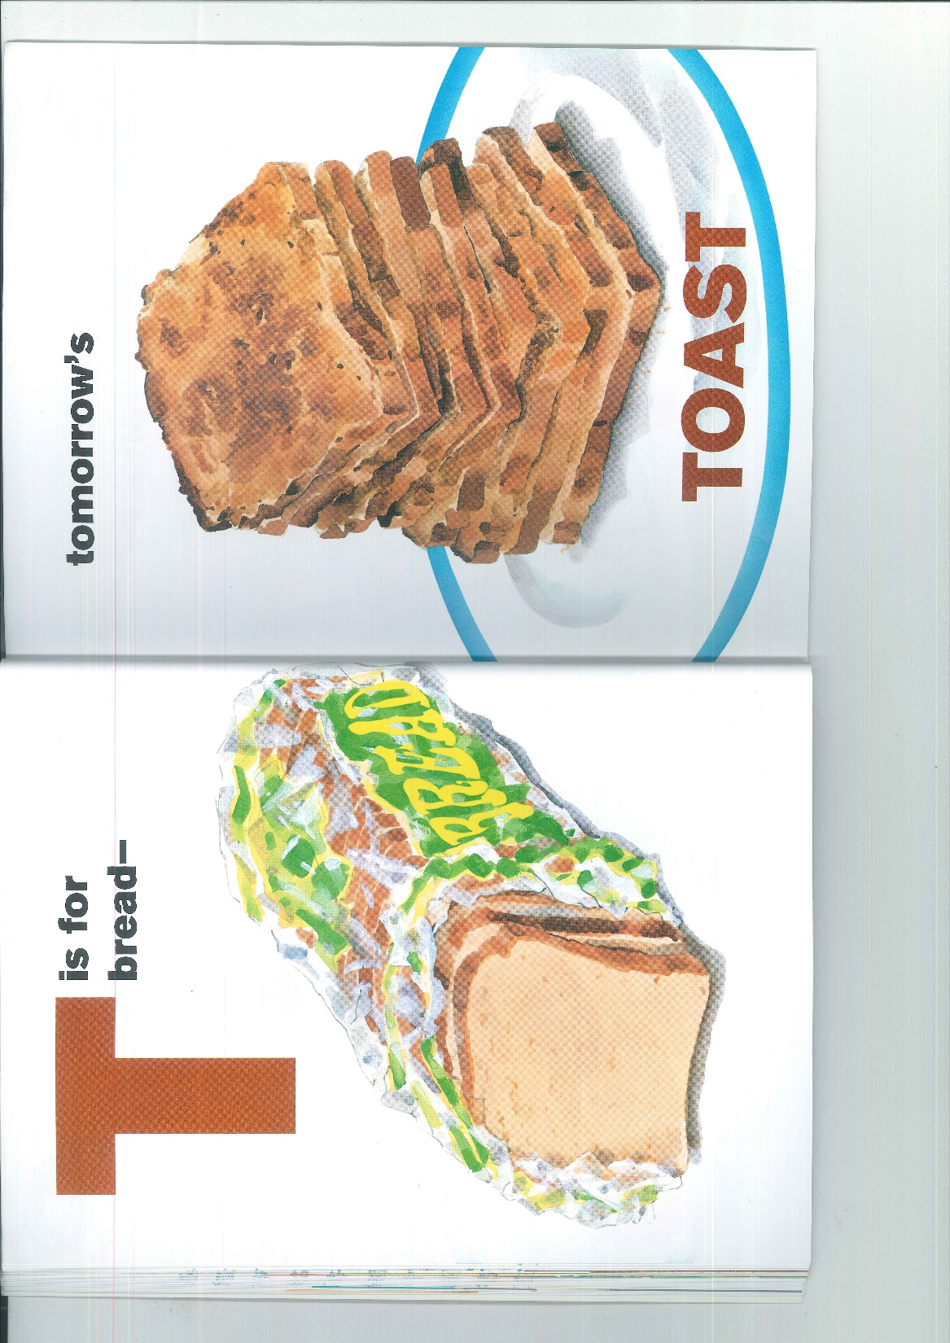

Slide 29


Slide 30


Slide 31
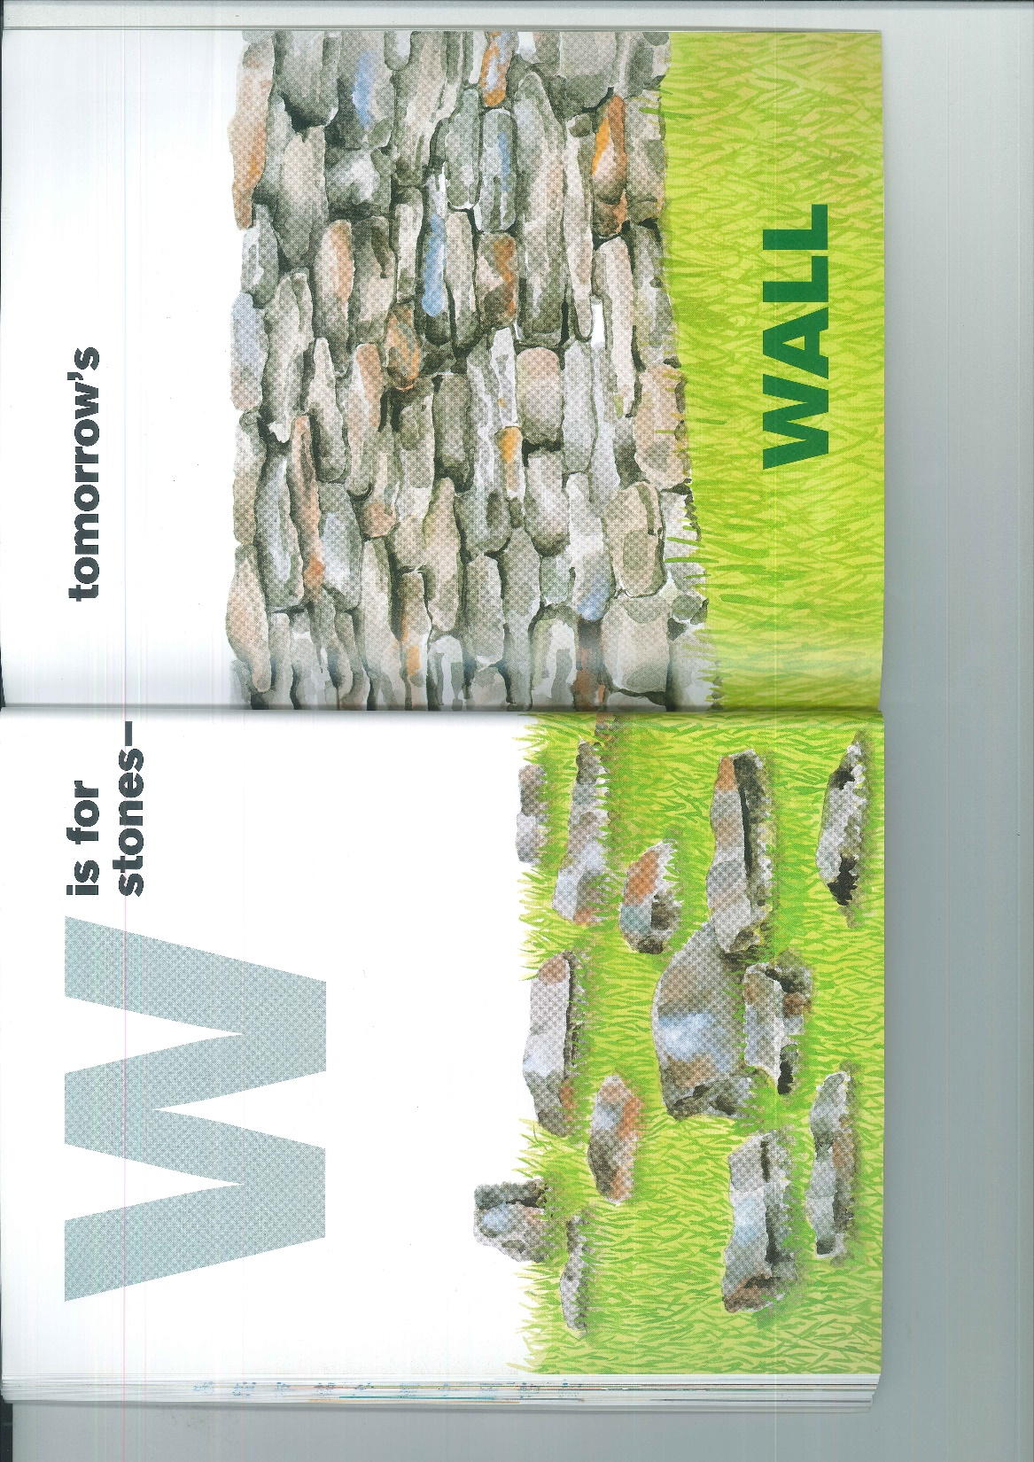

Slide 32
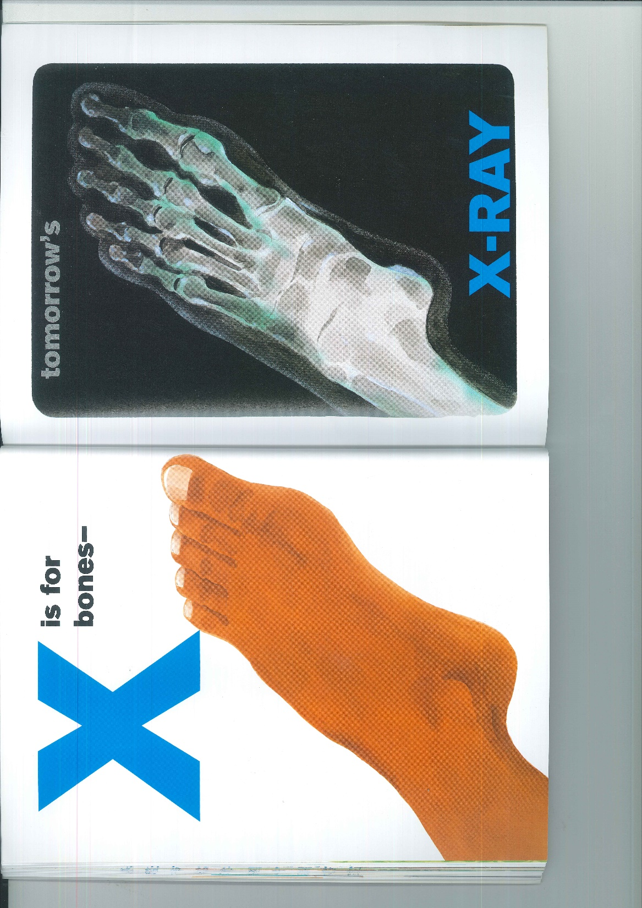

Slide 33
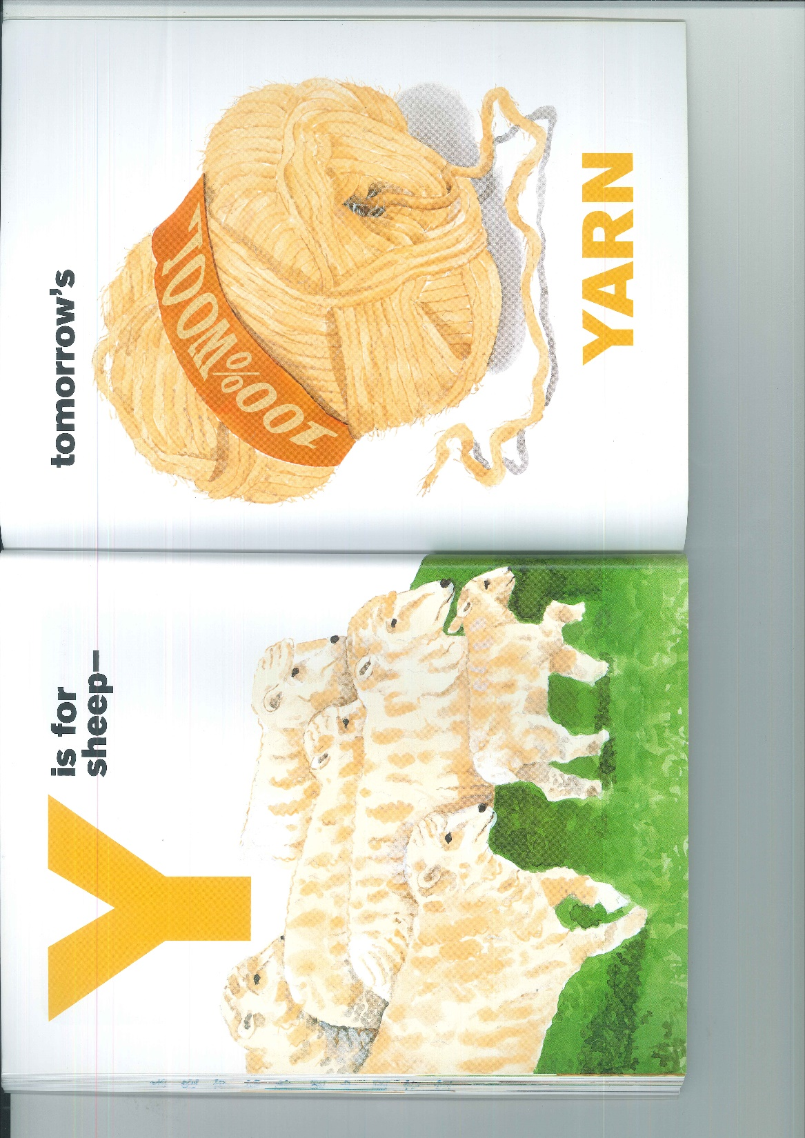

Slide 34


Slide 35
4-Be Rules
#1 Be respectful
#2 Be kind
#3 Be responsible
#4 Best teamwork

