Slide 1
Weird Foods
Around the World
Are you kidding me?!
I Eat. Therefore, I Am.
Originally Presented by Kelly You

Slide 2
One man’s meat is another man’s poison.

Slide 3
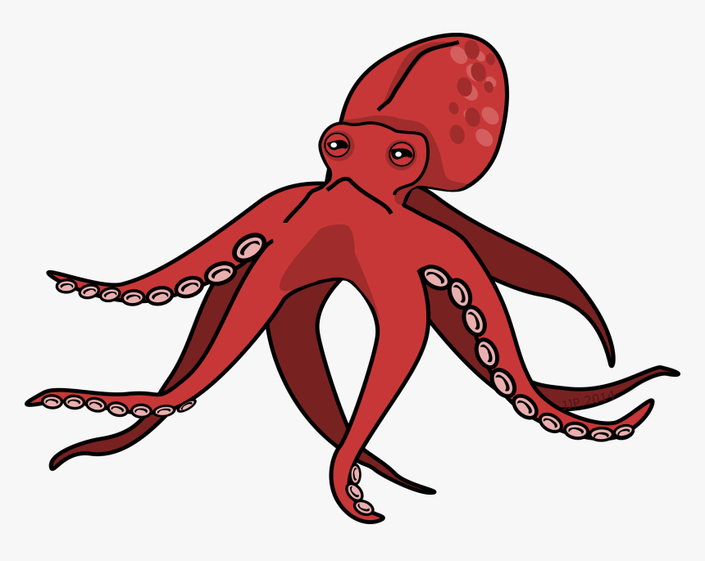
Strange Ways of Cooking (Preparing Foods)
alive(活吃)
Live Octupus Sashimi in Korea https://www.youtube.com/watch?v=JYDkzqCfJzg
raw(生吃)
Horse Sashimi in Japan https://www.youtube.com/watch?v=nuqR7y66UYE&t=116s
alkaline fermented (鹼液發酵)
Century Eggs in China https://www.youtube.com/watch?v=NL8kMj-GlLs
rotten (腐爛)
Casu Marzu: Cheese with Live Maggots in Italy https://www.youtube.com/watch?v=Y8F-0Ogp4fU

Slide 4
Blue Cheese
https://tw.voicetube.com/videos/54579
Many Taiwanese are scared of eating blue cheese because of its dark blue dots. However, its strong taste and smell make it popular with many Americans. Let’s find out some interesting facts about blue cheese. Blue cheese has been around since the ninth century. People found it inside a cave in Italy by chance. They tried it and they were surprised at its great taste. Later, they decided to make blue cheese for themselves. They started to use cow’s, sheep’s, or goat’s milk to make blue cheese. As for the ways to eat blue cheese, people enjoy eating it alone or with other foods. Sometimes they like to eat it with other foods because of its flavor. For example, blue cheese goes best with pizza, baked pears, hamburgers and salad with lemon pieces. After reading these interesting facts about blue cheese, do you want to give it a try? Who knows? You may just like it.

Slide 5
巨臭的藍紋奶酪有傳說的那麼難吃嗎？藍紋芝士的種類、吃法和入門教學 Blue Cheese

Slide 6
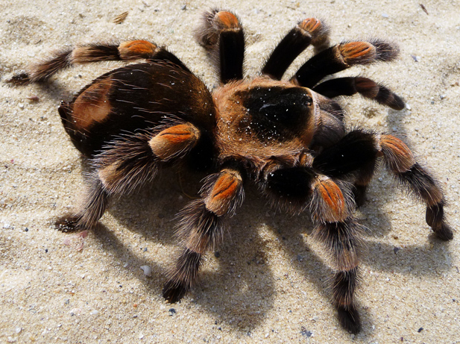
Special and Scary Ingredients
Chicken Feet 雞腳 (Trying Chicken Feet for the First Time) https://www.youtube.com/watch?v=h7llD8iJ_hE
Rotten Shark Meat 腐爛鯊魚肉: Hakarl in Iceland (Eating Rotten Shark National Geographic) https://www.youtube.com/watch?v=mbYqznD0R5M
Fertilized Duck Eggs 鴨仔蛋: Balut in Philippines (How to Eat Balut: Fertilized Duck Eggs) https://www.youtube.com/watch?v=NCsa_Doev7Y
Fried Tarantula in Cambodia (Eating Tarantula in Cambodia) https://www.youtube.com/watch?v=GZkhpRfqsI0
Human placenta (don’t eat placenta: medical experts say) https://www.youtube.com/watch?v=AYTeiAIvfrY

Slide 7
Your Turn
Finish Your Weird Foods Profile (Hand in to GC)
Name and Origin of the Dish on cover page
Ingredients
How to Make It
Origins & Reasons for Eating It
How to Eat It
Its Flavor and Texture

