Slide 1
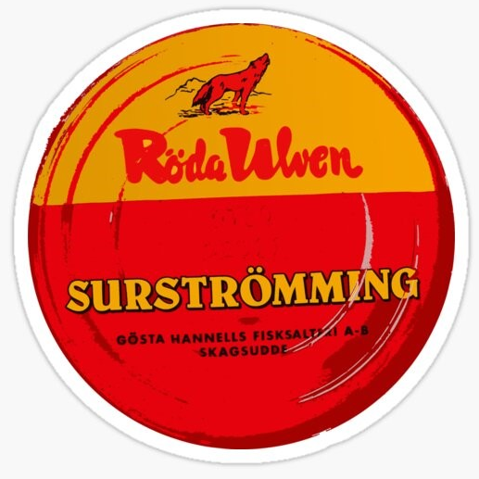
Weird Food Profile~
surströmming
瑞典鹽醃鯡魚

Slide 2
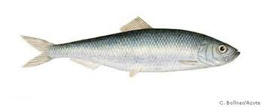
Ingredients
鯡魚 herring
鹽水 brine

Slide 3
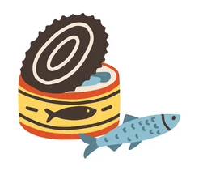
How to make the dish
將鯡魚的頭切除、內臟清除乾淨
Cut off the head of the herring and take out its internal organs.
抹上鹽巴，醃製20小時去除血液
Apply salt all over the fish and pickle for 20 hours to get rid of the blood.
放入桶子內自然發酵1~2個月
Put it into a bucket and let it ferment naturally for 1 to 2 months.

Slide 4
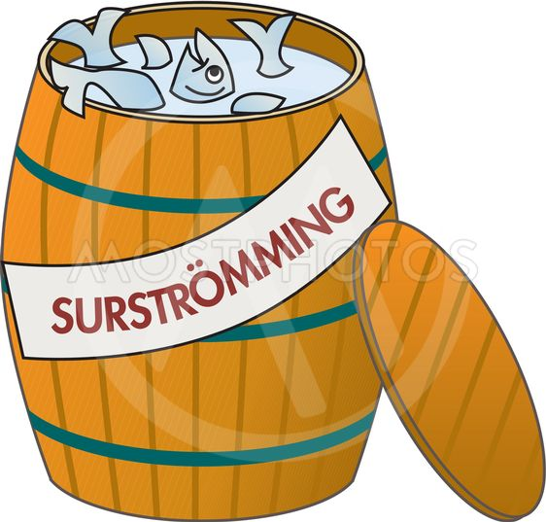
Origins/ Reasons for eating the dish
鹽醃鯡魚出現的原因是因為以前的鹽巴曾經很昂貴，因此用稀鹽水醃漬把魚保存下來的方式，大概就是鹽醃鯡魚的由來。
The history of surströmming seems to begin during a time when brine was very expensive, and the weak brine used in the fermenting process could have been a way to cut costs for preservation that led to this dish.
在當時，把魚存放在大木桶裡面是很平常的保存方式，一般人家都會利用這種方式製作美食，而且可以吃一段時間。
At the time, storing the fish in wooden barrels would have been normal practice of course, with families making a batch of the delicacy and eating it over time.

Slide 5
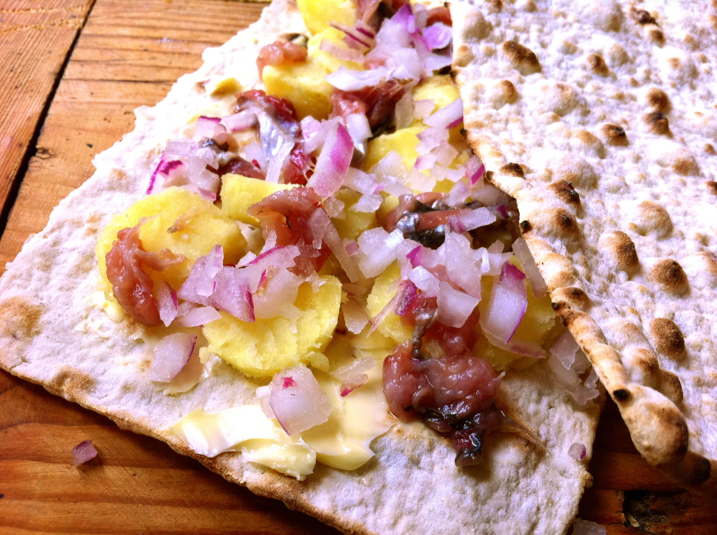
How to eat the dish
瑞典人傳統吃鹽醃鯡魚的方式，就是用tunnbröd(瑞典薄麵包)中間夾魚肉做成三明治的樣子。
The traditional way to eat surströmming for Swedes has been with a thin bread known as tunnbröd, using two slices to create a sandwich.
除了魚之外，通常還會配上碎馬鈴薯跟洋蔥，這道菜就會變成"surströmmingsklämma"。到現在在瑞典北部，也就是鹽醃鯡魚的起源地，還是很流行的美食。
In addition to the fish, these sandwiches often contain sliced potatoes and onions. These are commonly known as "surströmmingsklämma" and remain popular in Northern Sweden where the dish originates from.

Slide 6
Flavor and Texture
它的氣味非常強烈，主要是來自於鯡魚在醃漬過程中的自溶(autolysis)，酶(enzyme)和細菌起作用產生了各種的酸(acid)。
It has a very strong smell which is attributed to autolysis in the fermentation, when the enzymes and bacteria create various acids.
鹽醃鯡魚本身的味道一點都不臭，嘗起來就是很鹹的味道而已。
The fish itself does not smell that strong at all. Surströmming has a salty baseline of flavor.

Slide 7
My reflection
(請寫下研究完食物之後的感想，有機會是否想嘗試等等心得)(中/英文)

