Slide 1
Pedlet上傳照片說明
Instructions for uploading the pictures of Pedlet

Slide 2
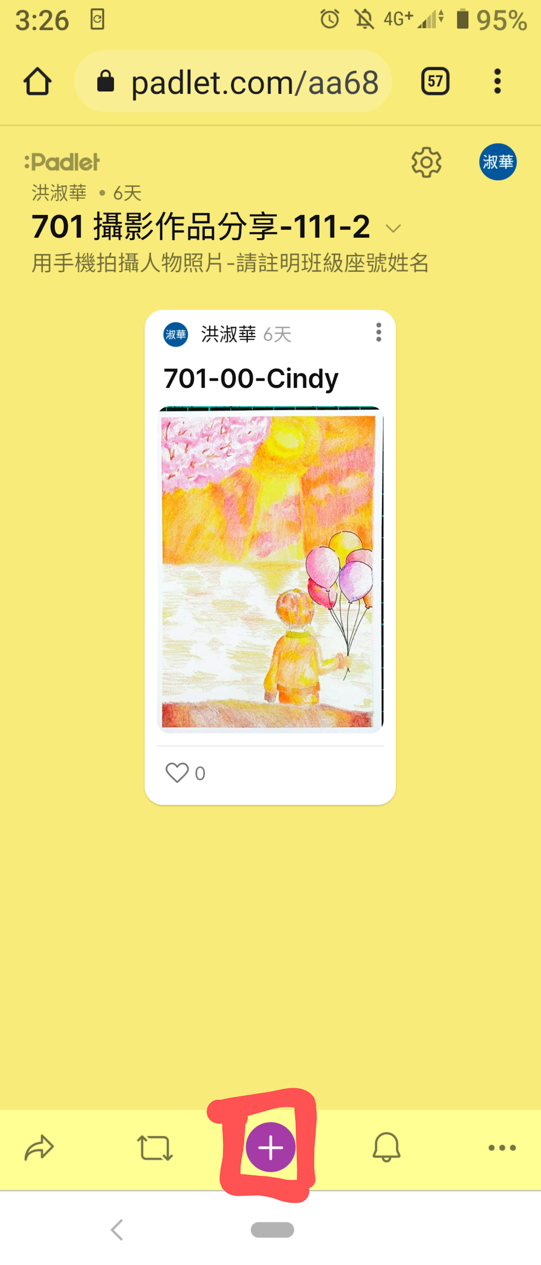
1.進入網站連結：
按頁面下方+
Enter the website
and find the icon
+

Slide 3
2. 點選主題
輸入班級座號姓名
Enter Subject
and key in class, number,
and name.

Slide 4
3. 點選頁面下方右邊...
Enter … on the
bottom right page.

Slide 5
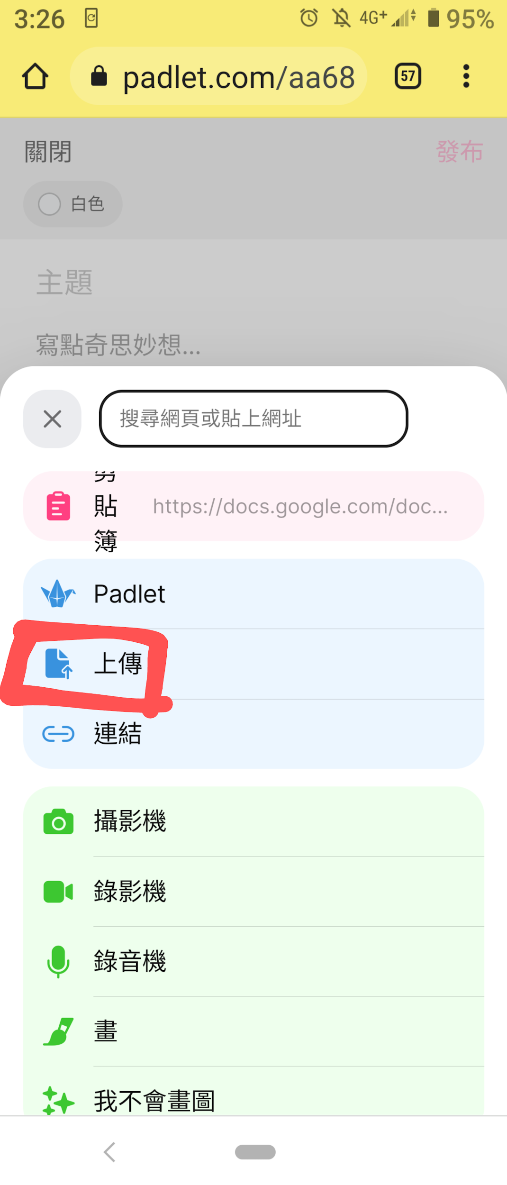
5.點選上傳：
Enter upload

Slide 6
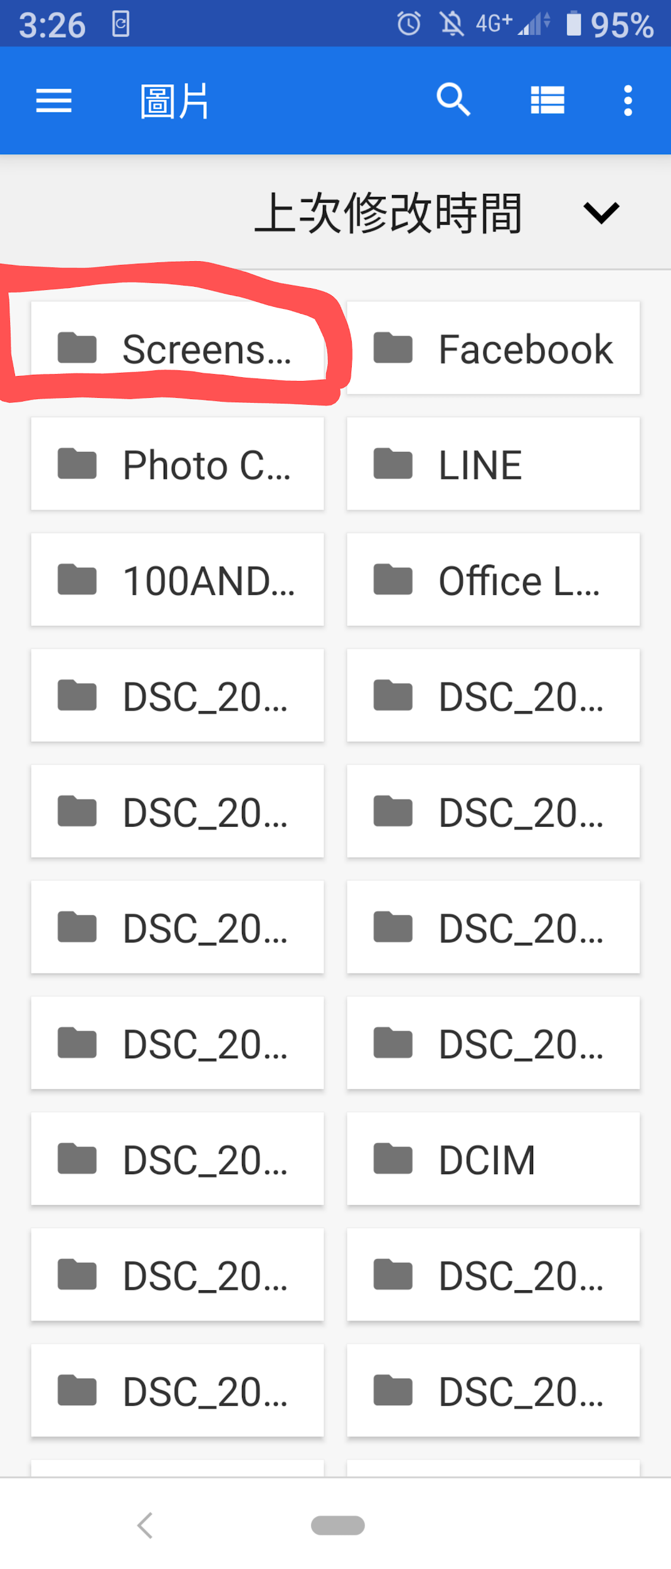
6.點選檔案
點選要上傳的照片：
Enter Files and choose
the picture you upload.

