Slide 1
Warm up:
Guess Who Did it!

Slide 2
A man was found murdered on Sunday morning around 6. The wife called the cops and there were 5 suspects and their alibis.
The wife said she was sleeping then.
The cook was cooking at that time.
The gardener was growing fruit at 6 this morning.
The maid was waiting for the garbage truck then.
The butler was wiping the window at that time.

Slide 3
The first activity: Time Code
Divide the class into 4 groups.
Discuss the time within the group.
The first group to guess the time right will get one point!
You must tell the time by using “o’clock/half/ quarter/past/after/to.”
Time setting: From 1 o’clock to 12: 45
1:00
1:15
1:30
1:45

Slide 4
Are you ready?

Slide 5
Time code #1

Slide 6
Time code #2

Slide 7
Time code #3

Slide 8
Time code #4

Slide 9
Time code #5

Slide 10
Next activity: Guess the Housework
I just show you some of the words, and the first one who raises the hand and guesses it right will get the point.
*If you get it right, you can’t guess it again. Let your teammate do it.
Ex: cl_ _ _ the b_ _ _ r_ _ m

Slide 11
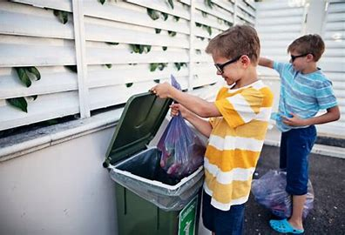
Next game: Guess the Housework
_ _ _ _ o_ _ the g_ _ _ _ge

Slide 12
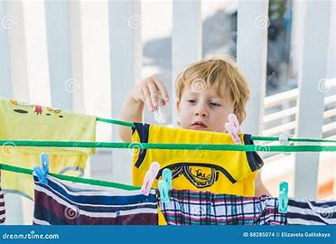
Next game: Guess the Housework
_ _ _ _ the _ _ _thes

Slide 13
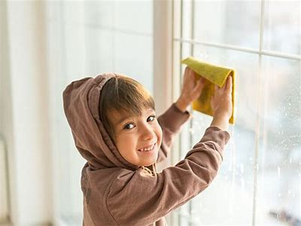
Next game: Guess the Housework
w _ _ _ the _ _ _ _ _ w

Slide 14
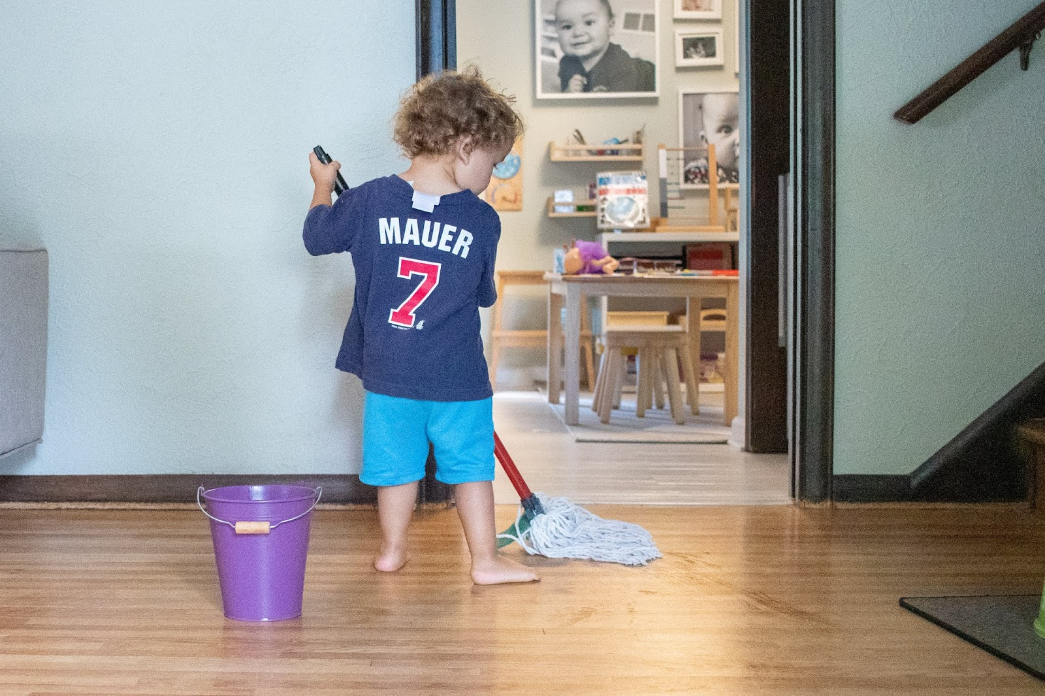
Next game: Guess the Housework
_ _ _ the _ _ oo _

Slide 15
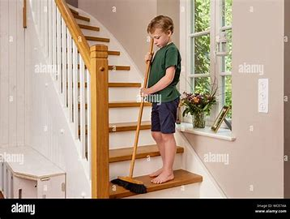
Next game: Guess the Housework
s _ _ _ _ the s_ _ _ _ s

Slide 16
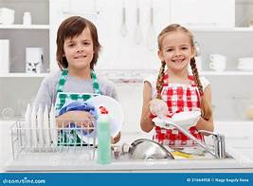
Next game: Guess the Housework
_ _ the _ _ shes

Slide 17
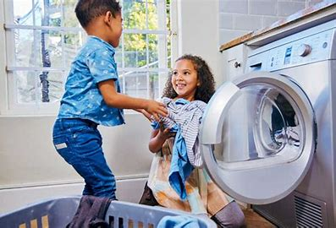
Next game: Guess the Housework
_ _ the l _ _ _dry

Slide 18
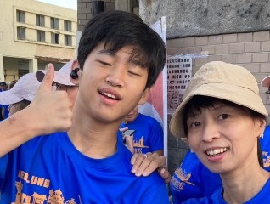
The 3rd activity: Making sentence: was/were Ving
Please make sentences by using the 4 pictures.
Ex: Nick and Meggy were doing the laundry
at a quarter past eight last night.

Slide 19
Are you ready?

Slide 20
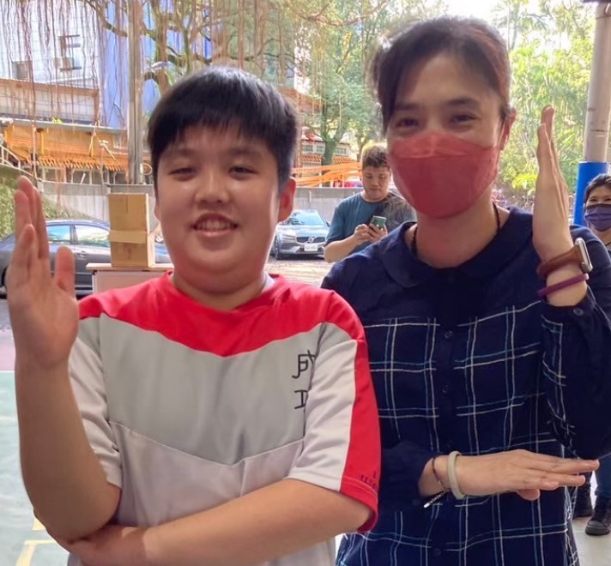
Making sentence: was/were Ving
Please make sentences by using the 4 pictures.
A: Wilson and Jamie were mopping the window(s) at a quarter to ten this morning.

Slide 21
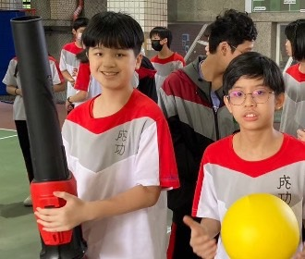
Making sentence: was/were Ving
Please make sentences by using the 4 pictures.
A: Joinn and Jack were taking out the garbage/trash
at half past one yesterday afternoon.

Slide 22
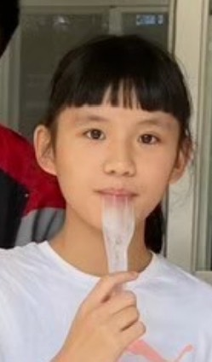
Making sentence: was/were Ving
Please make sentences by using the 4 pictures.
17:45
A: Annie was sweeping the stairs
at a quarter to six yesterday evening.

Slide 23
Making sentence: was/were Ving
Please make sentences by using the 4 pictures.
A: Angel was sweeping the stairs
at half past six this morning.

Slide 24
# What kind of housework
do you do at home?
and the group that got the most points is...Group ? !
Congratulations!!!

Slide 25
See you again!

