Slide 1
八年級彈性課程
銘心繪
- Play with the Letters I -

Slide 2
Attitude
態 度
Determines Everything
決定一切

Slide 3
811 is the BEST team
Group | G1 | G2 | G3 | G4 | G5 | G6
No. | ? | 32 | 1 | 37 | 4 | 31
No. | 6 | 42 | 11 | ? | ? | 12
No. | ? | ? | ? | 2 | 13 | ?
No. | 3 | 9 | 34 | 33 | 35 | 5
No. | 5 | 8 | 44 | 10 | ? | 0
Total | 122 | 98 | 131 | 118 | 134 | 92

Slide 4
811 is the BEST team
Group | G1 | G2 | G3 | G4 | G5 | G6
No. | 38 | 32 | 1 | 37 | 4 | 31
No. | 6 | 42 | 11 | 36 | 43 | 12
No. | 40 | 7 | 41 | 2 | 13 | 44
No. | 3 | 9 | 34 | 33 | 35 | 5
No. | 5 | 8 | 44 | 10 | 39 | 0
Total | 122 | 98 | 131 | 118 | 134 | 92

Slide 5
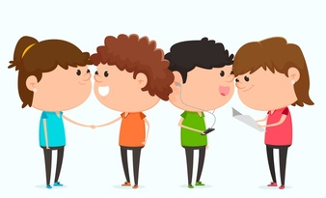
4-Be Rules
#1 Be respectful
#2 Be kind
#3 Be responsible
#4 Best teamwork

Slide 8
Tomorrow’s Alphabet
Notes:
1. Work of 4
2. Have one person get a whiteboard and a marker
3. Figure out the rules through the following two examples

Slide 9
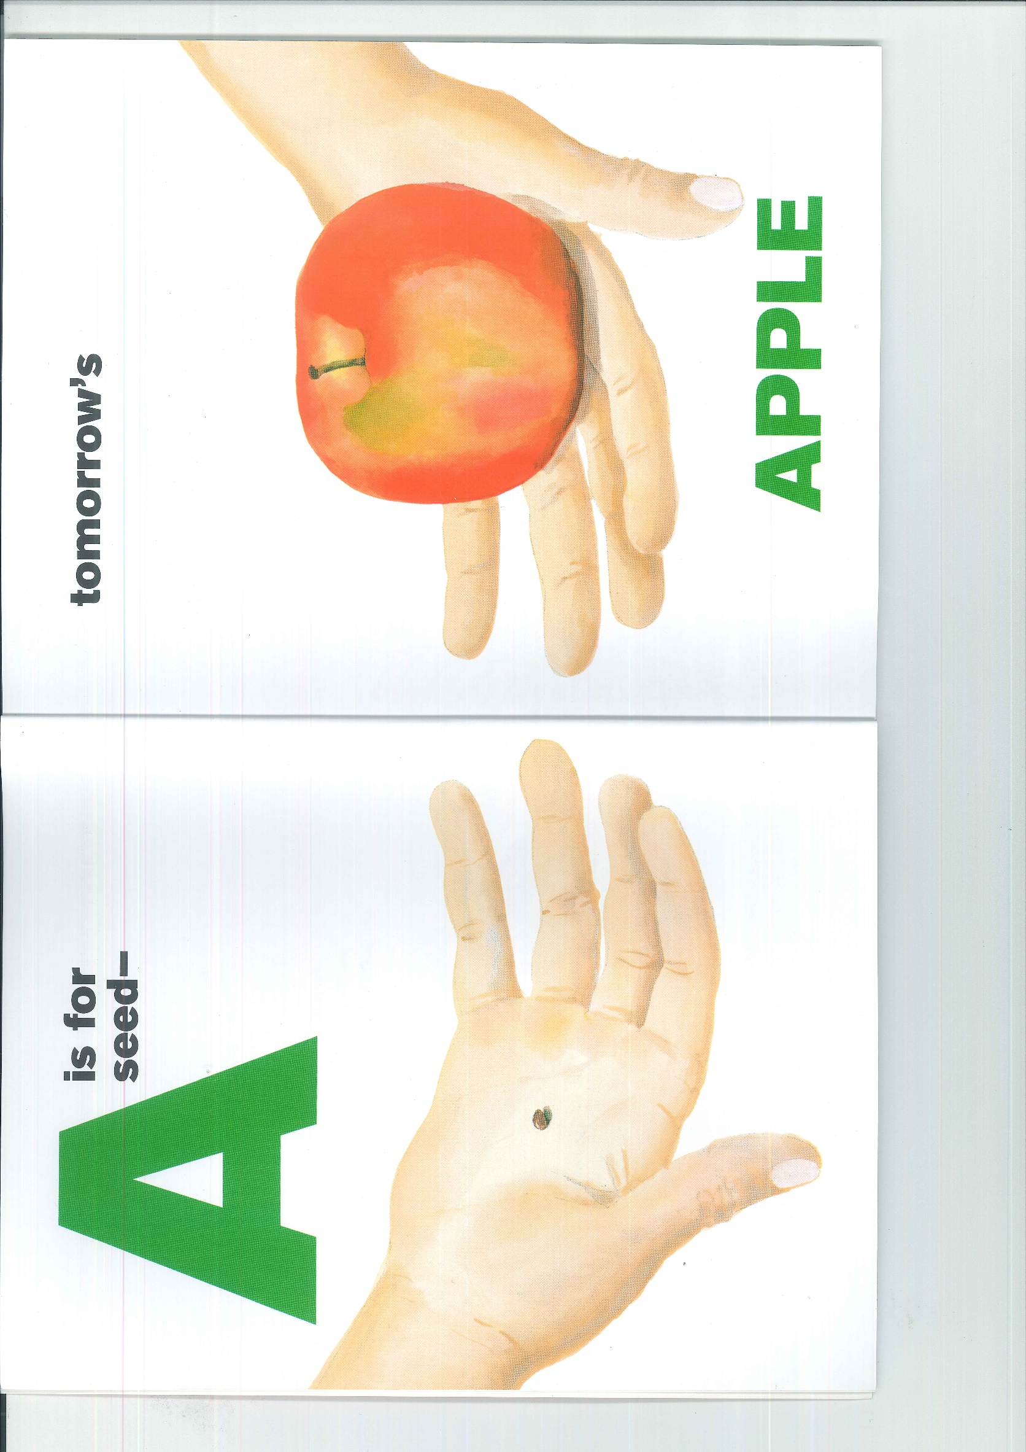

Slide 11
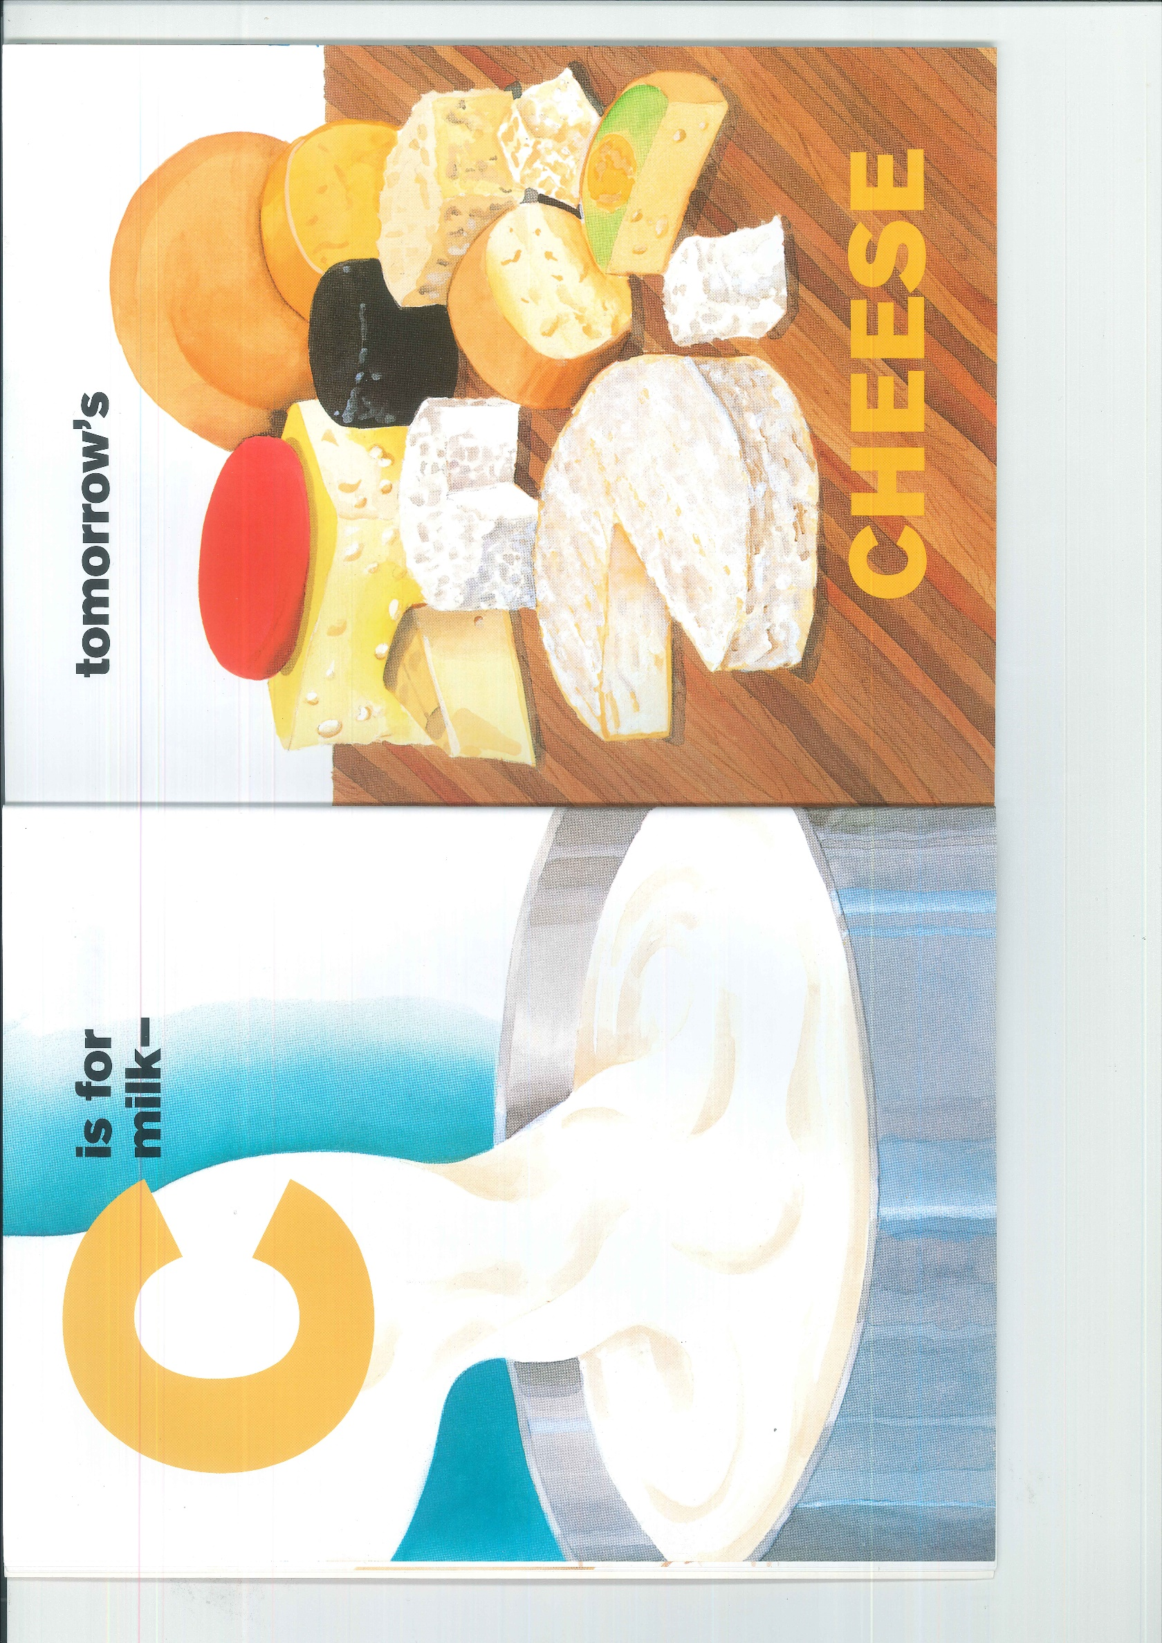

Slide 12
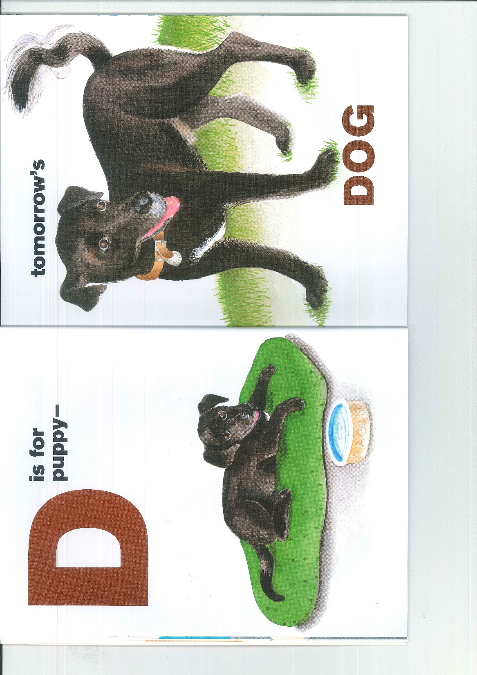

Slide 19
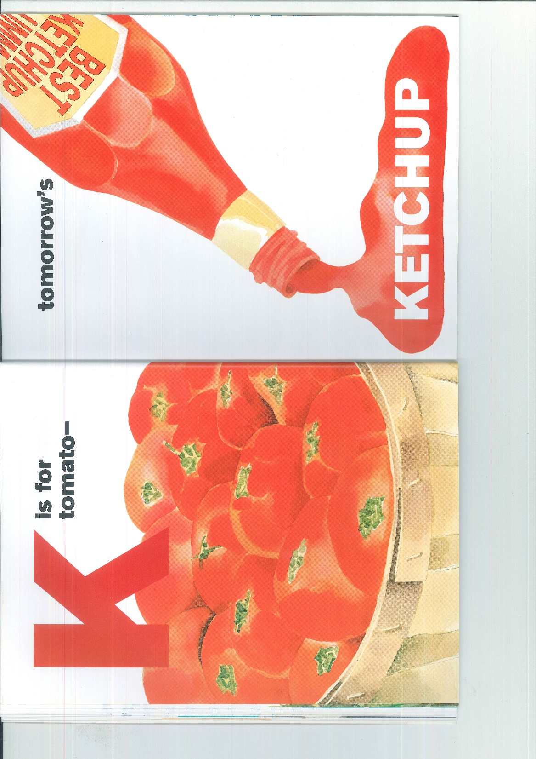

Slide 20
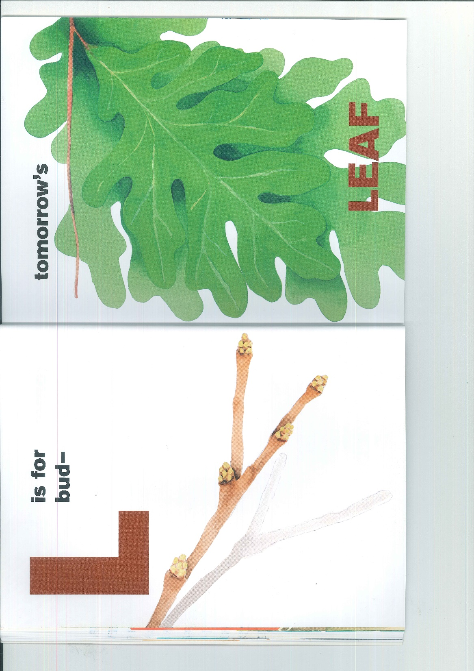

Slide 24
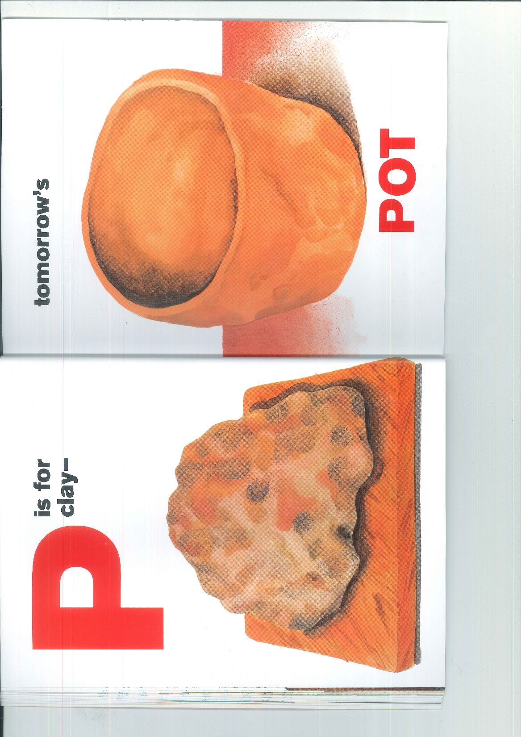

Slide 25
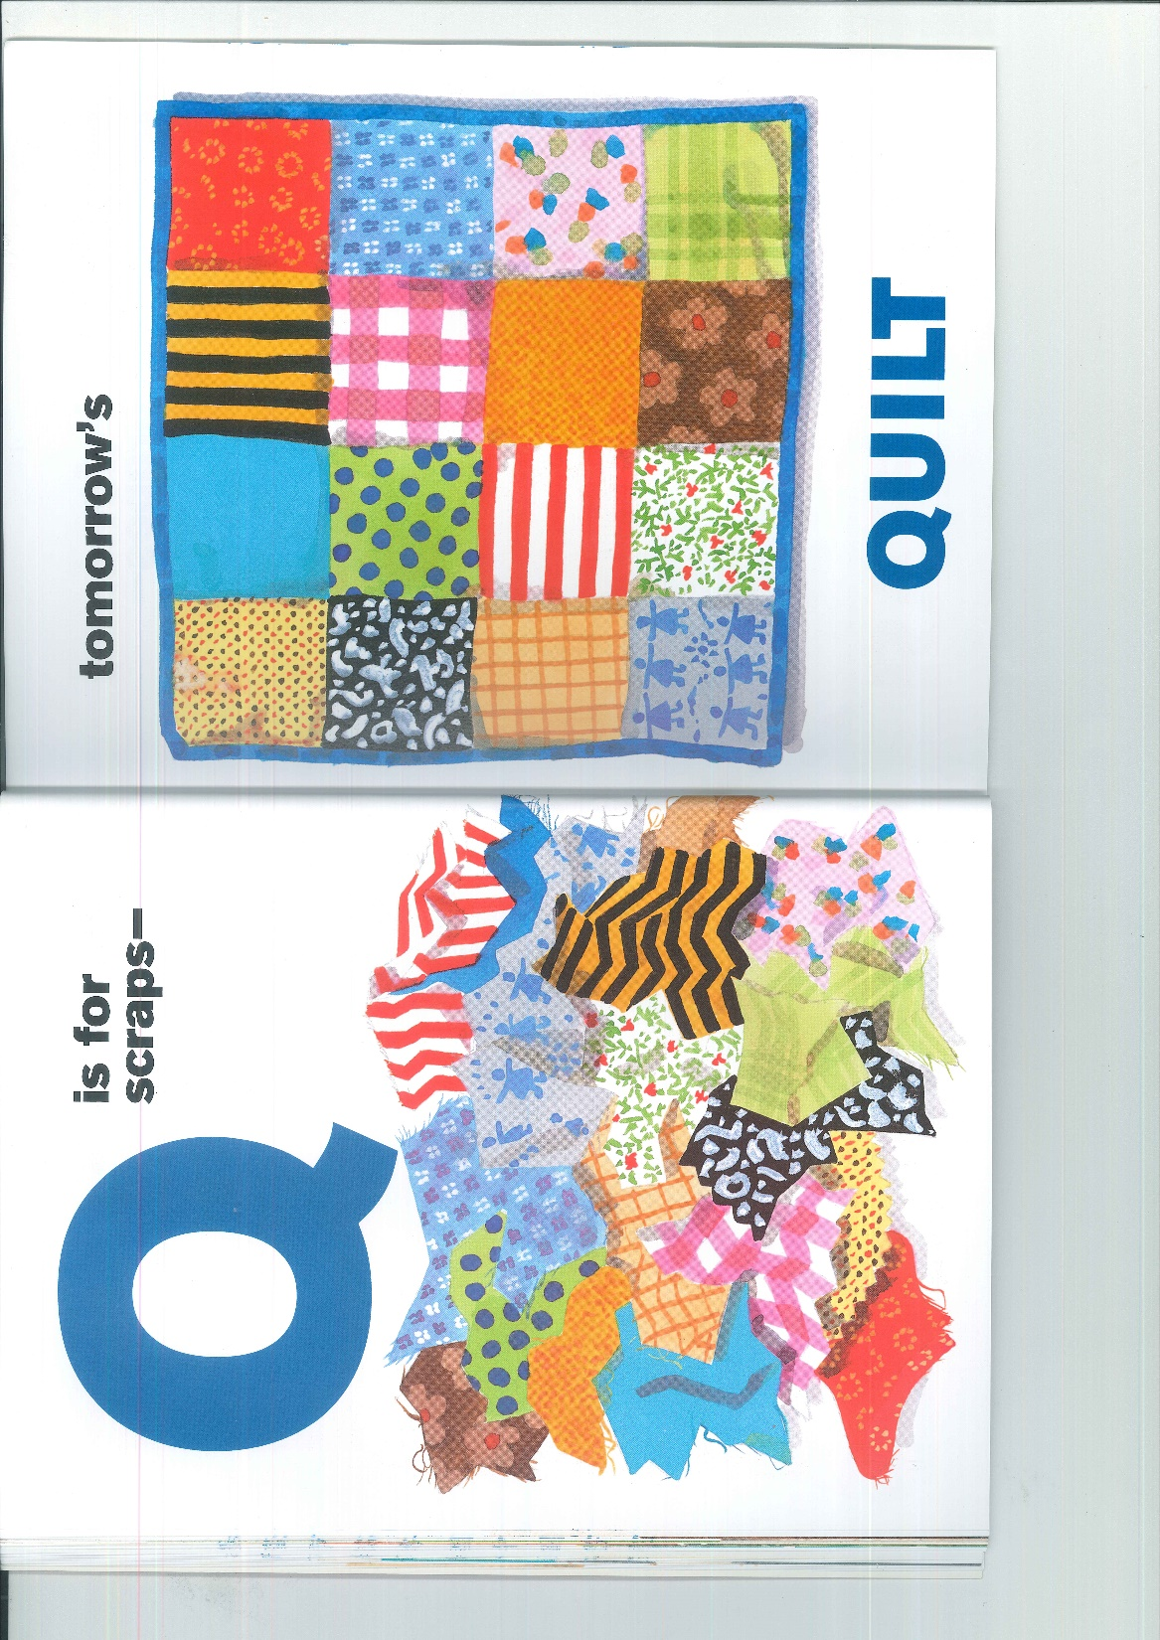

Slide 26
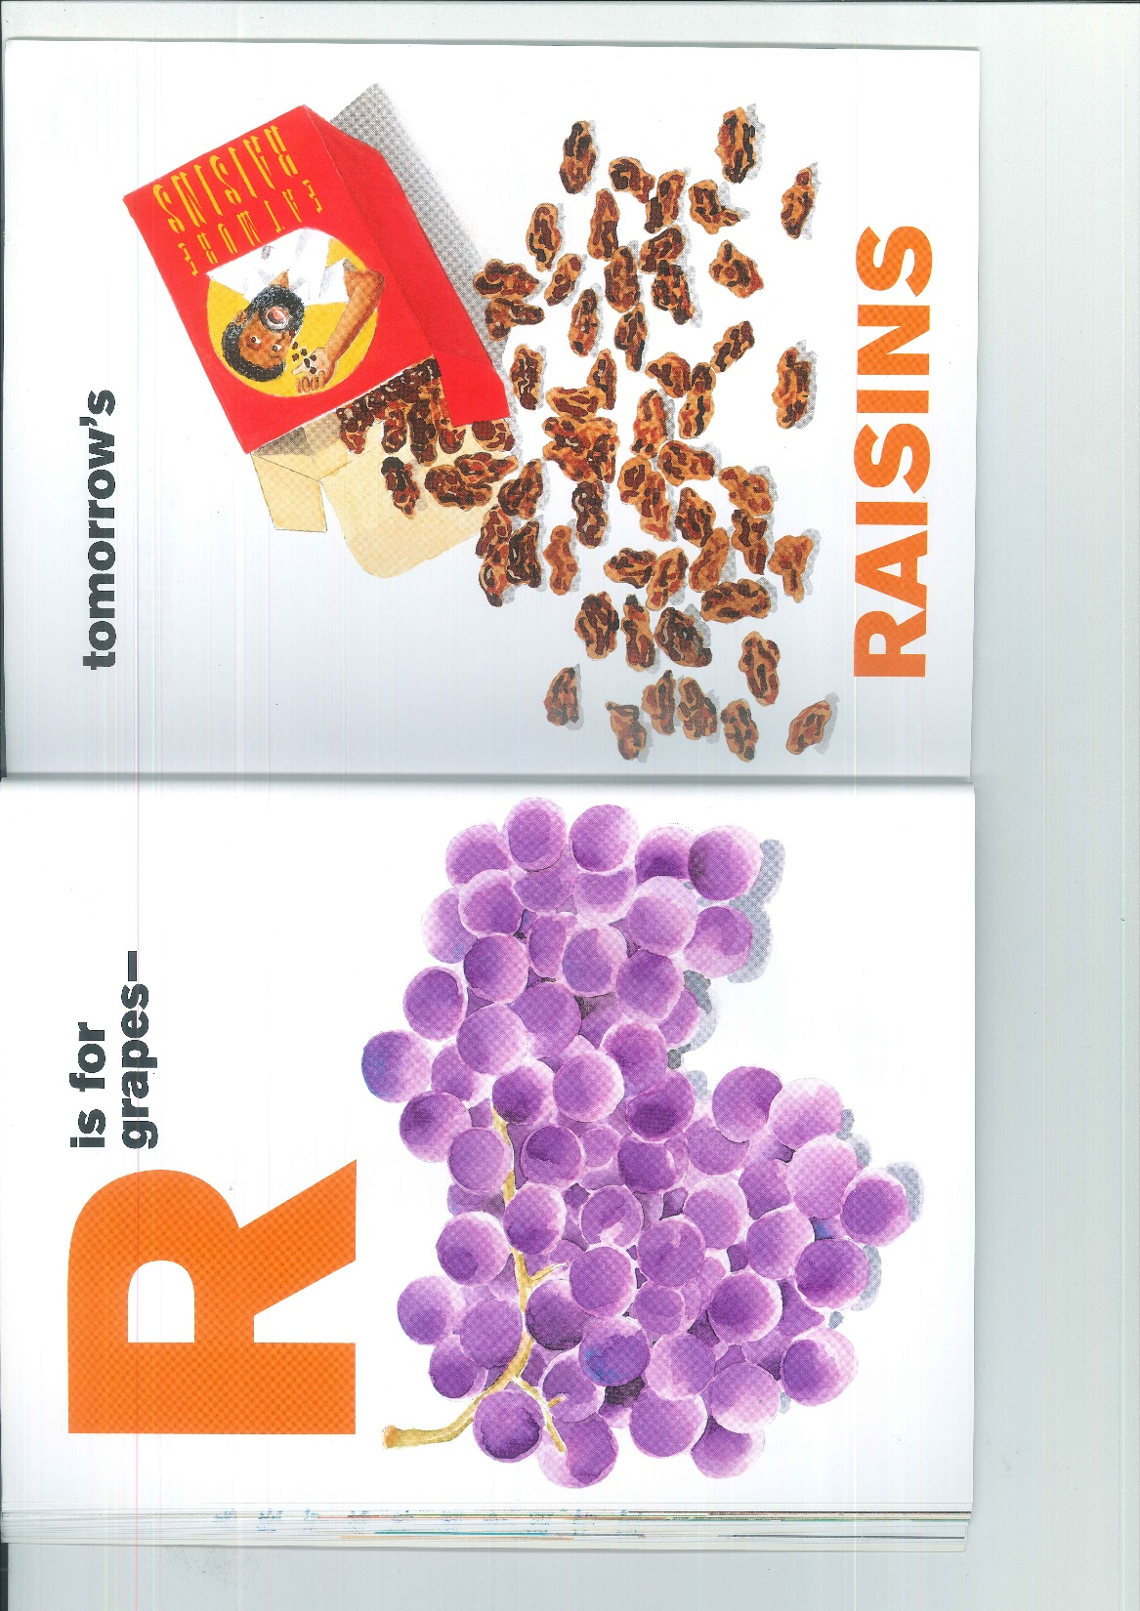

Slide 28
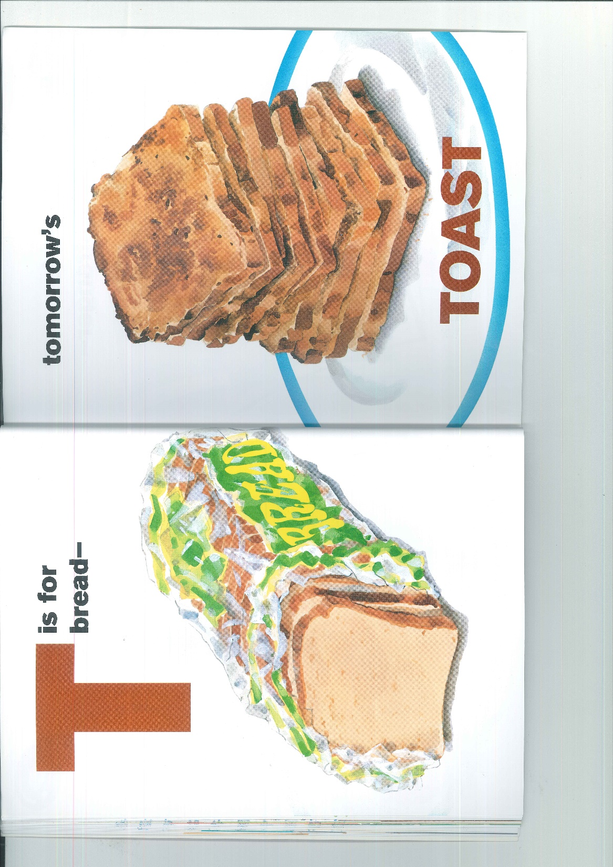

Slide 32
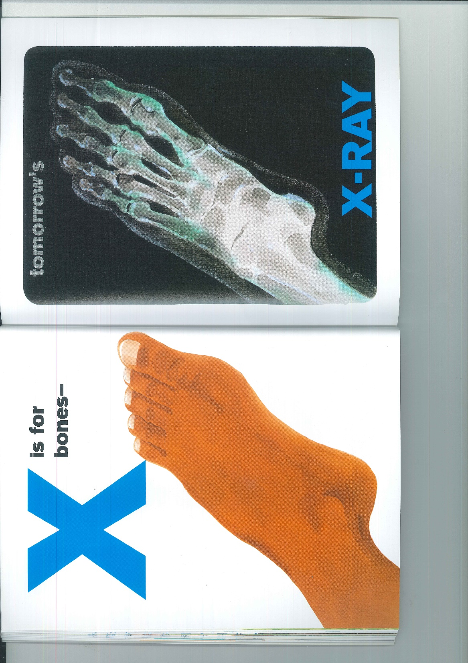

Slide 33
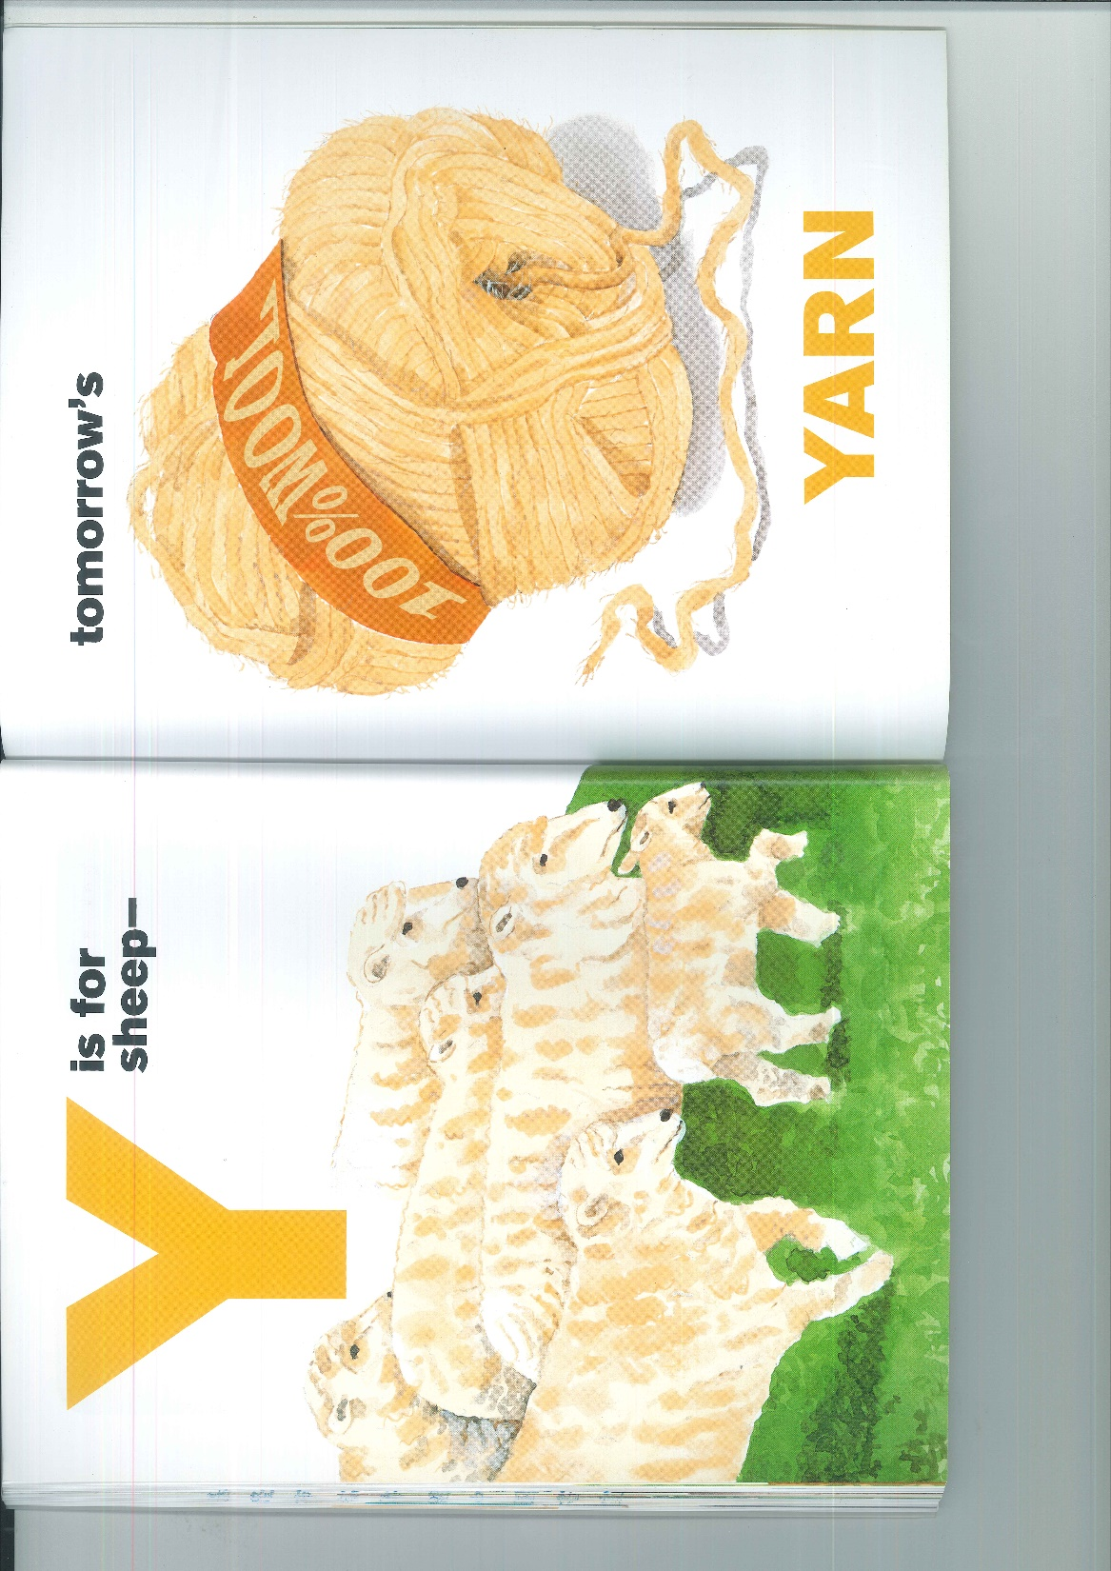

Slide 35
4-Be Rules
#1 Be respectful
#2 Be kind
#3 Be responsible
#4 Best teamwork

Slide 36
811 is the BEST team
Group | G1 | G2 | G3 | G4 | G5 | G6
No. | 11 | 40 | 4 | 10 | 45 | 41
No. | 3 | 1 | 34 | 38 | 42 | 13
No. | 36 | 33 | 2 | 12 | 7 | 8
No. | 37 | 9 | 43 | 31 | 5 | 32
No. | 39 | 14 | 6 | 0 | 44 | 0
Total | 122 | 98 | 89 | 91 | 143 | 94

