Slide 1
https://wordwall.net/tc/resource/52762572/%e6%95%b8%e5%ad%b8/18%e4%bb%a5%e5%85%a7%e7%9a%84%e5%8a%a0%e6%b3%95-%e8%a8%88%e7%ae%97
加法計算挑戰
https://wordwall.net/tc/resource/33268328/%e6%95%b8%e5%ad%b8/20%e4%bb%a5%e5%85%a7%e5%8a%a0%e6%b3%95
https://wordwall.net/tc/resource/52768497/%e6%95%b8%e5%ad%b8/20%e4%bb%a5%e5%85%a7%e7%9a%84%e5%8a%a0%e6%b3%95

Slide 2
看圖說題

Slide 4
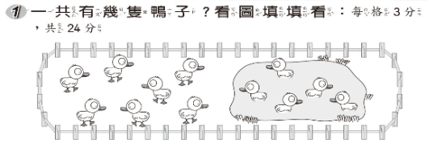

Slide 5
依算式說題

Slide 6
7+8=15

Slide 7
3+9=12

Slide 8
依題意說題

Slide 12
速測派

