Slide 1
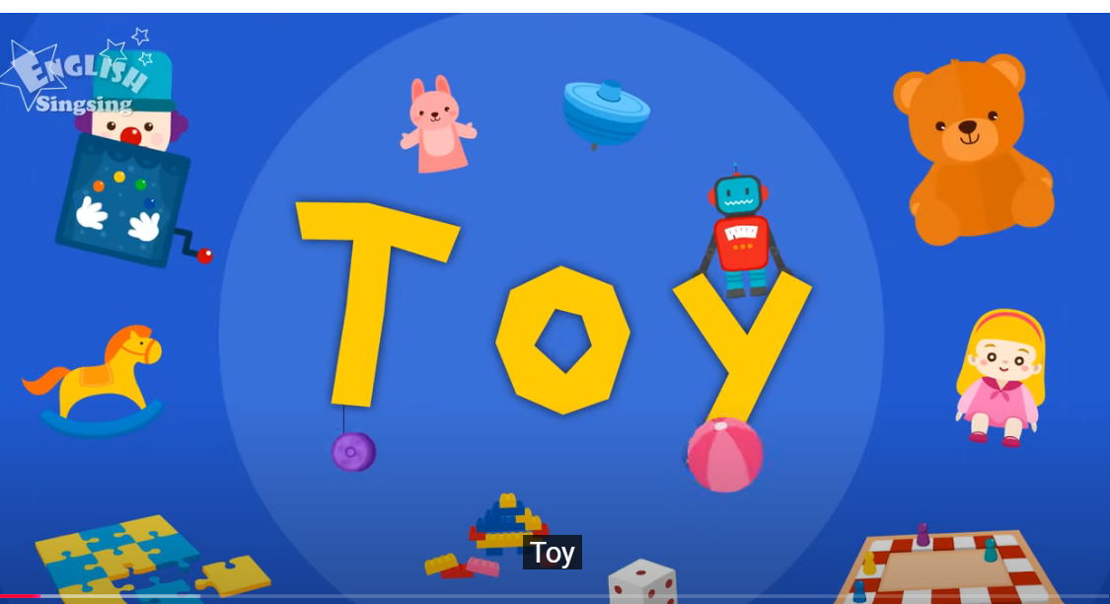
What’s in the box? 3Grade
2024.11.11

Slide 2
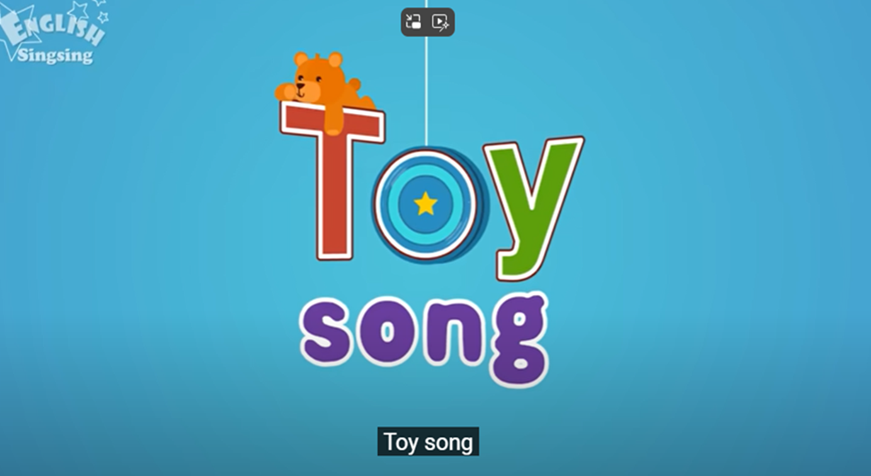
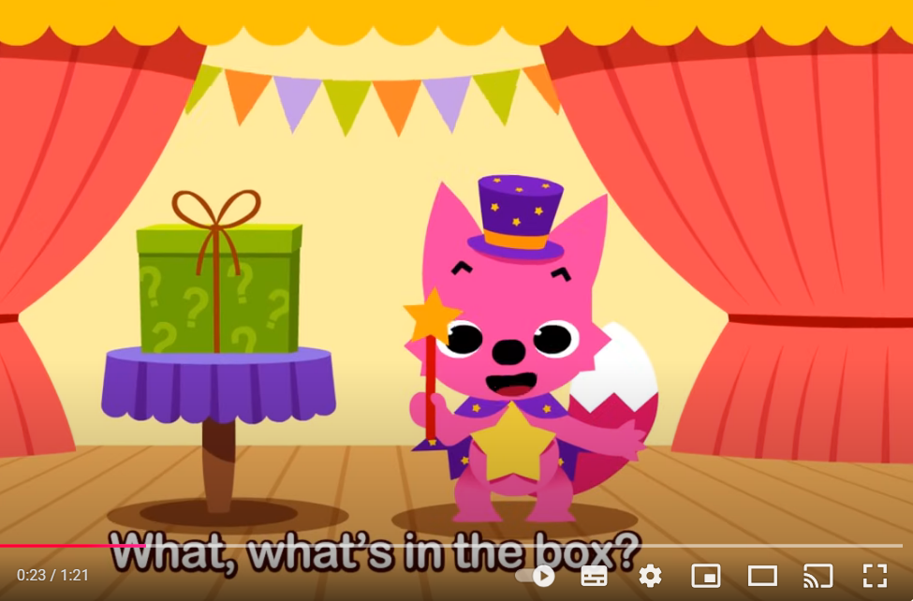
Let’s sing

Slide 3
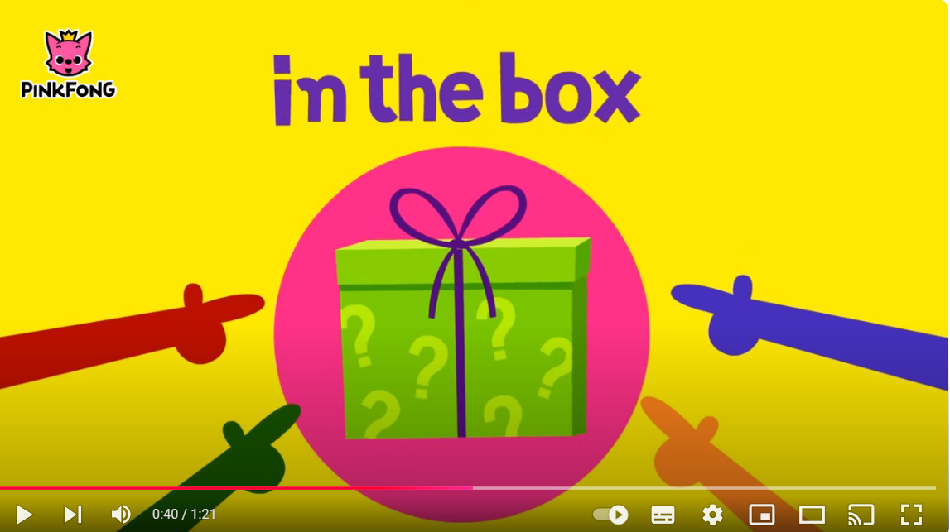
Do you know
What’s ?

Slide 4
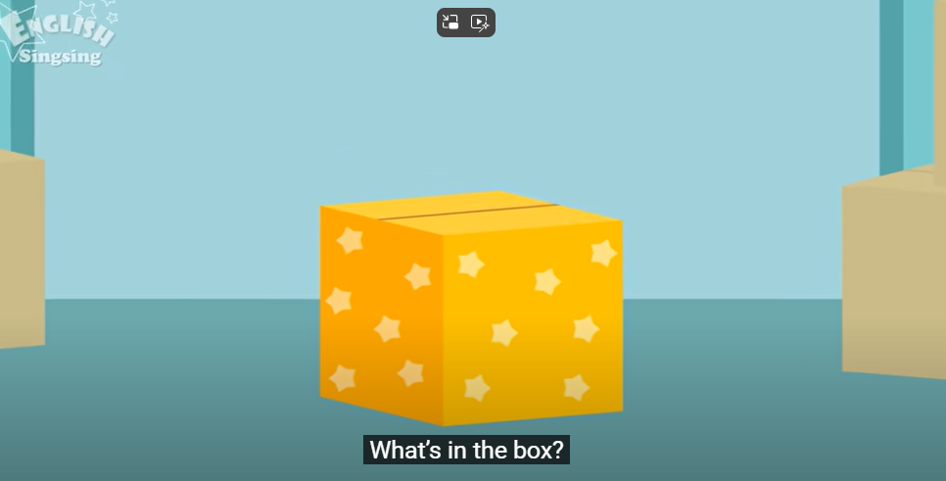
What’s in the box?

Slide 5
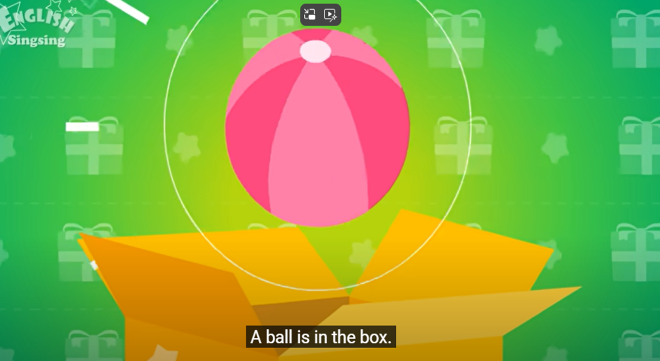
A ball

Slide 6
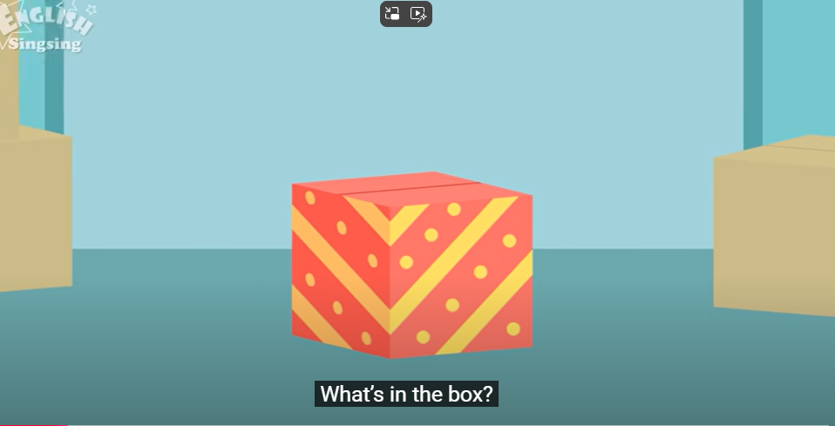
What’s in the box?

Slide 7
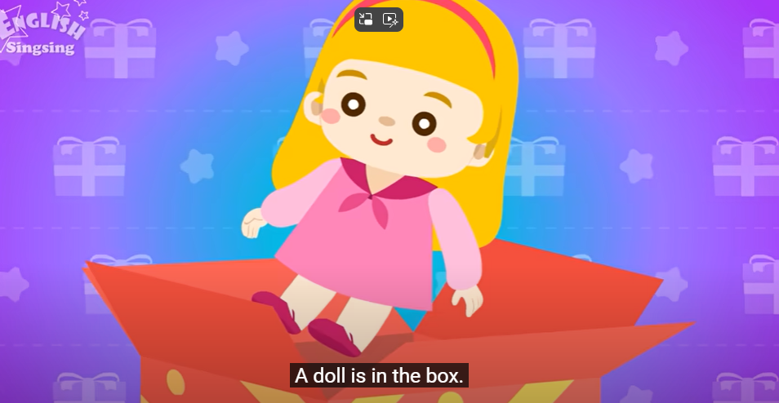
A doll

Slide 8
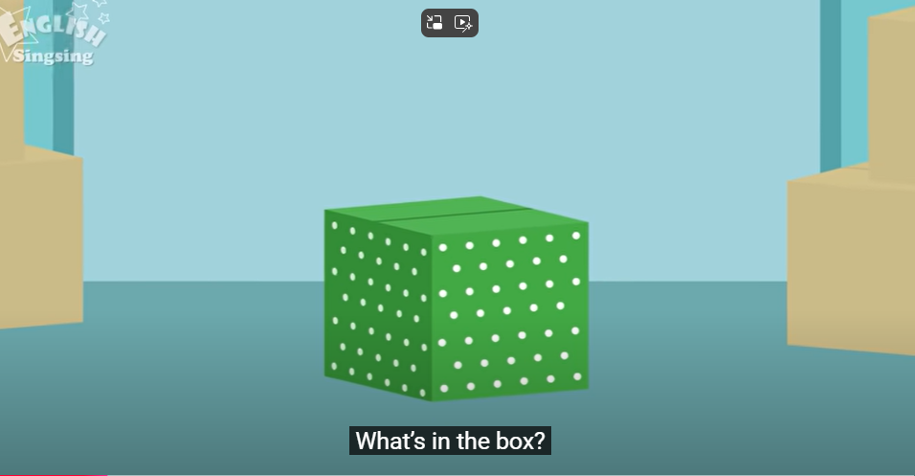
What’s in the box?

Slide 9
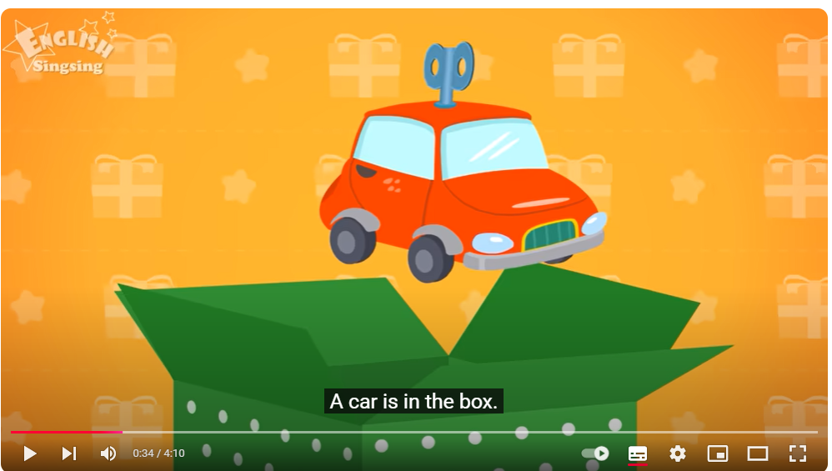
A car

Slide 10
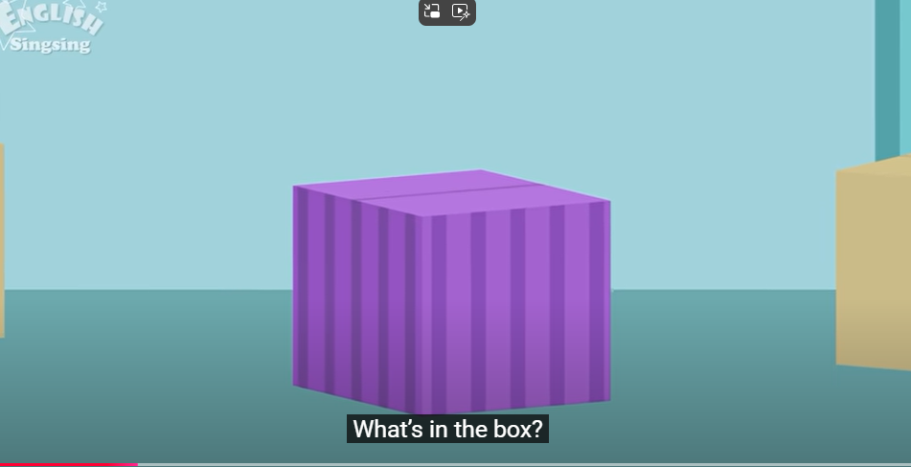
What’s in the box?

Slide 11
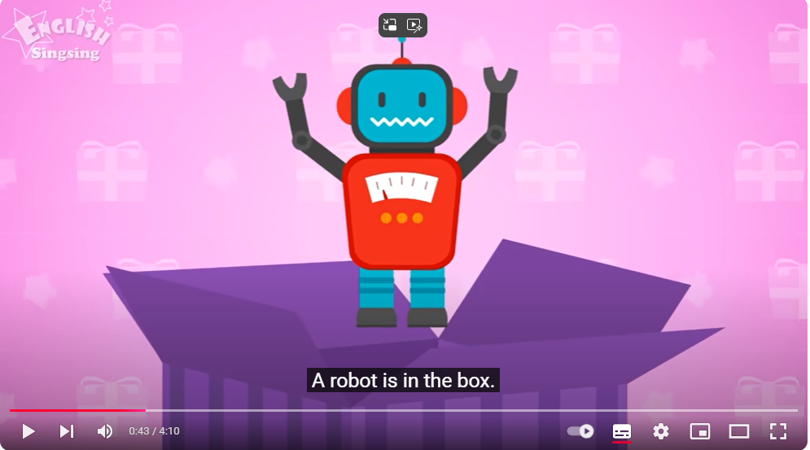
A robot

Slide 12
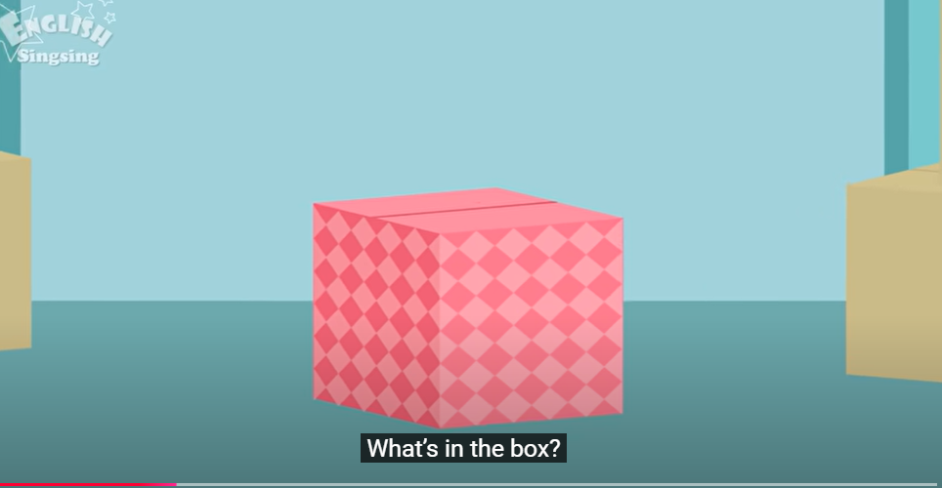
What’s in the box?

Slide 13
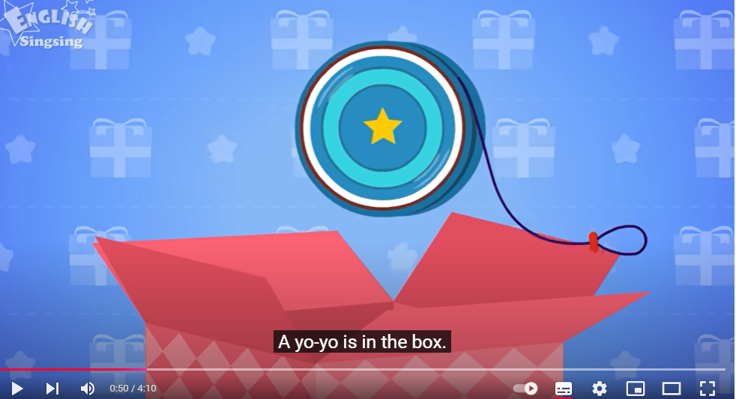
A yo-yo

Slide 14
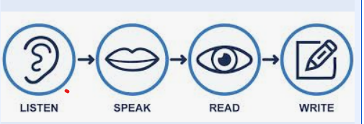





Team work
組長抽圖卡並引導 寫出單字 檢查拼寫 說出單字

Slide 15


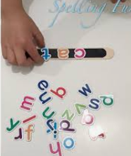
Let’s find out
What’s in your box?
拼出完整圖案 拼出正確單字

Slide 16

Upload file
Padlet

Slide 17
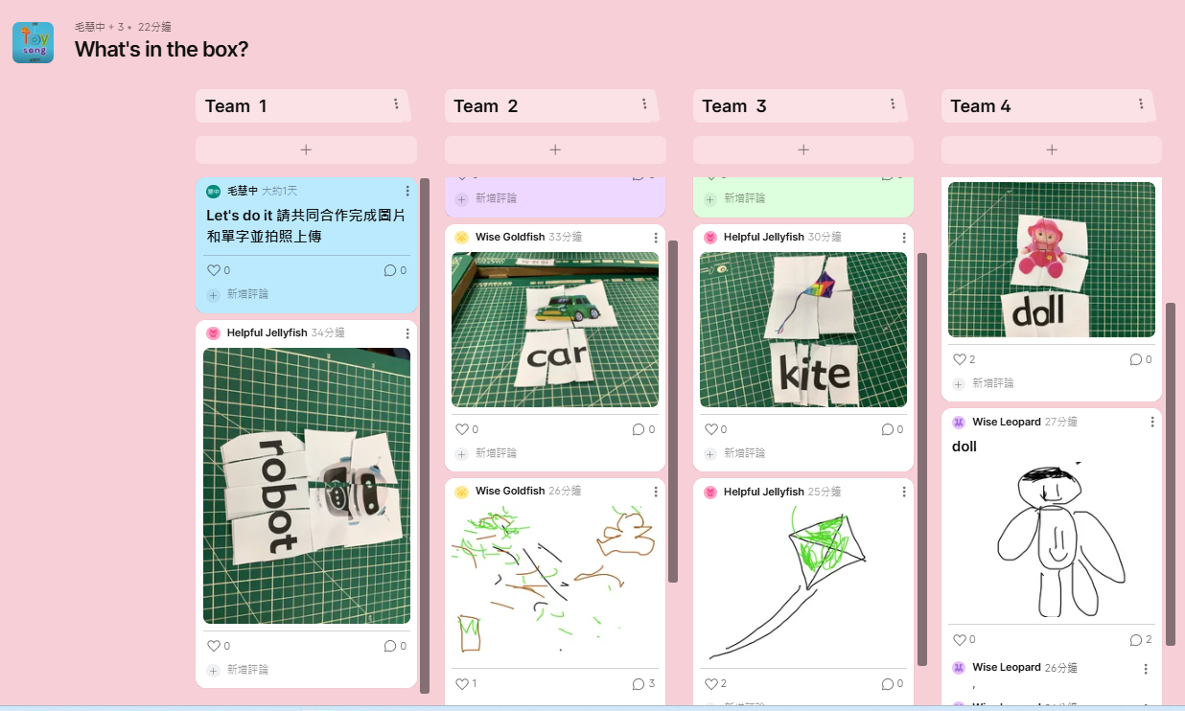
Let’s show and say

Slide 18
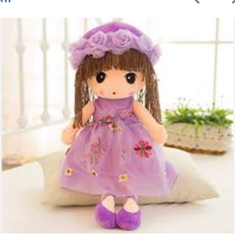
What’ s in the box?
Team:5 Name: Amanda
Write and draw
1.A__doll________is in the box.
2.A__yo-yo______ is _in_the box.
3.A__________is ____the_____.
I like toys

Slide 19
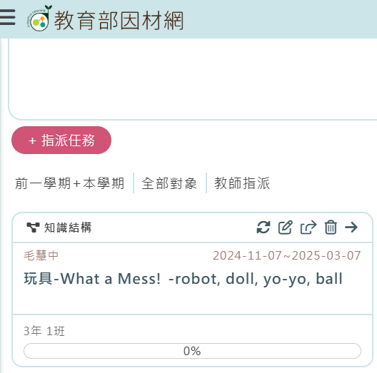
Homework

Slide 20
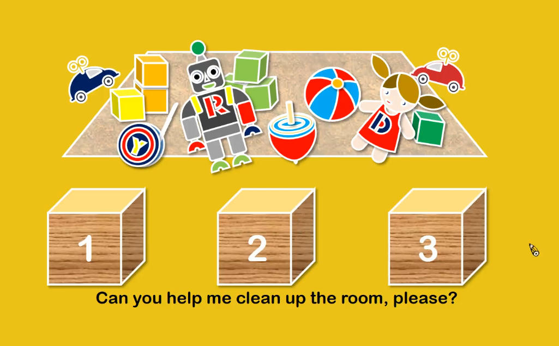
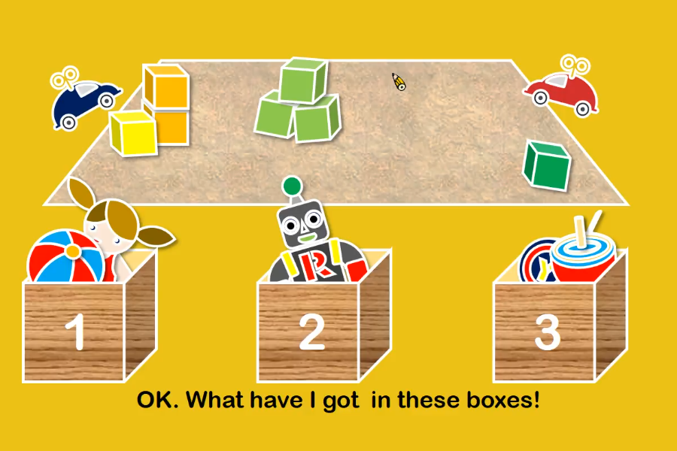

Slide 21
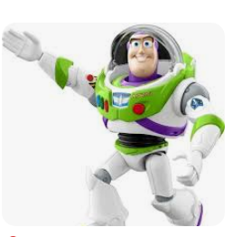
Have a nice day!

