Slide 1
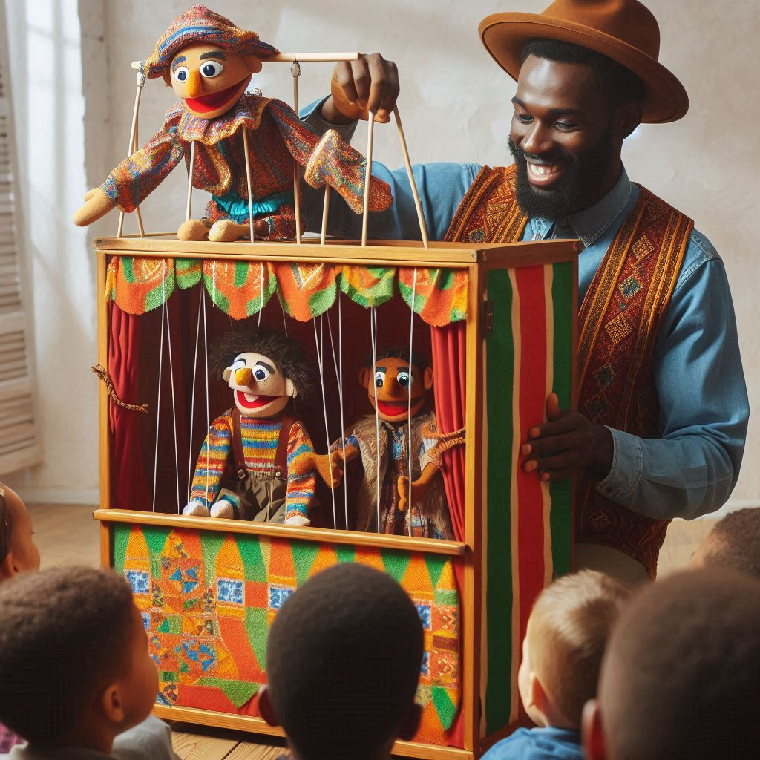
Today, we’re going to read the script and practice acting it out.
今天，我們將閱讀劇本並練習表演。

Slide 2
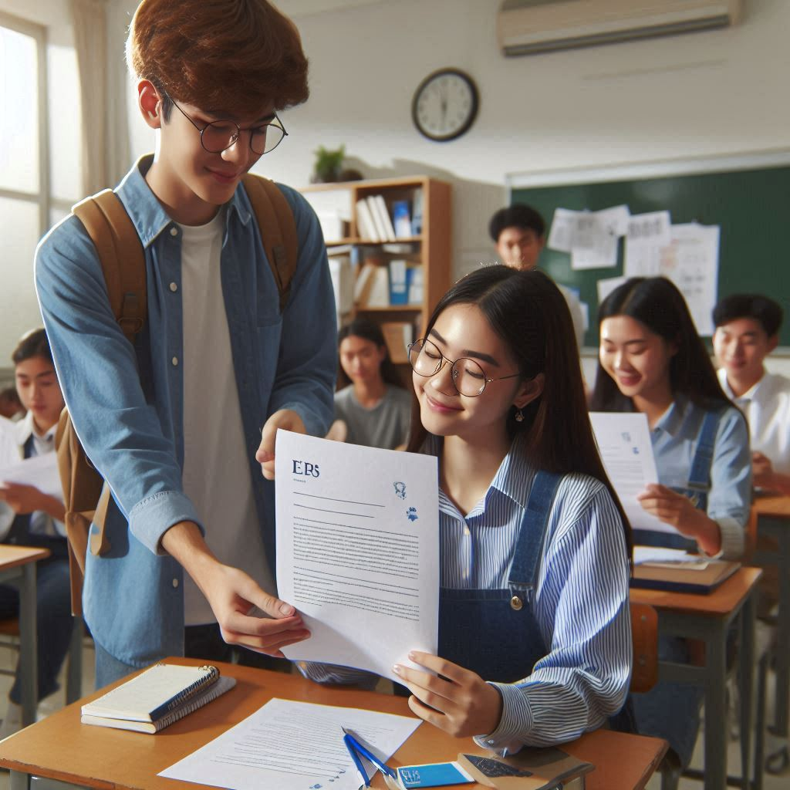
Can today’s duty student please come and pass out the scripts? One copy per person.
今天的值日生可以過來發一下劇本嗎？每人一份。

Slide 3
In each group, please have the student with the best English stand up.
請每一組英文最好的那位同學站起來
For the next five minutes, I need these seven students to help guide their group members.
接下來五分鐘，我需要這五位同學指導自己組內的同學
Now, each group, please practice reading the script. I want everyone to be able to read it.
現在，請小組各自練習讀這份劇本，我需要每個人都能夠唸

Slide 4
I’ll set a timer for five minutes. Let’s start!
計時五分鐘，開始

Slide 5
I will count one two three,and the last one stand up,will read script and group.
我接下來將會數一二三，最慢站起來的組別唸劇本
I will come one two three to change another group to read .
我隨時可能重新數一二三換組唸

Slide 6
Next, please start practicing your puppets with the script.
接下來請你們搭配你們的劇本練習操偶
Please let your puppet touch the stage and not float up
請不要讓你的偶浮起來，要接觸地面
It is necessary to grasp the timing of the puppet's appearance and exit
要掌握好偶出場與退場的時機
When the puppet speak, you need to give it some movement
偶說話的時候要會動

Slide 7
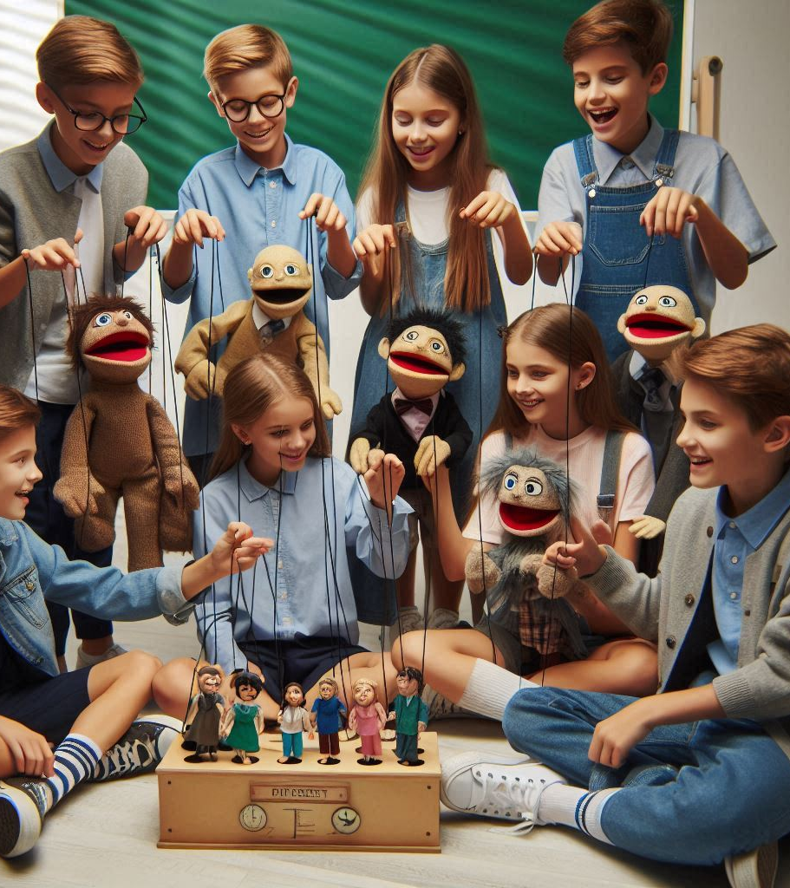
That’s it for today’s class.
今天的課就到這裡
Next week is your official performance, so please be ready.
下週就是你們正式呈現的時候，請做好準備
Class dismissed!
下課

