Slide 1
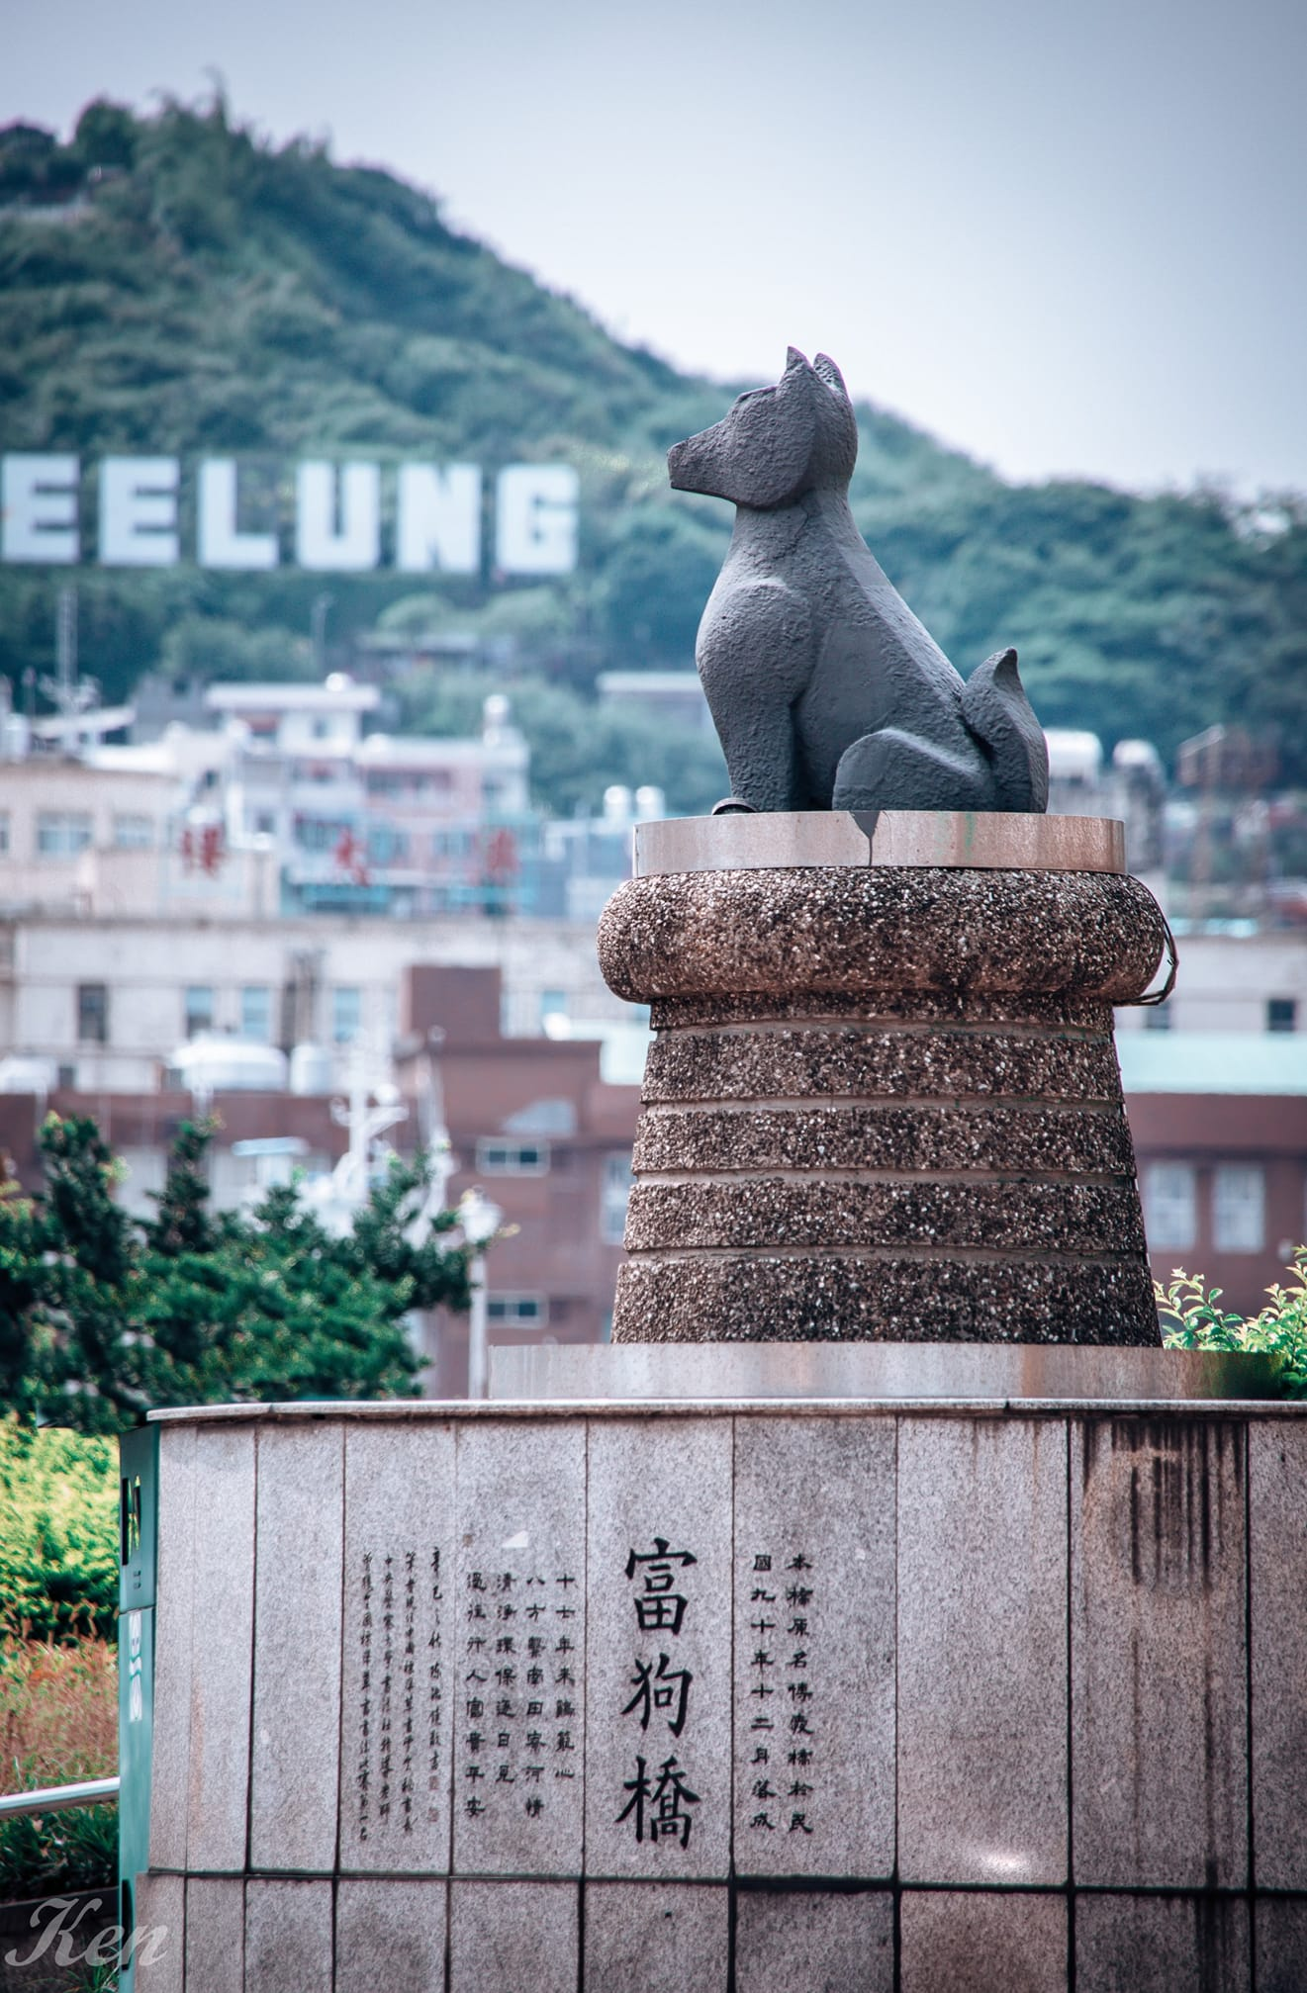
The Twelve
Zodiac Bridges
in Keelung
(At the Zoo)

Slide 2
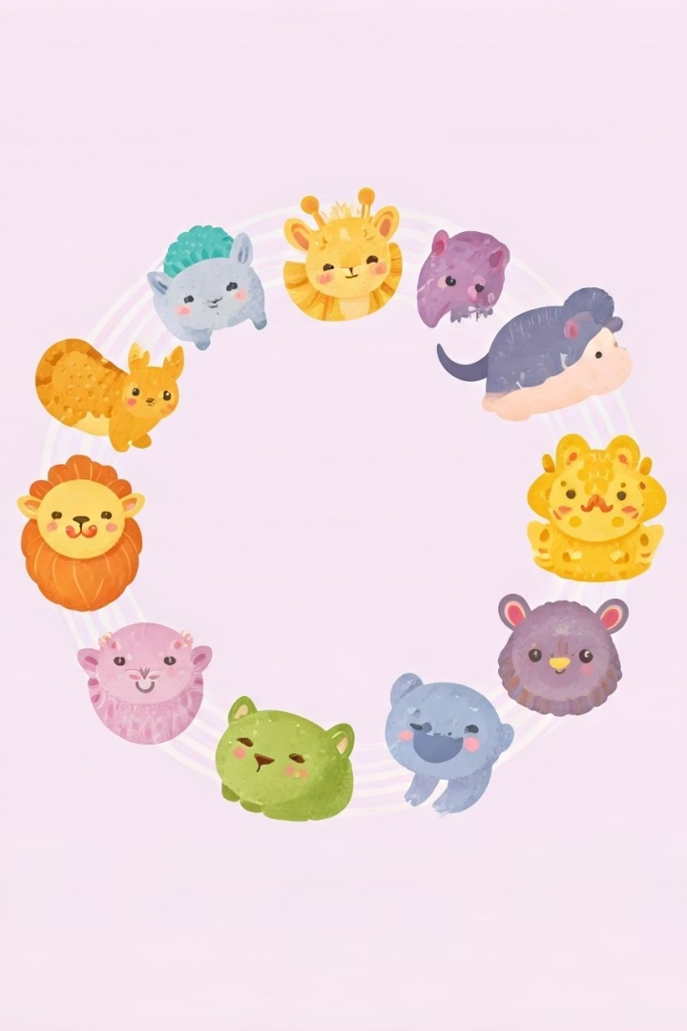
Good morning, kids!

Slide 3
How old are you?
I am 10 years old.
I am 11 years old.

Slide 4
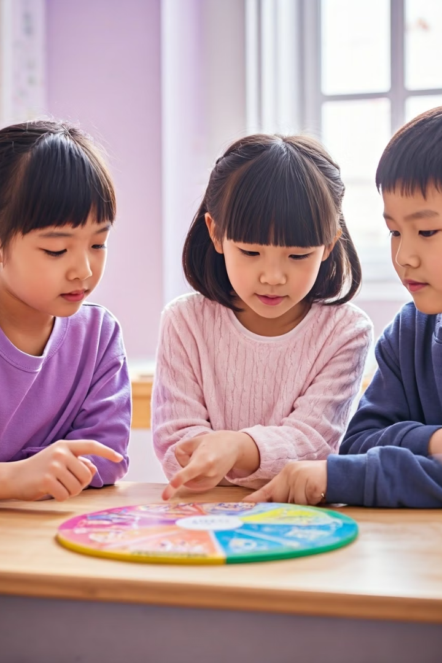
What is your Chinese
Zodiac sign?
I am a dragon!
What about you?

Slide 5
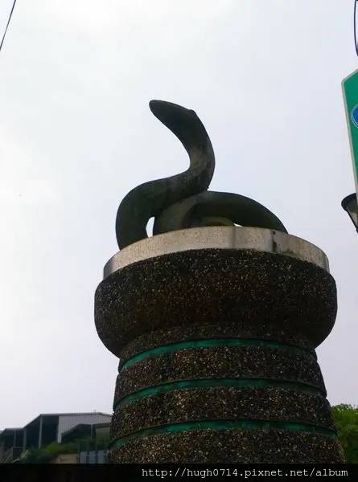
Meet the Zodiac Animals!
12
1
Zodiac Animals
Birth Year
Rat, Ox, Tiger, Rabbit, Dragon, Snake, Horse, Goat, Monkey, Rooster, Dog, Pig
Each person has one zodiac animal based on birth year
thousands
Years Old
This tradition is very ancient!

Slide 6
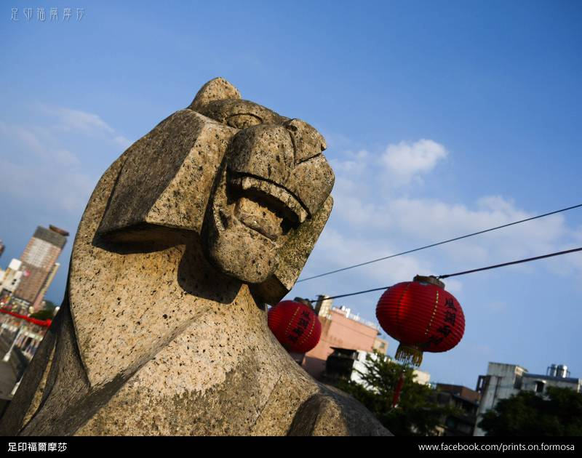
The Zodiac Bridge
Special Place
Amazing Animals
The Zodiac Bridge in Keelung has 12 animals.
Each part of the bridge has one zodiac animal.
Fun Visit
People love to visit this colorful bridge!

Slide 8
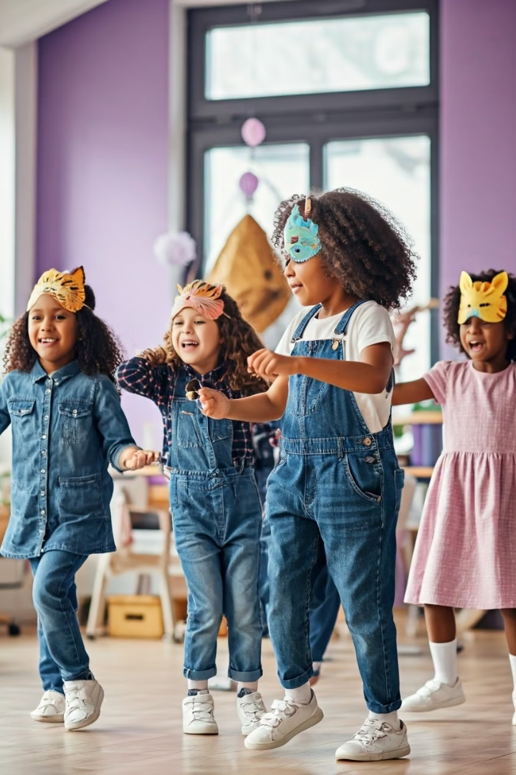
Let's Sing and Dance!
Watch the Video
https://www.youtube.com/watch?v=oEYq5Wqb2qQ
Learn the Song
Sing along with the animal names.
Do the Moves
Each animal has a special dance move!

Slide 9
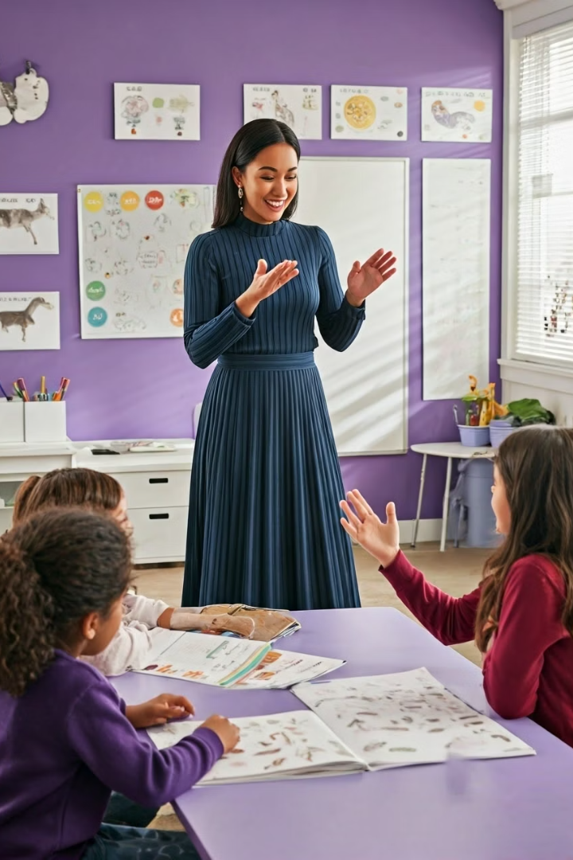
Guess the Animal!
Act It Out
Listen Closely
Raise Your Hand
Watch carefully as I move like an animal.
What animal sound am I making?
Raise your hand when you know the answer!

Slide 10
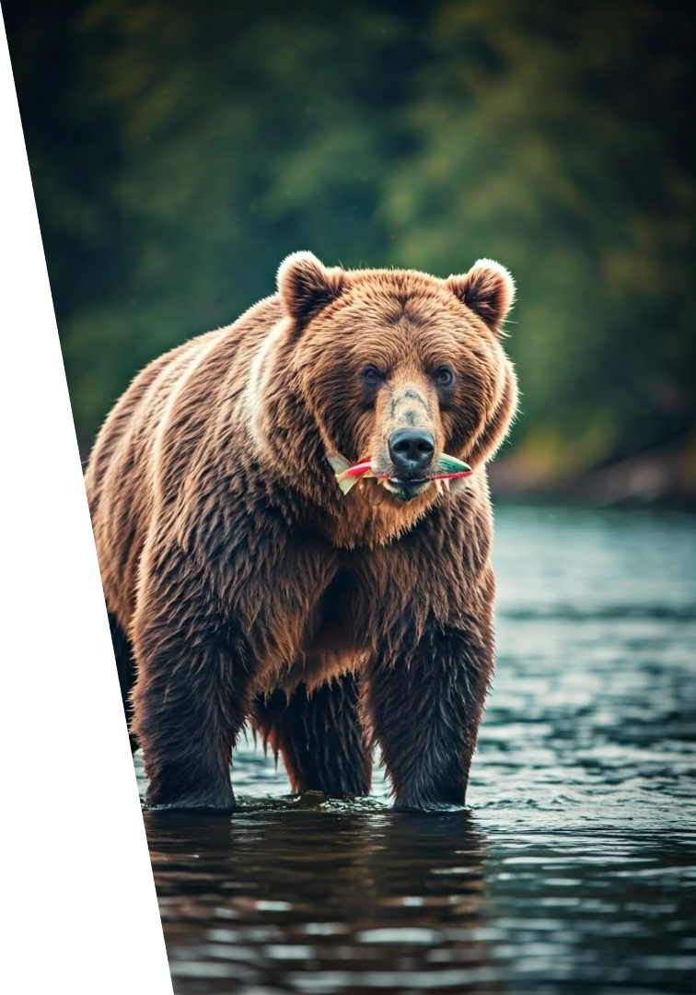
Bear
Big and fluffy word
How to spell it
This word describes a large furry animal that loves honey.
B-E-A-R
Say it out loud

Slide 11
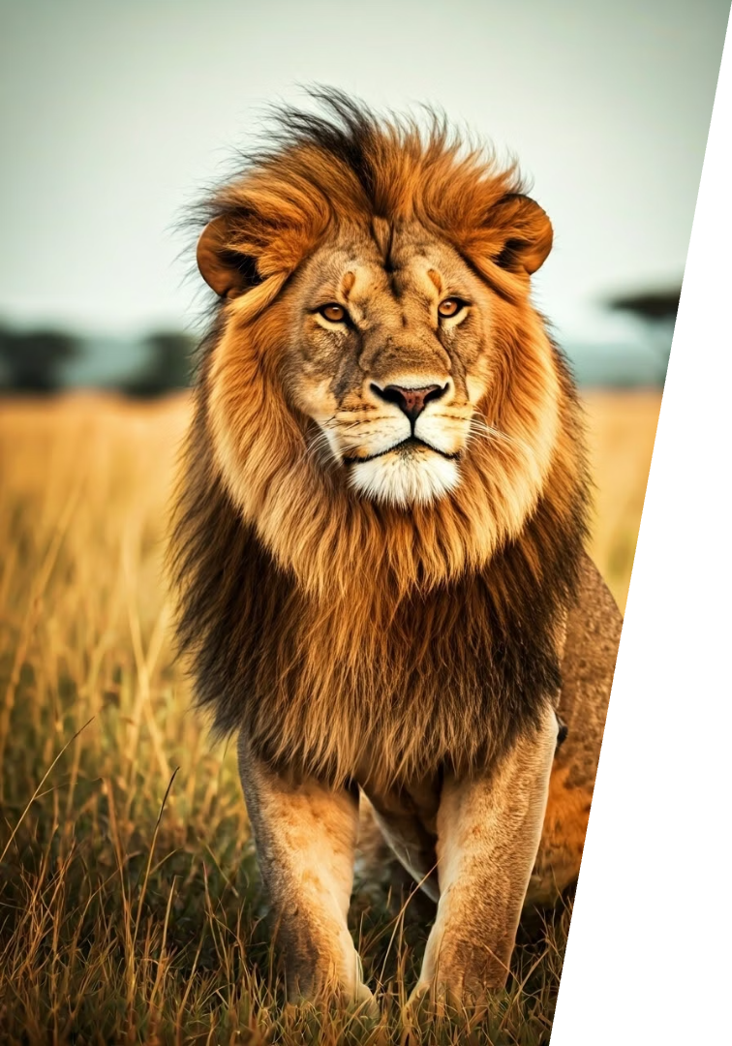
Lion
The Kingly Word
How to spell it
Say it out loud
This word describes the majestic "king of the jungle."
L-I-O-N

Slide 12
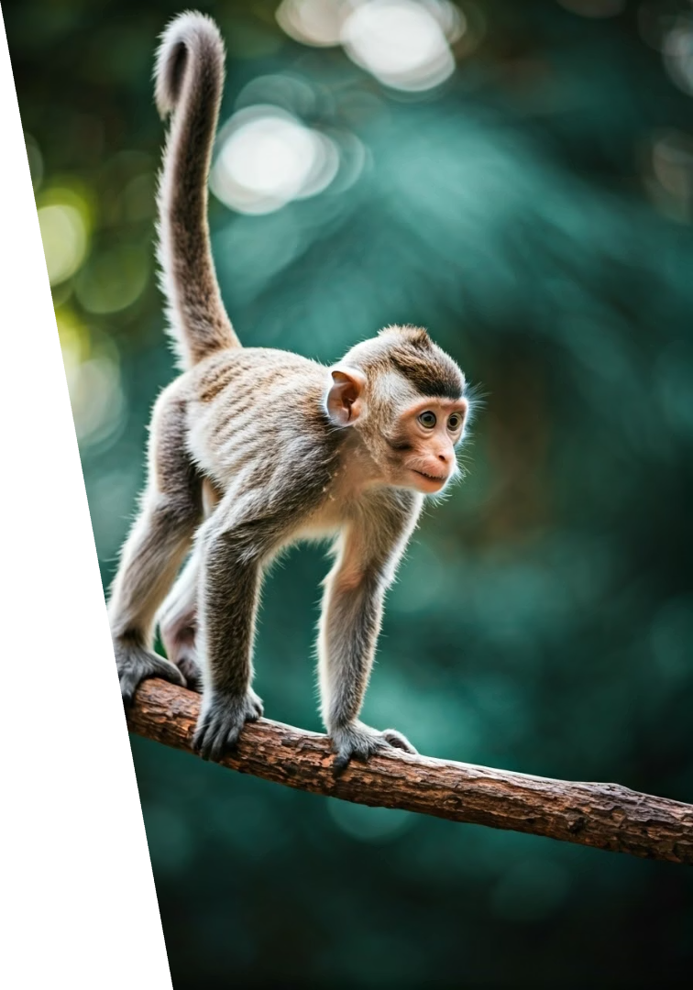
Monkey
1
The Playful Word
This word describes a clever animal that loves to swing and climb.
2
How to spell it
M-O-N-K-E-Y
3
Say it out loud

Slide 13
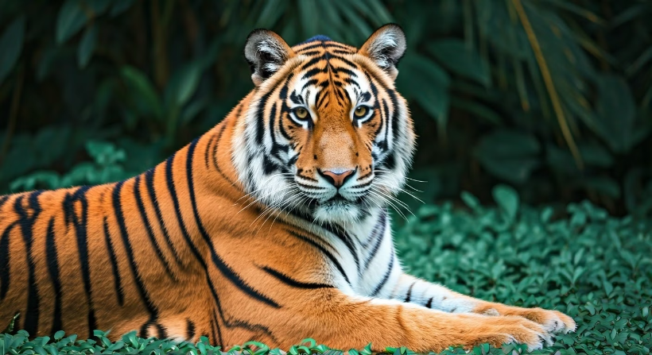
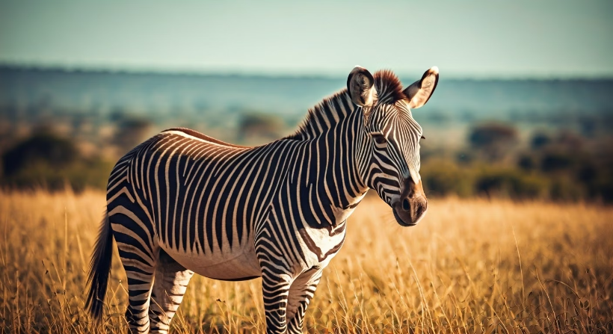
Tiger & Zebra
Tiger
Zebra
Spell it: T-I-G-E-R
Spell it: Z-E-B-R-A

Slide 14
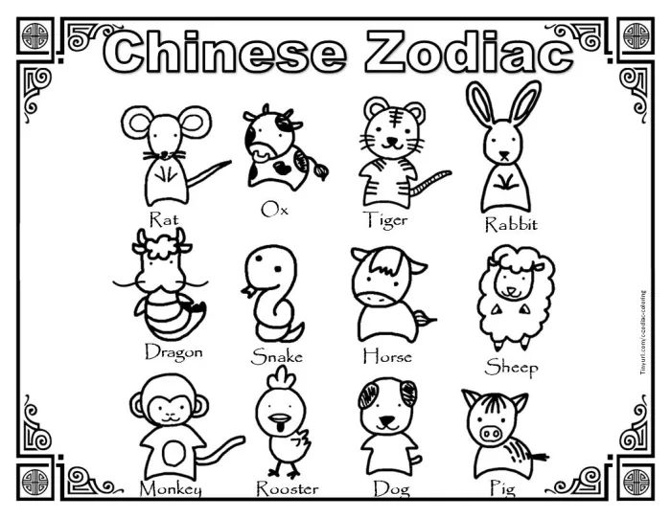

Slide 15
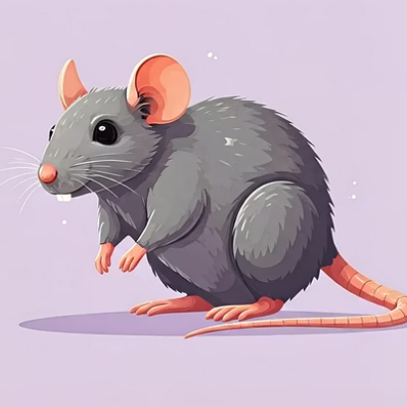
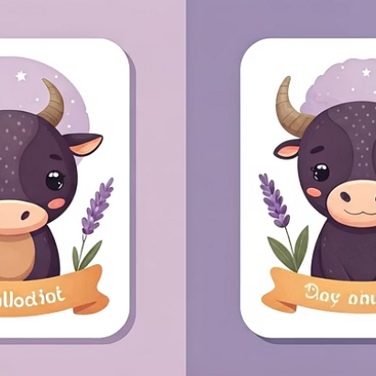
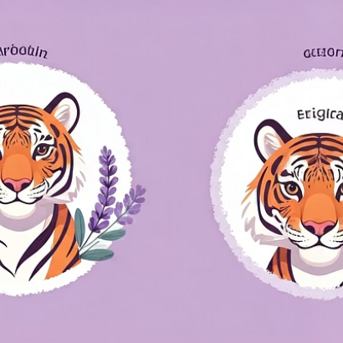
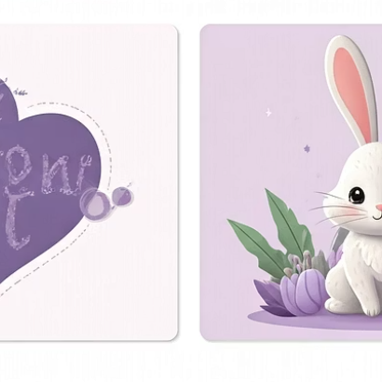
Say It Loudly!
Let's practice saying each animal name together!

Slide 16
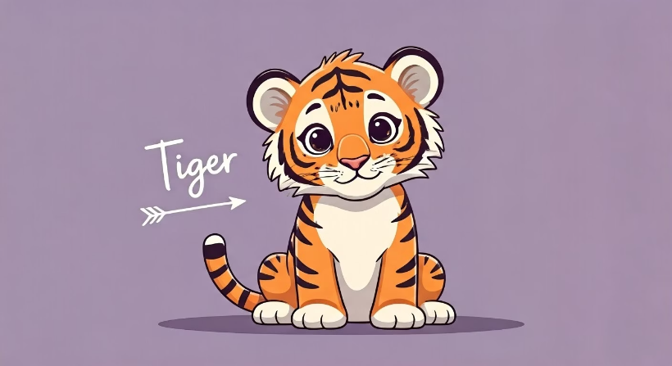
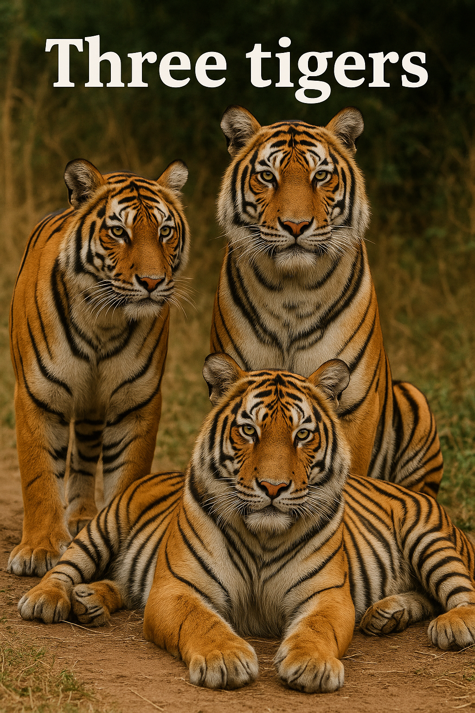
One or Many?
One Animal
Many Animals
We say "a tiger" for one.
We say "tigers" for many.

Slide 17
Whiteboard Challenge!
Get Ready
Listen
Grab your whiteboard and marker!
I'll say a word and show fingers.
Show Me
Write
Hold up your board when finished!
Write "a dog" or "dogs" correctly.

Slide 18
Review Time!
Remember
Practice
Review
Let's say all animal names together.
Complete your worksheet carefully.
Take home any unfinished work.

Slide 19
See You Tomorrow!
Great Job Today!
Remember
Don't Forget
You learned all 12 zodiac animals.
Practice saying the animal names at home.
Bring back your worksheet tomorrow!

