Slide 1


Shape of the class
1. Talk about “Carbon footprint.”
2. Group competition.
3. Bingo activity: Find someone who say “yes.”
4. Time for sharing

Slide 2

What is “carbon footprint”?

Slide 3
The meaning of “carbon footprint”
A carbon footprint is the total amount of greenhouse gases (including carbon dioxide and methane) that are from our actions.

Slide 4
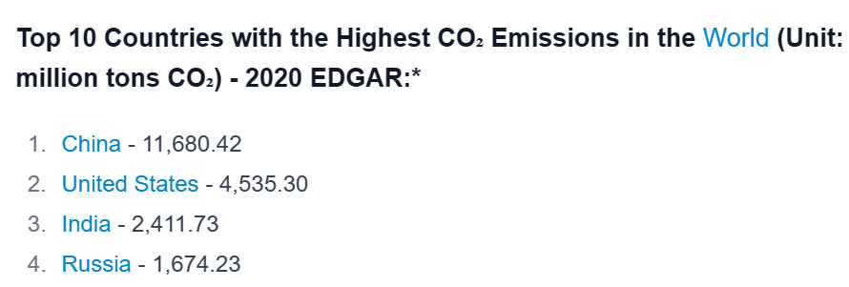
Q: Which country was the top 1 with the highest CO₂ emissions(排放量)
in 2020 in the world?
China
(B) The USA
(C) India
(D)Russia

Slide 5

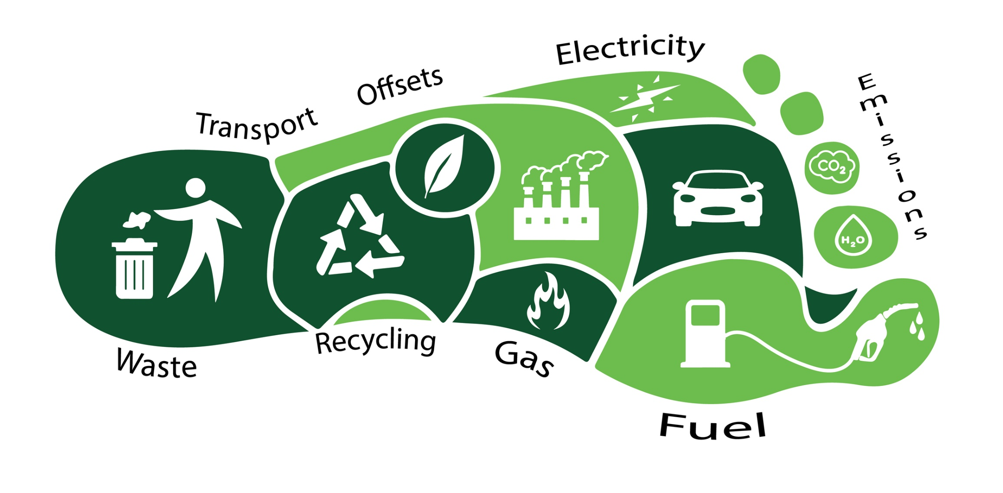
What can we do to reduce “carbon footprint”?

Slide 6
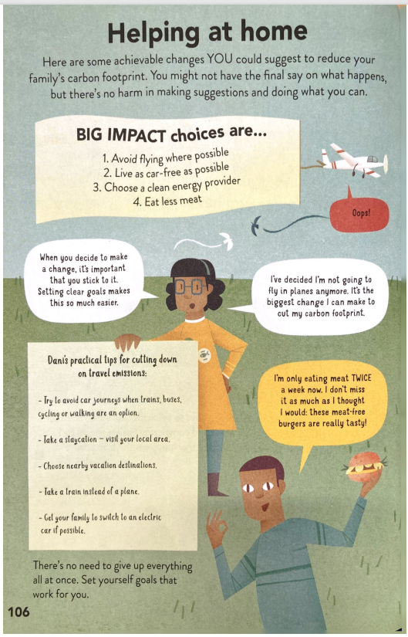
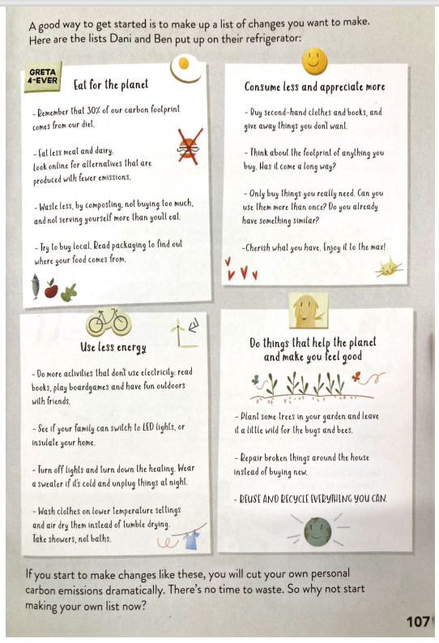
Have you ever …?
THE GAME

Slide 7
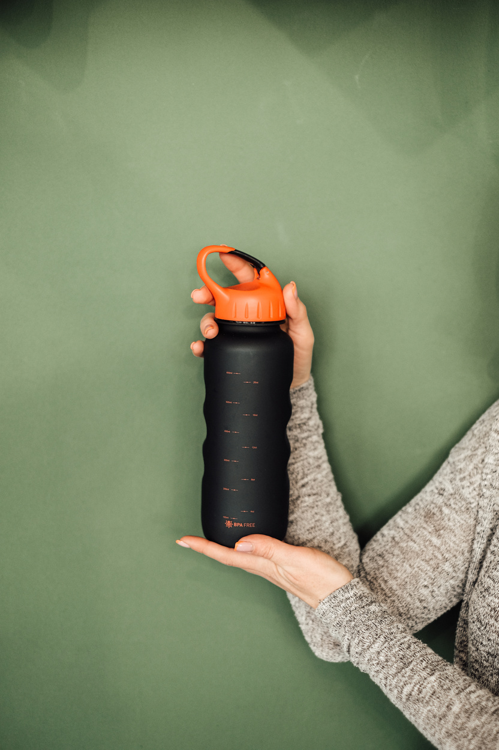
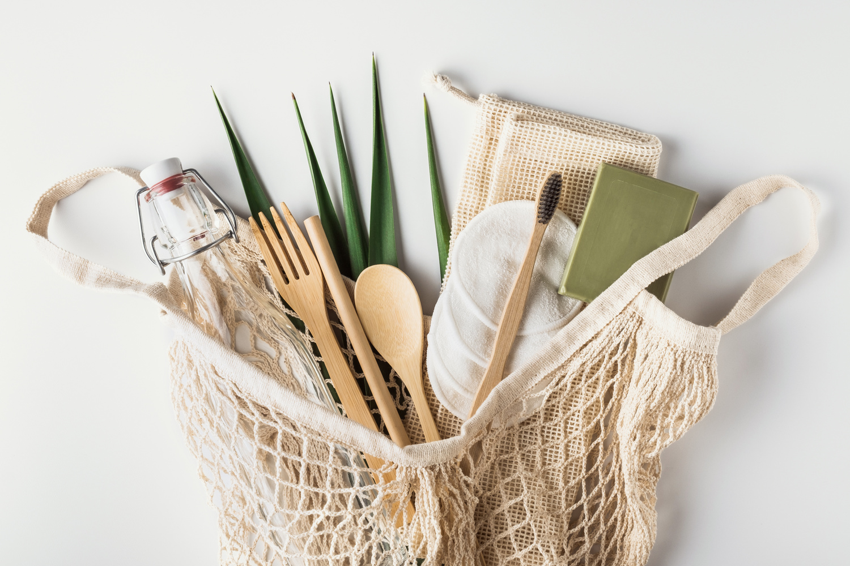
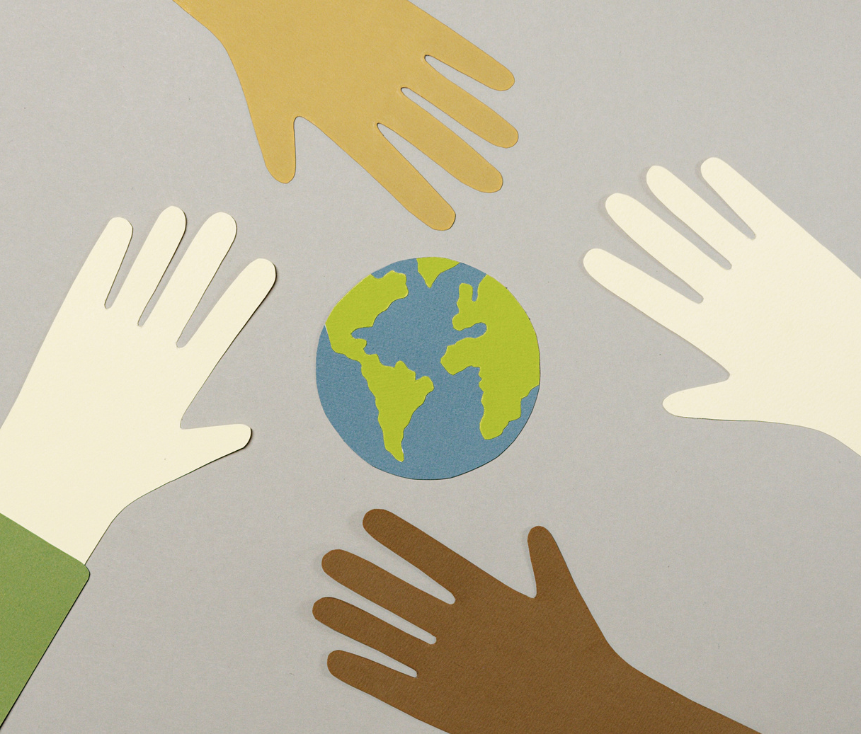
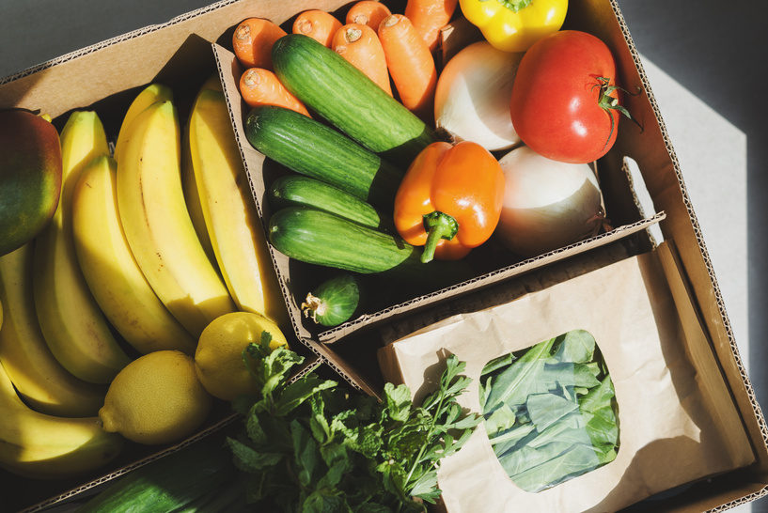

Have you ever …?
Present perfect tense

Slide 8
Q: Have you ever……..…….…?
A: Yes, I have p.p…. before.
Each of you (from A to D/E) needs to look at the picture, and write down a question and an answer by using perfect present tense.
The
rules!
If you can write down correct sentences in a minute, your team can get one point. The winner team can get some rewards.

Slide 9
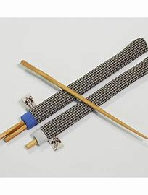
Use the sentence pattern
“ Q: Have you ever…? A: I have… before.”
Q: Have you ever brought your chopsticks?
A:(1) Yes, I have brought our chopsticks before.
(2) No, I haven’t brought our chopsticks before.

Slide 10

Have you ever …?

Slide 11
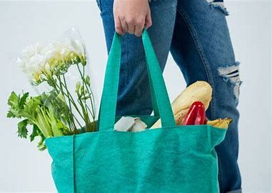
Q: Have you ever………………....….….…….…?
A: Yes, I have…/No, I haven’t…before.
1. A from each team
bring your shopping bag

Slide 12

Q: Have you ever………………....….….…….…?
A: Yes, I have…/No, I haven’t…before.
2. B from each team
read any books about climate crisis
(氣候危機)

Slide 13
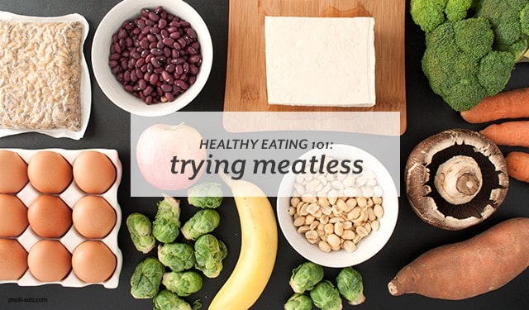
Q: Have you ever………………....….….…….…?
A: Yes, I have…/No, I haven’t…before.
3. C from each team
eat a meal without meat

Slide 14
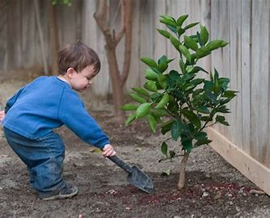
Q: Have you ever………………....….….…….…?
A: Yes, I have…/No, I haven’t…before.
4. D from each team
plant any trees

Slide 15
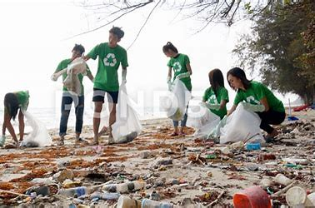
Q: Have you ever………………....….….…….…?
A: Yes, I have…/No, I haven’t…before.
5. D/E from each team
clean up the beach

Slide 16

Have you ever…?
6. A from each team
live as car-free as possible

Slide 17
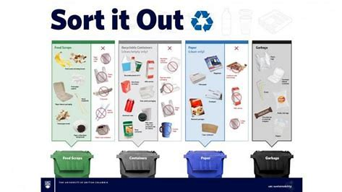
Have you ever…?
7. B from each team
Fsort the garbage

Slide 18
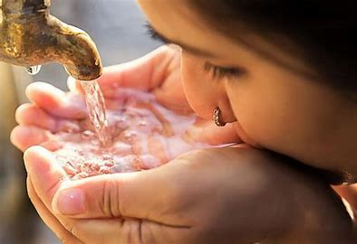
Have you ever…?
8. C from each team
drink tap water

Slide 19
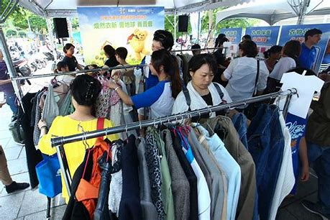
Have you ever…?
9. D from each team
buy second-hand clothes

Slide 20

Have you ever…?
10. C/E from each team
fix broken things

Slide 21
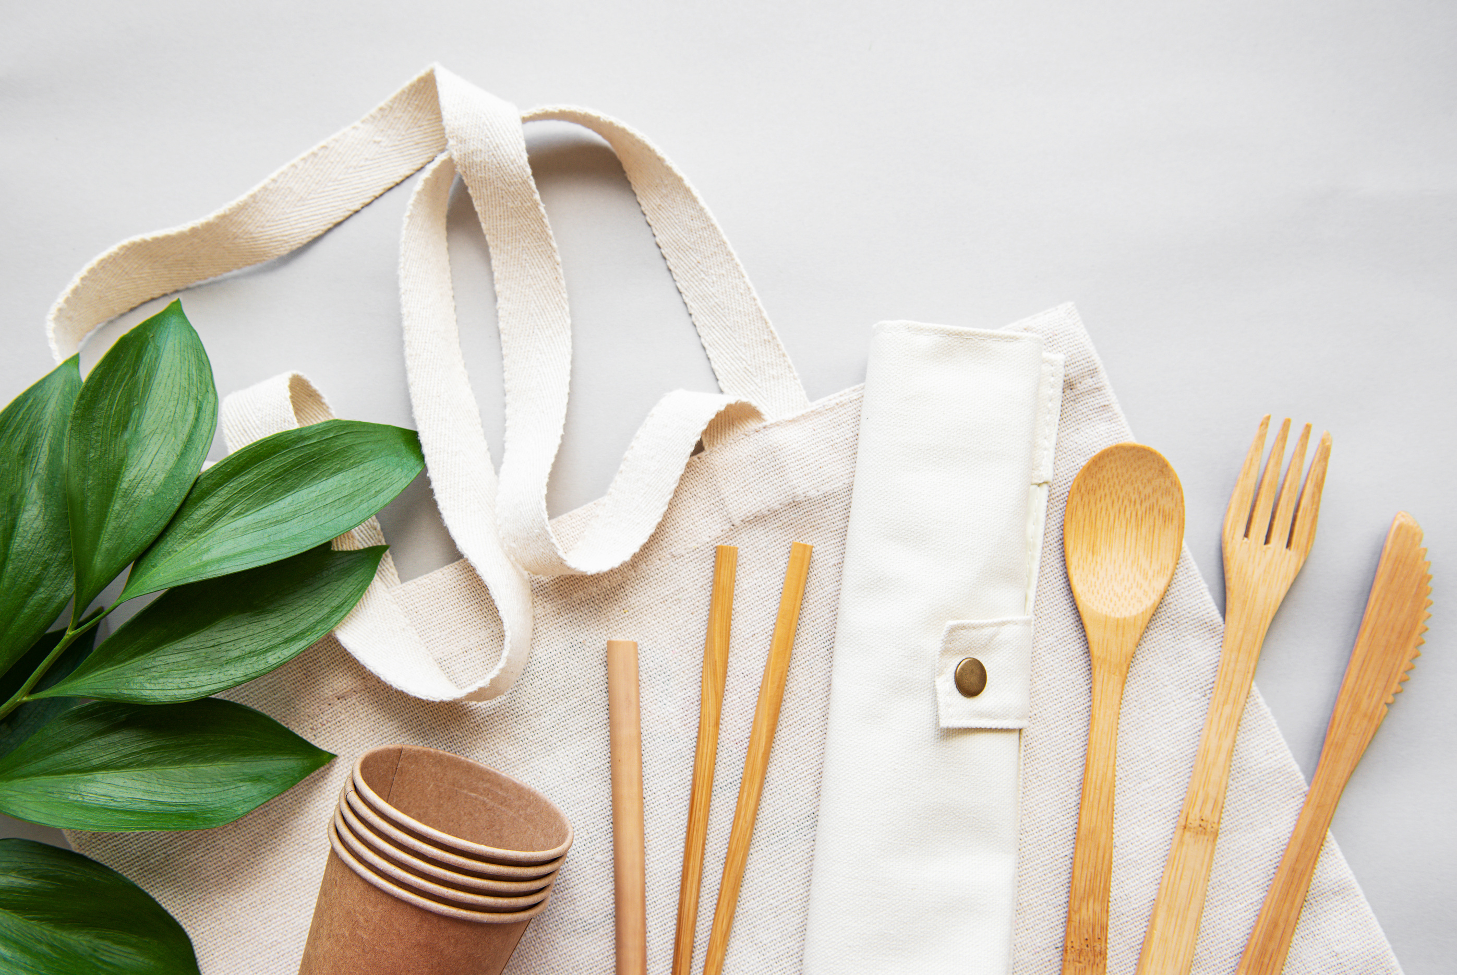


Daily Reminder

