Slide 1
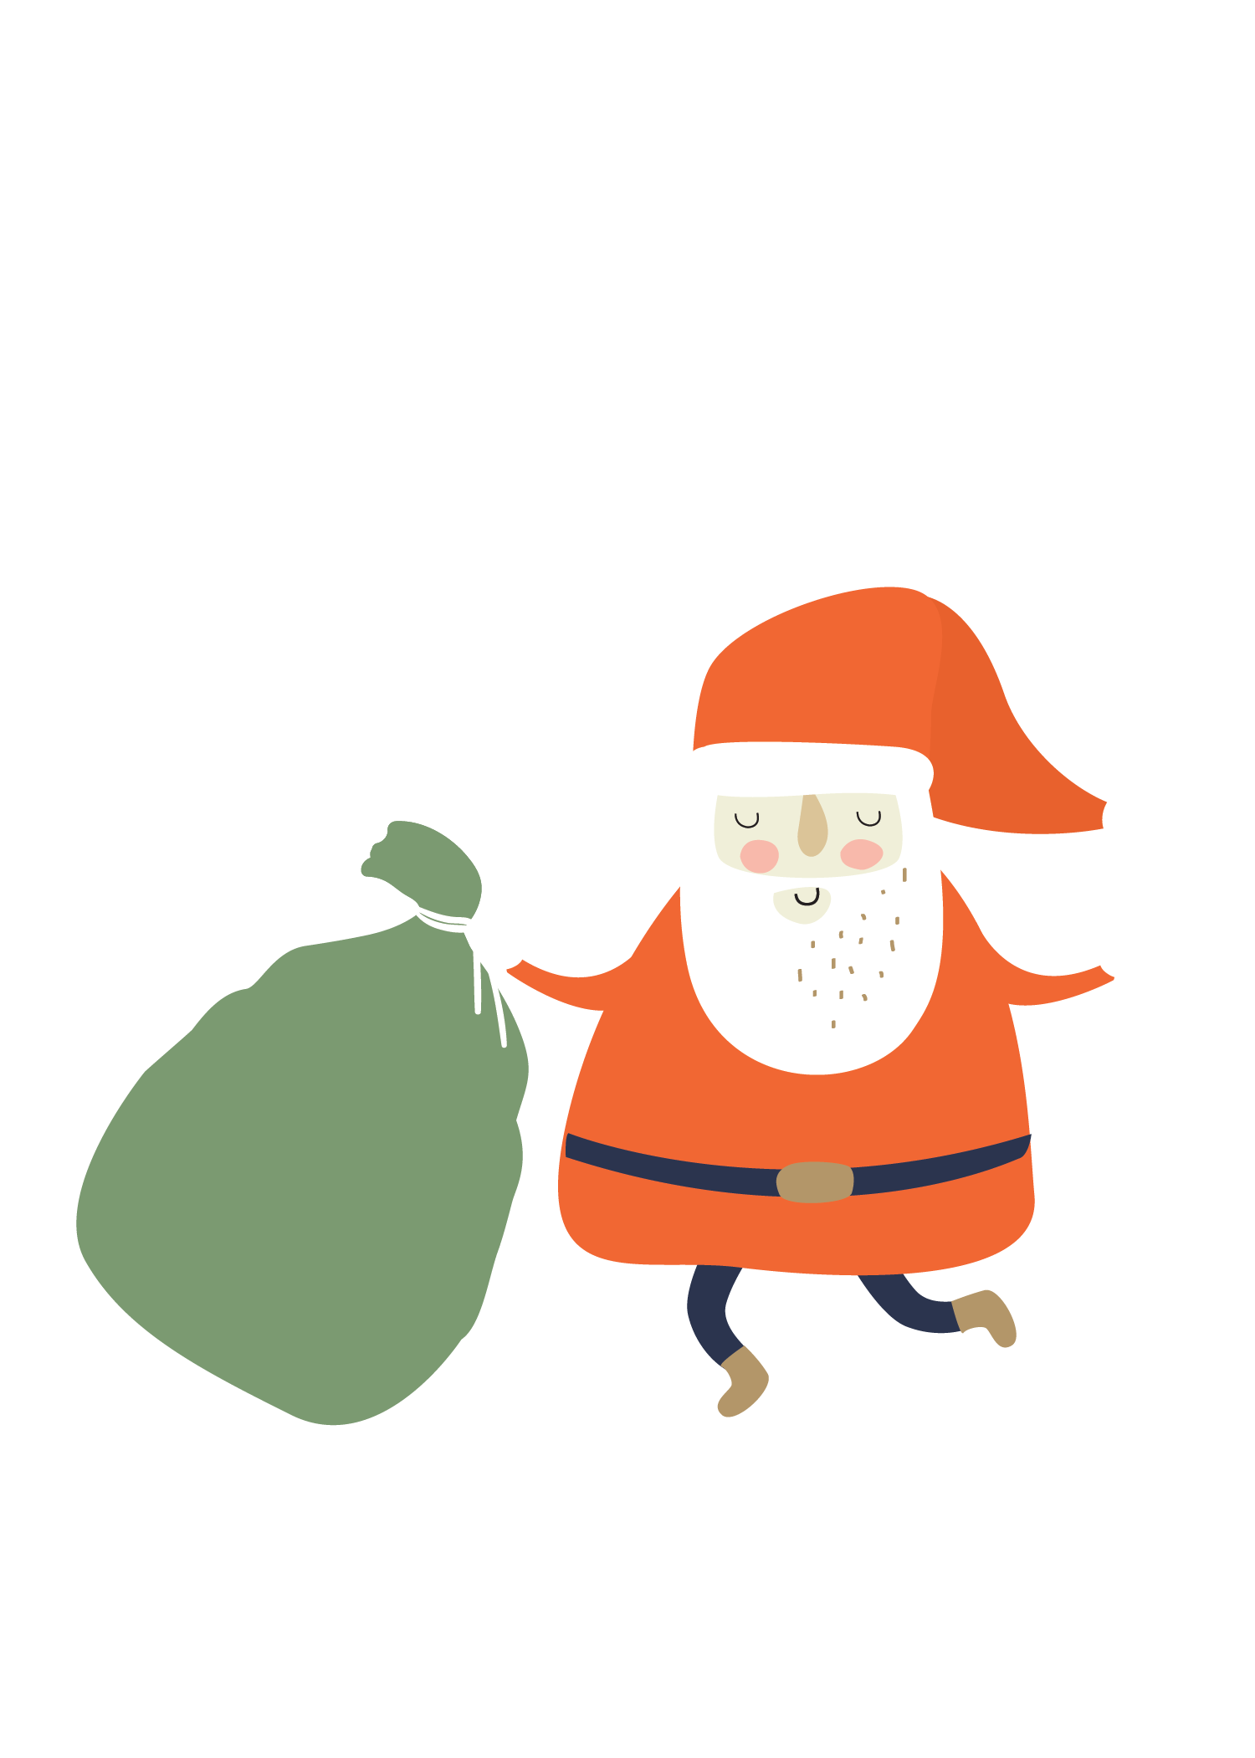
聖誕節的由來
https://www.youtube.com/watch?v=JXw5LsZS0p8
跟春節有什麼不一樣?

Slide 2
What is it?
https://www.youtube.com/watch?v=406GPN2h7jo

Slide 3
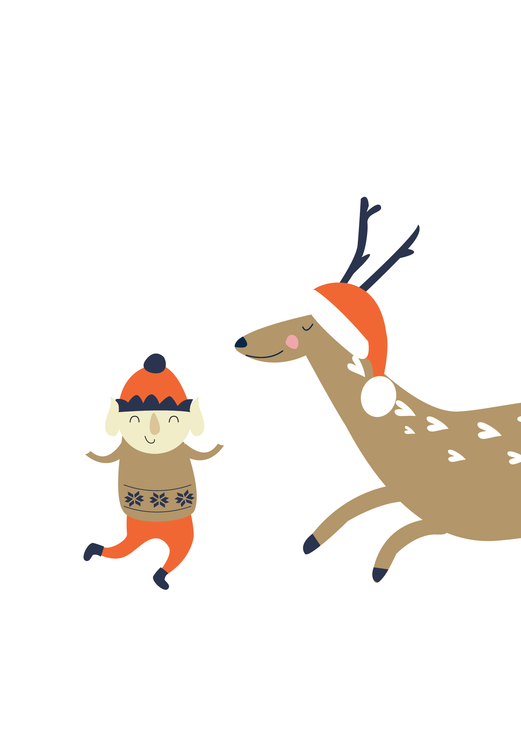
Rudolph-Red nosed reindeer
紅鼻子魯道夫
https://www.youtube.com/watch?v=UsTZ2zGybeM&t=30s
請致電或以信件回覆邀請 555-0100 | 345 Main St. Centerville

Slide 4
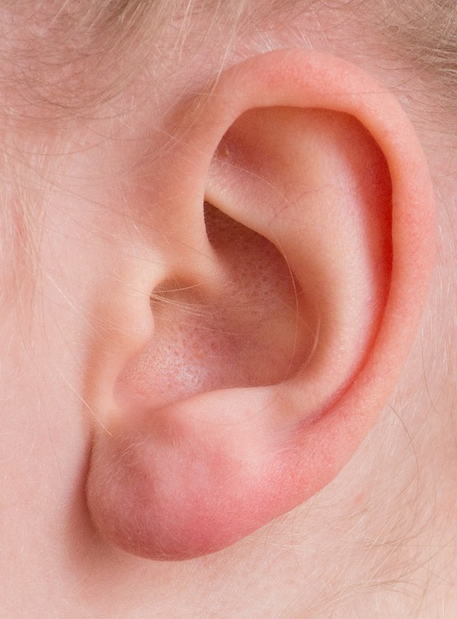
ear

Slide 5
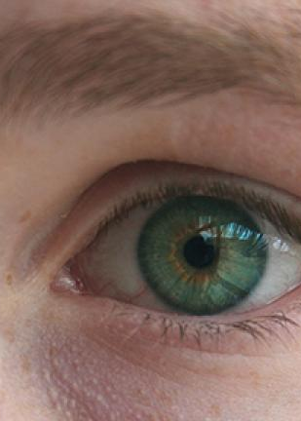
eye

Slide 6
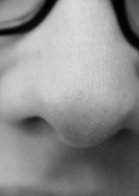
nose

Slide 7

mouth

Slide 8
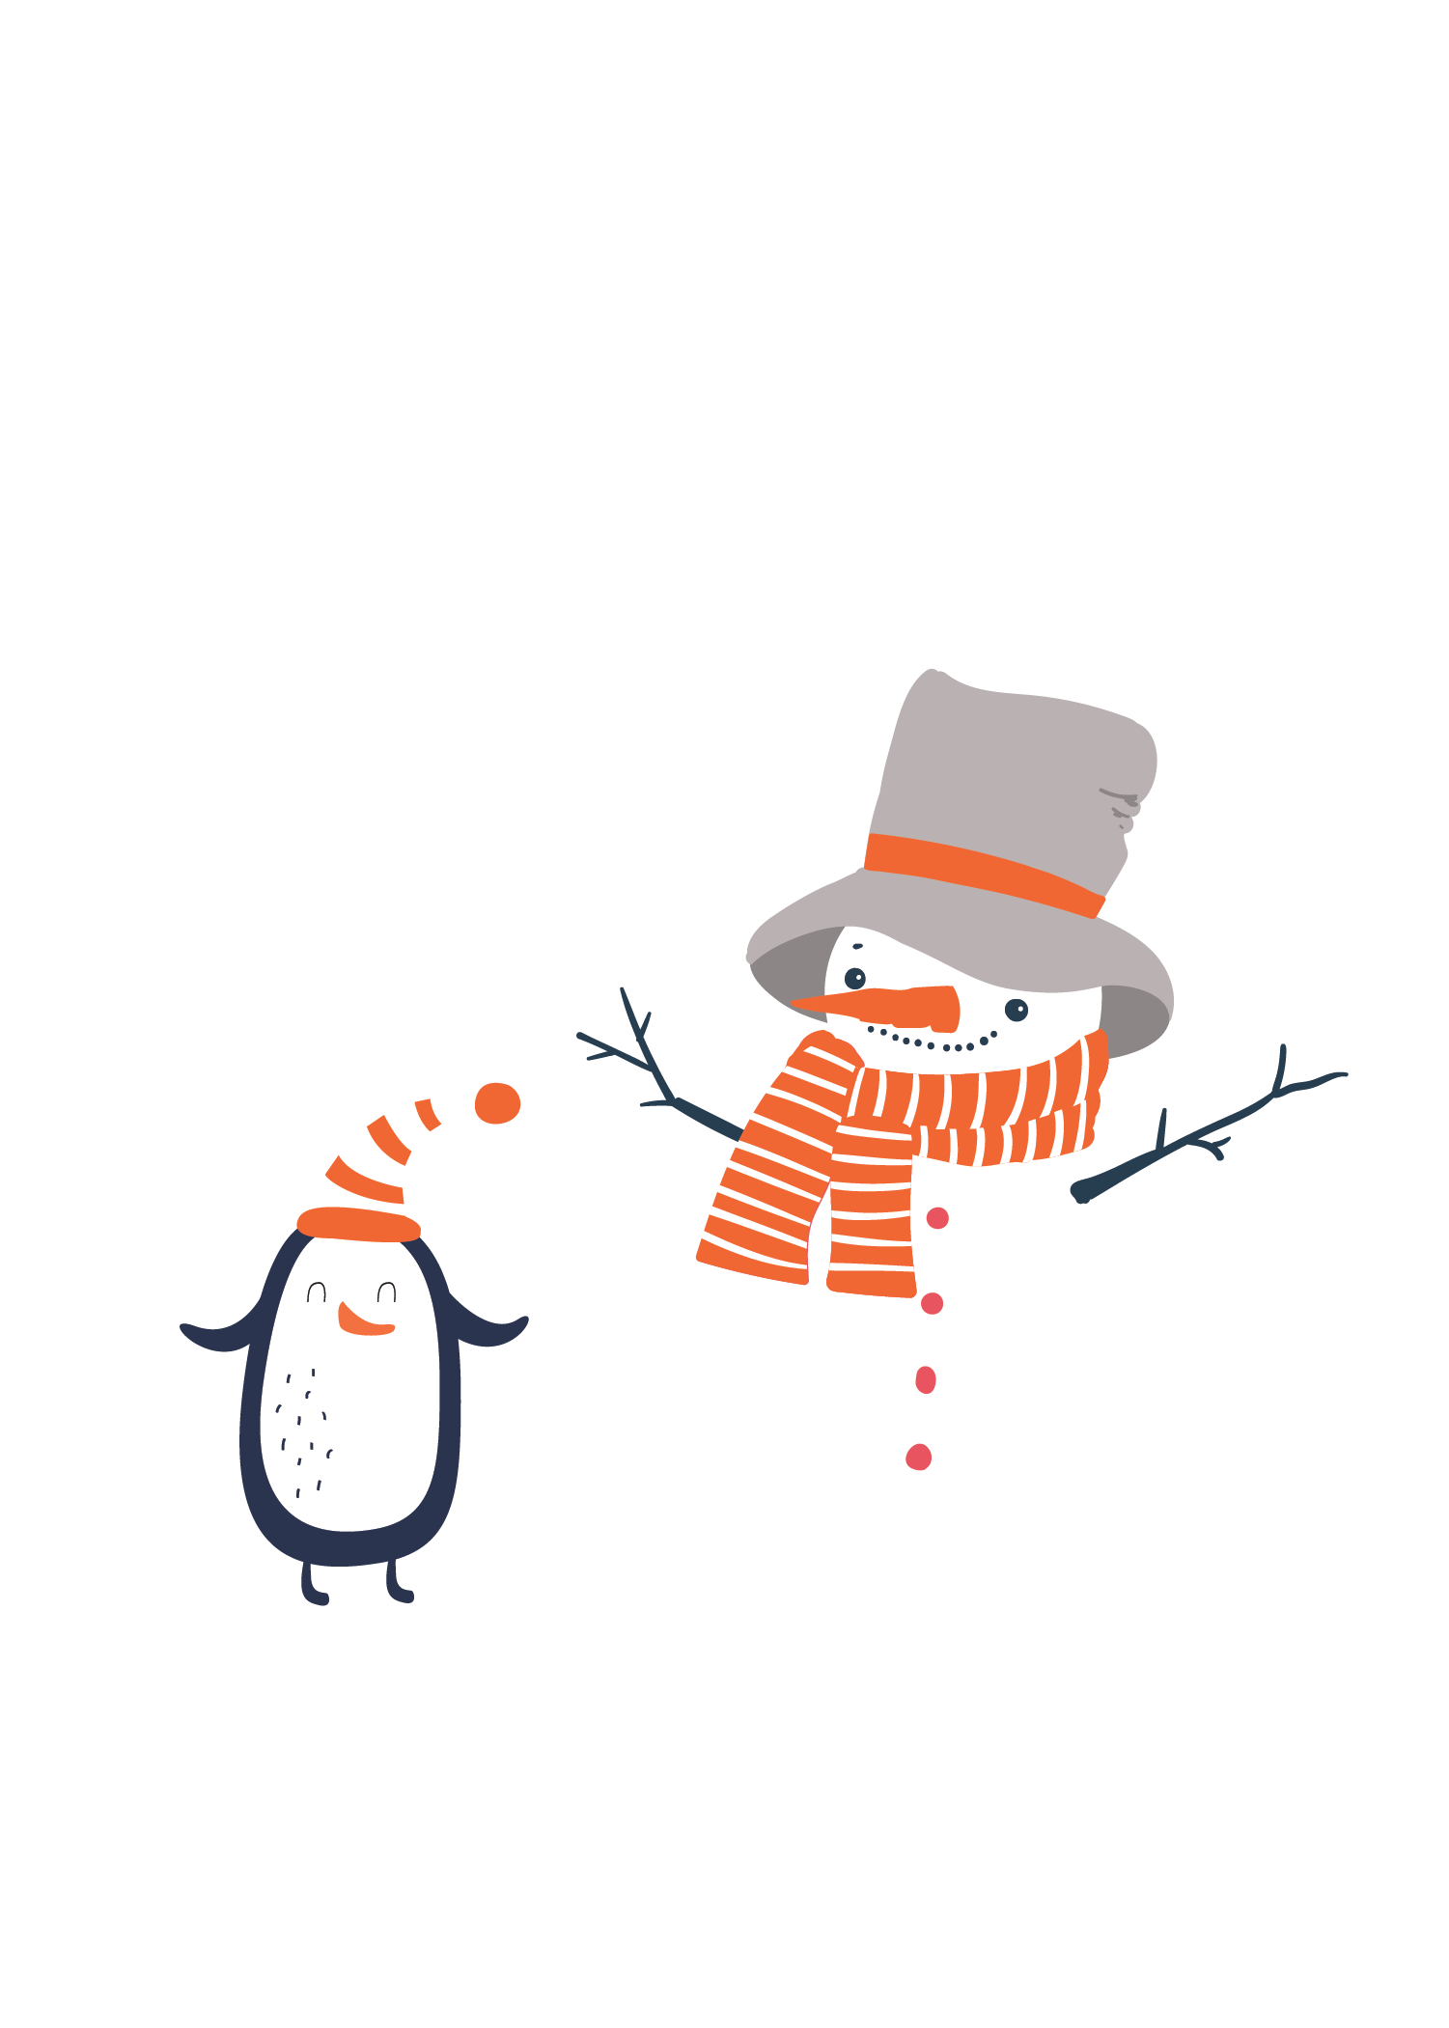
Merry Christmas！
https://www.youtube.com/watch?v=3X4WxytBXis&list=RD3X4WxytBXis&start_radio=1

